Slide 1
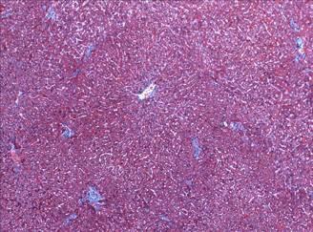
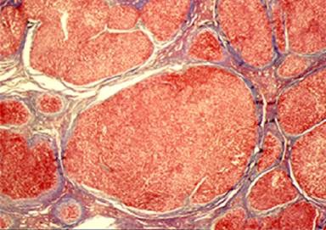
Community Clinics –What is the your role?
Stop The Progression Of Fibrosis
11/17/2021
Ray Thomason,M.D.
Notes:
I'm EXCITED TOPIC-How to...It COMES FROM the PERSPECTIVE U ONLY GET FROM EXPERIENCE AND BEING OLD
It comes from the QUESTIONS from the providers in community. I listen to the questions and volle
I invisioned my next project a new educational outreach lecture series. NEXT

Slide 2
Objectives:
Understand your Opportunity to stop the progression of Liver Disease
Identify silent early liver disease and the amount of fibrosis
History
Physical Findings
Labs
Indirect Measures of Fibrosis
Impact the natural timeline of the development of Cirrhosis:
Understand the median Survival of Compensated vs
De-Compensated
Prevent the complications of Cirrhosis:
Liver Cancer
Organ Failure requiring requiring Liver Transplant

Slide 3
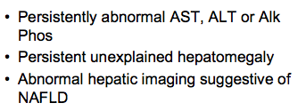
What Do We Evaluate

Slide 4
Important Historical Points
Alcohol: Age, Vol, DUI, PI, Social
IVDA: 90% 1-yr Cum Prob of C
Transfusion prior to 1992
Nasal Cocaine
Tattoos, Ear-Piercing, Acupuncture
Country of Origin
Lifetime Body Weight, IR, DM, BMI

Slide 5
Signs & Symptoms
Silent
  May be Detected at Autopsy or in OR
Fatigue
Weight Loss
Stigmata
Complication

Slide 6
Physical Findings in Cirrhosis
Ascites
Firm Liver (Cannot feel Nodules)
Splenomegaly
Jaundice
Parotid Enlargement=Alcohol

Slide 7
Stigmata of Cirrhosis
Vascular Spiders
Palmar Erythema
Abdominal Wall Collaterals
Clubbing
Testicular Atrophy

Slide 8
Types Of Liver Injury Tests
Aminotransferases Enzymes –(Transaminases)
Alanine and Aspartate Aminotransferases-
ALT and AST
Located in the hepatocyte thus markers for liver injury
Canalicular Enzymes
Alkanine Phosphatase
Gamma-Glutamyl Transpeptidase
AP and GGT
Located in the cells lining the biliary tree

Slide 9
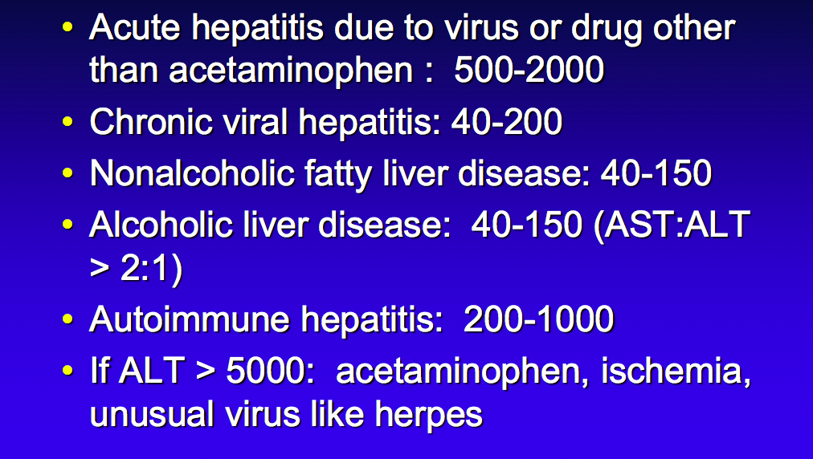
TYPICAL ALT ELEVATIONS

Slide 10
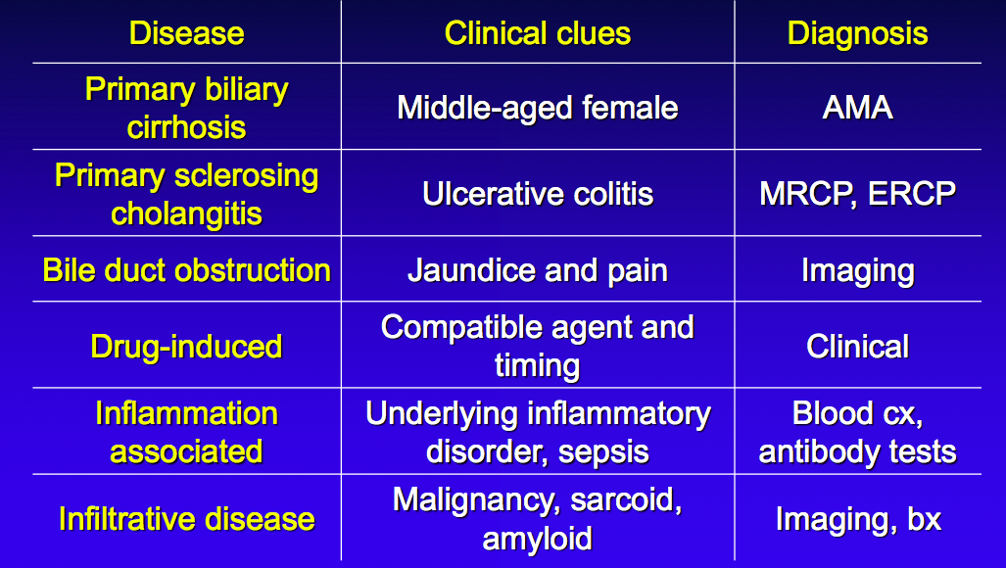
Elevated Alkaline Phosphatase

Slide 11
ASSESS ABNORMAL LIT
Transaminases-AST ALT
Canalicular-Alk Phos GGT
Serologies
Imaging U/S with doppler
Fibro Scan
Liver biopsy
Serologies
Imaging-U/S, CT SCAN, MRI-CP
Liver biopsy

Slide 12
Lab Abnormalities: Cirrhosis
May be normal, especially in Compensated ALD
Anemia (Multifactorial): Mean Hb in Ascites=10
Cytopenia (Plt<160 80% Cirr in Hep C)
Abnormal INR
Elevated Bilirubin
Low Albumin
Low BUN
AST>ALT
Alkaline Phos Variable

Slide 13
MOST IMPORTANT LIVER LAB
Platlet Count
< 150 k-Suspicious
< 100k- Cirrhosis Portqal Hypertension with Large Spleen

Slide 14
Work Up LIT
Hepatitis A: HAV IgM and IgG total
Hepatitis B: HBV S Ag, HBV Core IgM and IgG antibody testing, HBV S Ab
Hepatitis C: HCV Antibody, If + then order HCV pcr Quantitative for viral load , HCV Genotype
Hepatitis E: Hep E Ab, Hep B quantitative
Auto-Immune:
Autoimmune Hepatitis ANA reflex to titer, F-Actin , SMA, serum IgG, Serum IgG4 subclass
Primary Biliary Cholangitis ( PBC) AMA
Metabolic:
Iron Overload
Iron panel (Iron, TIBC, and serum Ferritin)
If Ferritin elevated or Transferrin saturation is > 60%-reflex to genotype->order the HFE
Copper Overload
Ceruloplasm
Inherited-A1Antitrypsin Deficiency-if less than 100 reflex to Genotypes

Slide 15
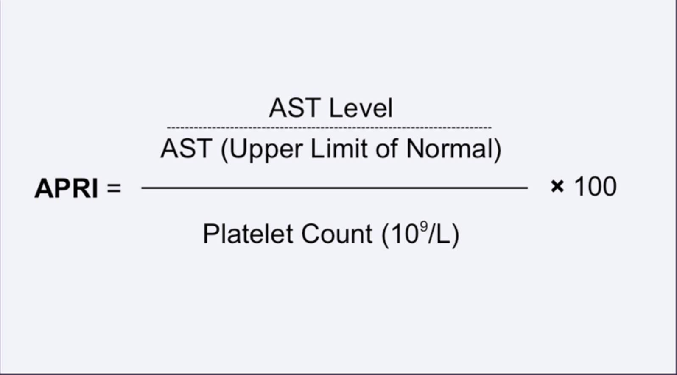
APRI Calculator:
>0.7 High Risk Advanced Fibrosis 77%sens 72%specif.
>1.0 High Risk Cirrhosis

Slide 16
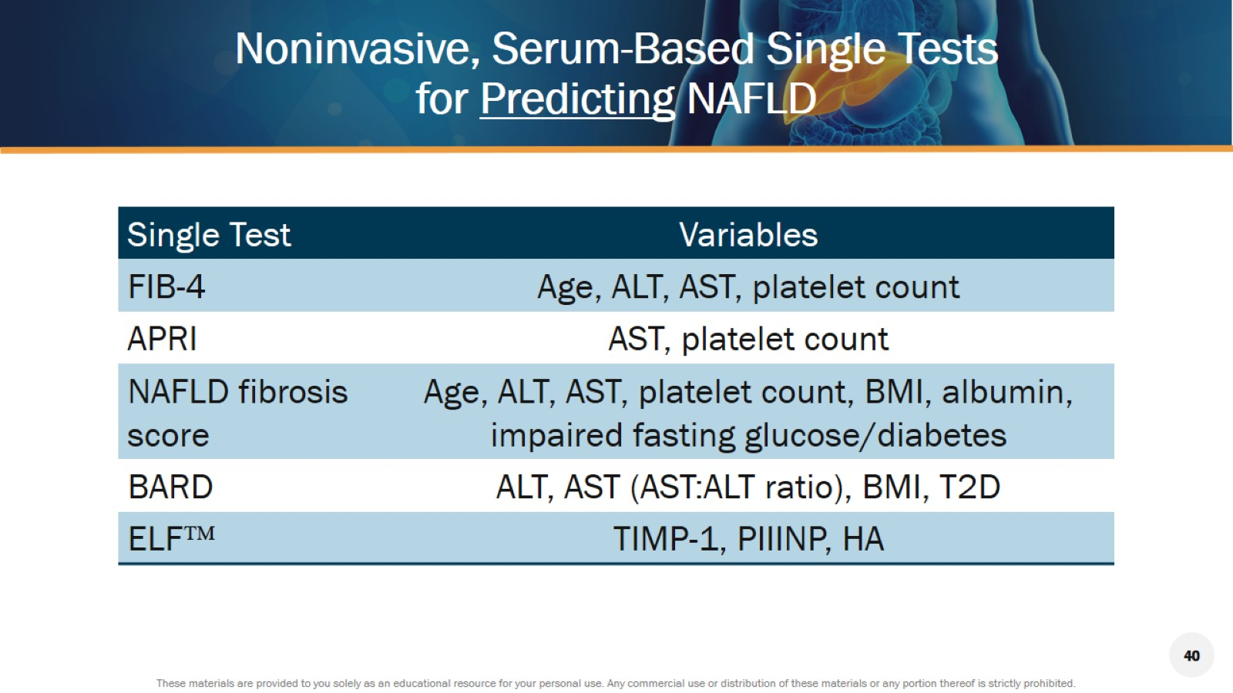
Noninvasive, Serum-Based Single Tests for Predicting NAFLD

Slide 17
Imaging in Liver Disease
Ultrasound
  Inexpensive, No Contrast for Now
  Not as Sensitive as CT for HCC
  Spleen Size: ≥12 cm= PHT
  AFP for HCC Screening
Fibro Scan –Amount of Fat and Stiffness –indirect score of fibrosis
CT: More Expensive, Contrast
MR: Very Expensive, Tumor Clarification

Slide 18
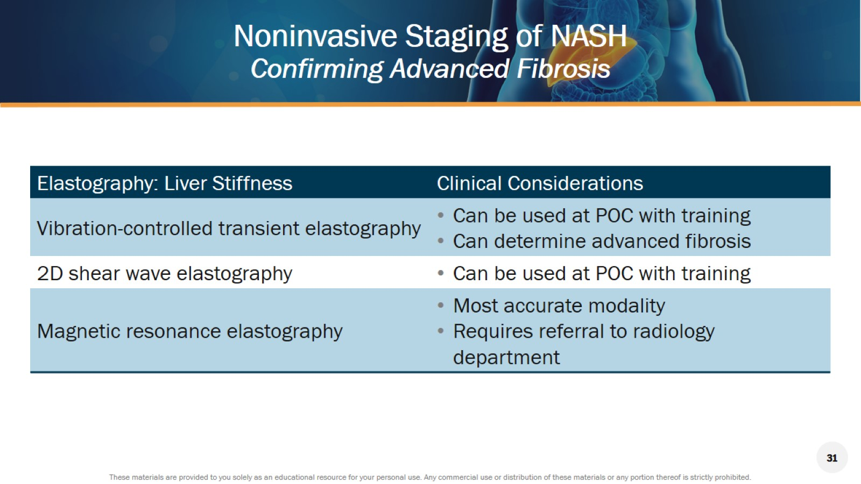
Noninvasive Staging of NASH
Confirming Advanced Fibrosis

Slide 19
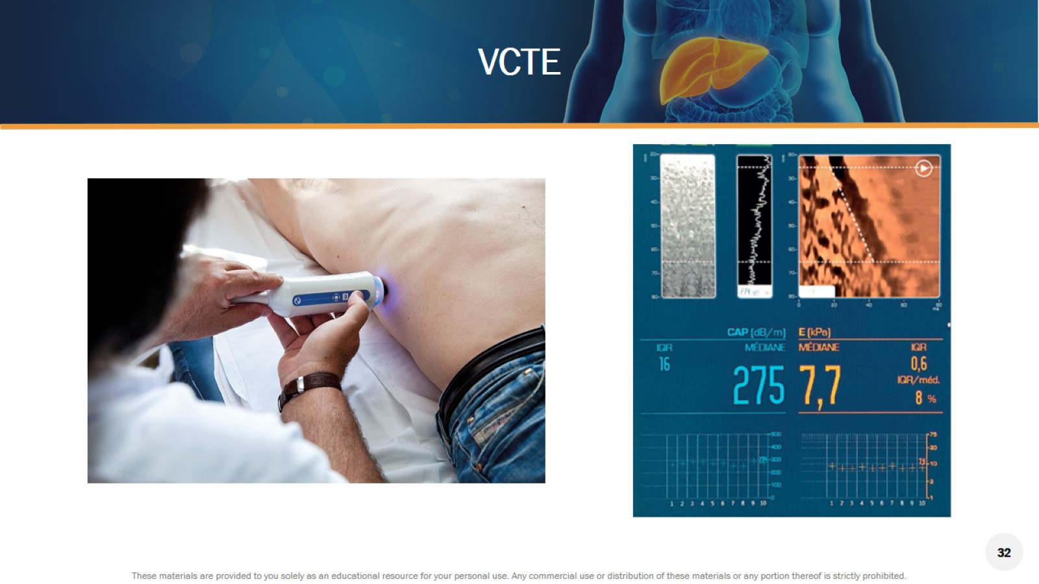
VCTE

Slide 20
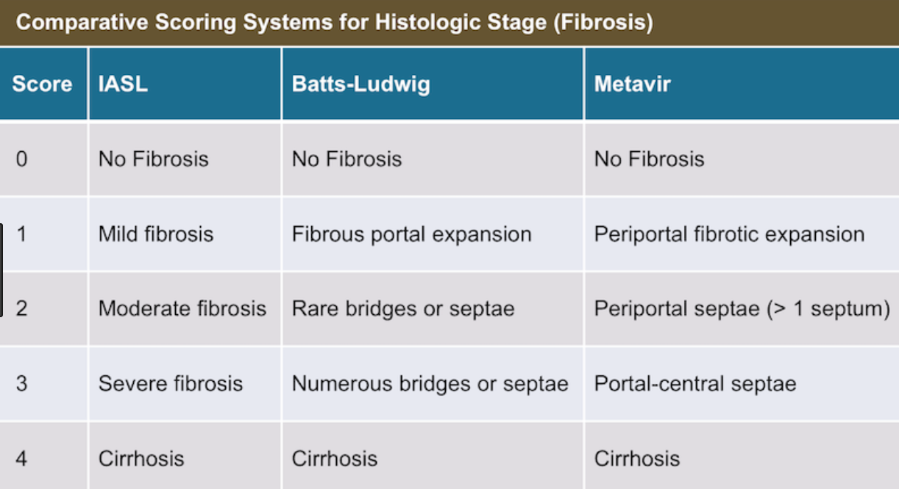
4 Stages of Fibrosis

Slide 21
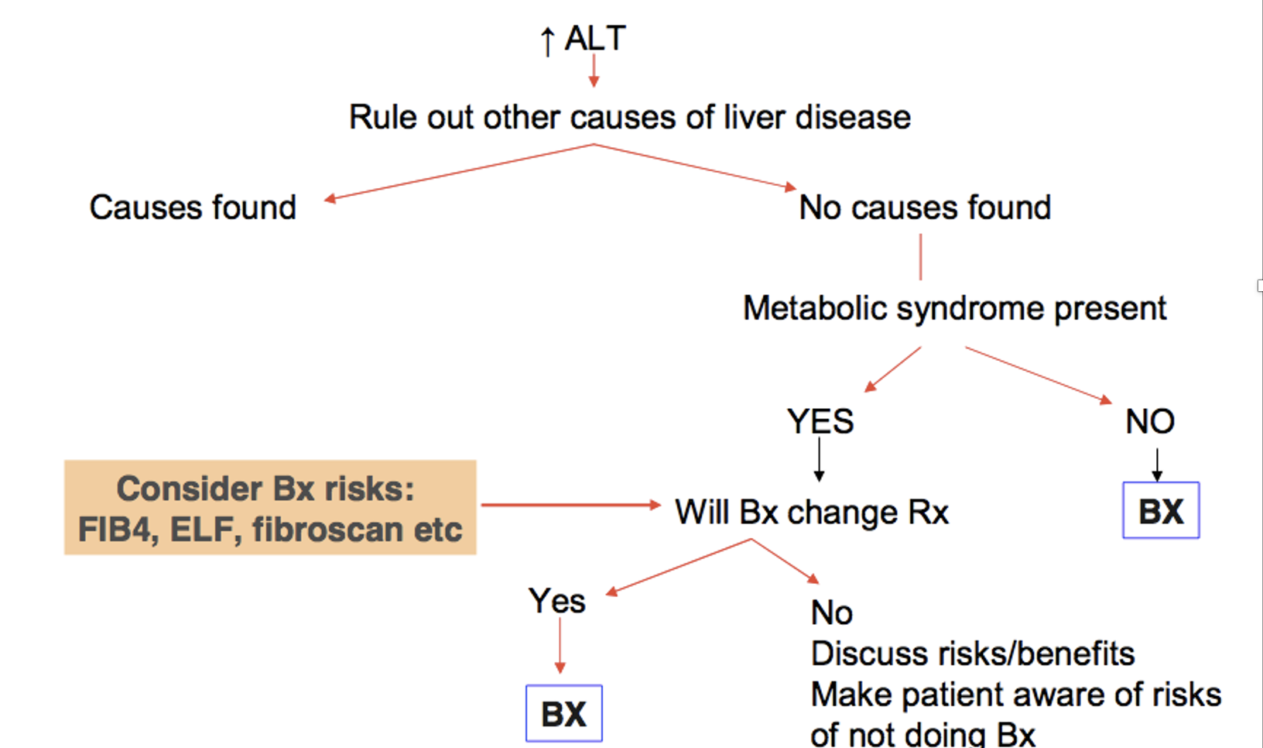
When Do A Liver Biopsy

Slide 22
Liver Biopsy in Unexplained LIT
33% NASH
27%. Steatosis
22% Misc. CAH, Sinusoidal Disease Fibrosis
19% Minimal Changes
De Ledinghen, et al J Hep 2006

Slide 24
Cirrhosis
Cirrhosis is an abnormal hepatic architecture deformity
Portal Hypertension is the measurable manifestation of cirrhosis
Fifth-leading cause of adult deaths
Eighth in economic cost among the major
illnesses
Notes:
Deformed structure of hepatocytes, biliary and vascular system

Slide 25
Natural History–Chronic Liver Disease
Two Main Prognostic Stages
Based on Clinical Complications
Chronic
liver
disease
Compensated
cirrhosis
Decompensated
cirrhosis
Death
Development of complications:
Variceal hemorrhage
Ascites
Encephalopathy
Jaundice
Notes:
The natural hx is defined by the Timeline of developing of complications
2 main prognostic stages defined by the presence or absence of these complications
we go from compensated cirrhosis completely ASX to the development of symptomatic complications
ascites jaundice variceal bleed encephalopathy-define decompensated cirrhosis

Slide 26
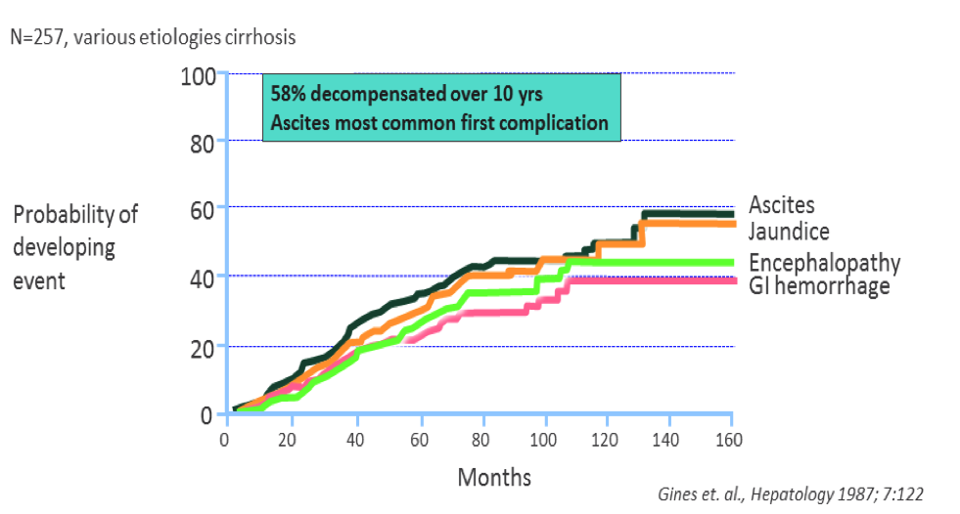
Development of Complications in Decompensated Cirrhosis
Notes:
Ascites is usually the 1st sign of decompensation

Slide 28
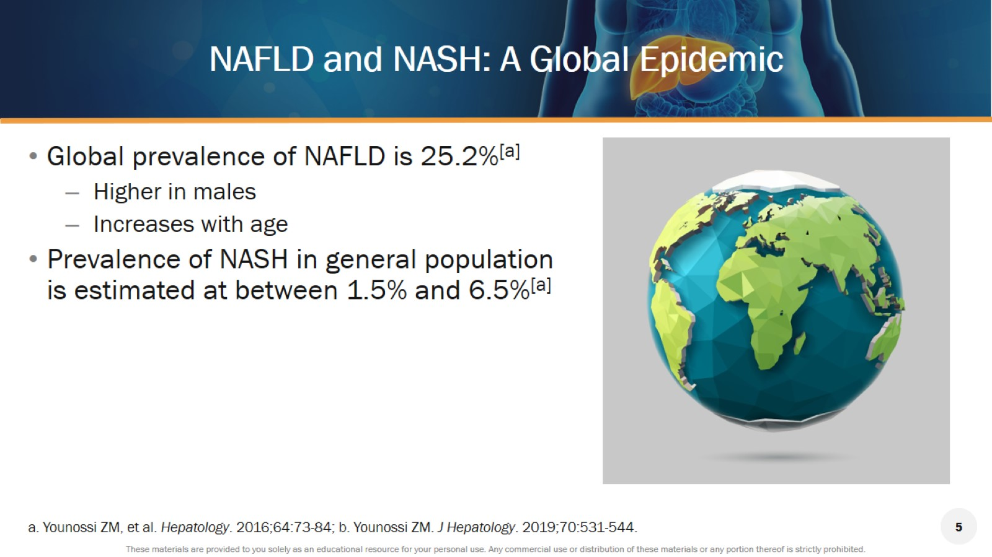
NAFLD and NASH: A Global Epidemic

Slide 29
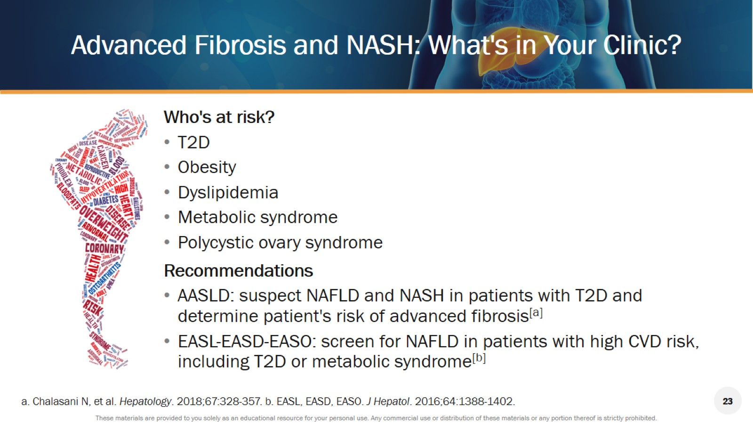
Advanced Fibrosis and NASH: What's in Your Clinic?

Slide 30
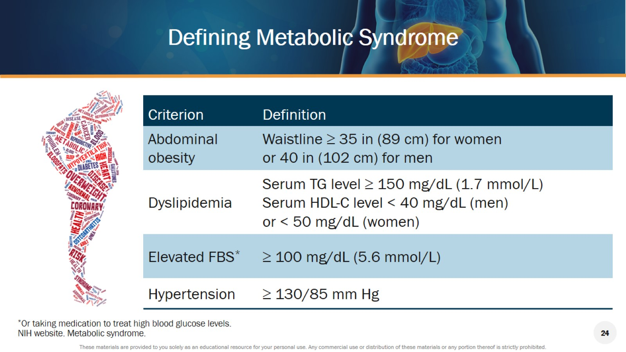
Defining Metabolic Syndrome

Slide 31
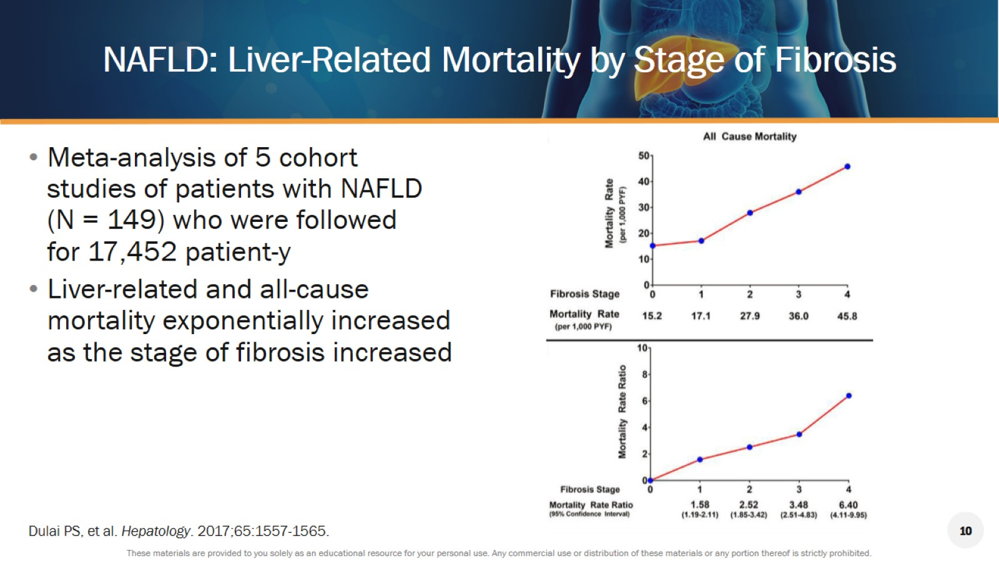
NAFLD: Liver-Related Mortality by Stage of Fibrosis

Slide 32
Your Role in CLD
Identify Silent Liver Disease-Hx Px Labs
Identify amount of Fibrosis
Once Identified – Treat underlying Disease
Liver Clinic/Hepatologist
Identified Cirrhosis
Compensated –Liver Clinic
Decompensated- Transplant Referral
Surveillance Liver Cancer
Imaging + Tumor marker AFP – every 6 months

Slide 33

QUESTIONS
TEXT ME
Ray Thomason,MD
801-556-1228
www.RAYTHOMASONMD.COM
Educational Website
THANK YOU

Slide 35
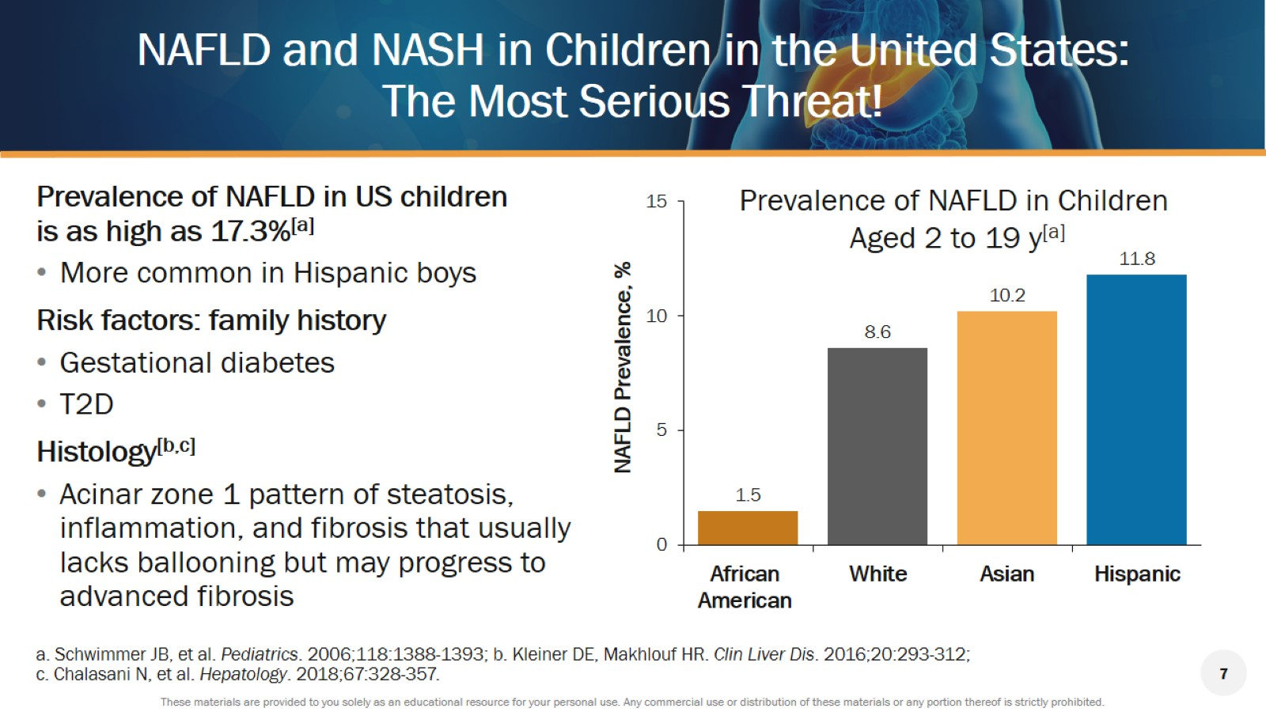
NAFLD and NASH in Children in the United States:
The Most Serious Threat!

Slide 37
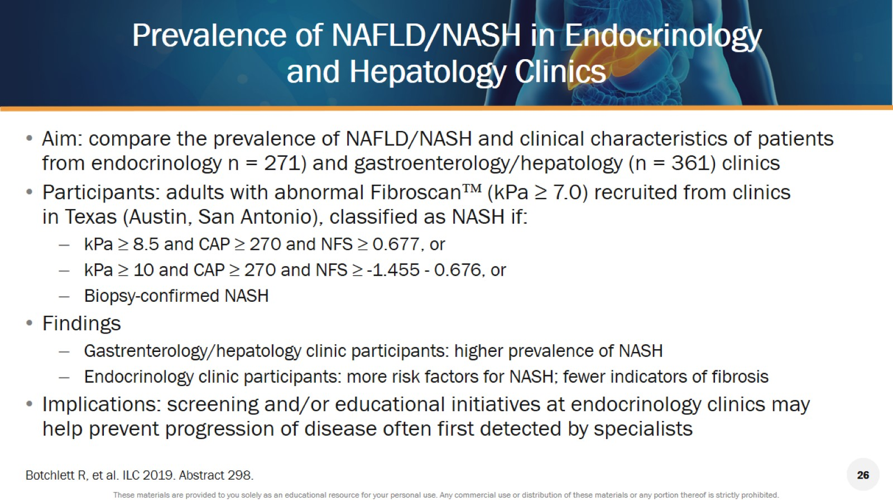
Prevalence of NAFLD/NASH in Endocrinology and Hepatology Clinics

Slide 38
