Slide 1
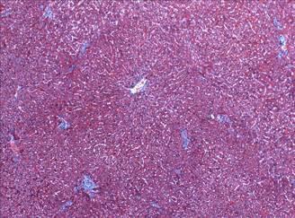
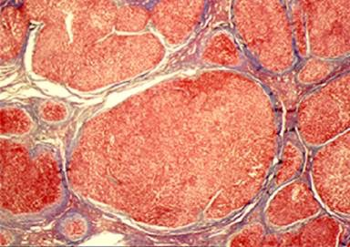
How to Improve the Survival of Your Hospitalized Cirrhotic Patients
Ray Thomason,M.D. No Financial Disclosures
Notes:
Good..-I'm RT-Thank U having me-
CONTEXT-Why I'm Here and Why I Care Livers
Preston Id ist Hospitalist -GRAN PRIX
ED LDS-10 yr-Trauma Know 2 am
1986 Honor/Privil-Utah's first LTx Team at LDS Hosp
2002 Ironically best friend TDB- Father LT 26# vascular
2012- Opportun2 return to the UU and joined a new LTx team Which Leads us into the Origin Talk n
Lessons Learned from the Transfer Call Center

Slide 2
Lessons from the Transfer Call Center
#1- New Partners Caring for ESLD: Not Trained in Transplant
Not Gastroenterologist
Hospitalist-Intensivist-ED
#2- Confusion Regarding Liver Disease Tx and Listing Criteria:
How to initiate Listing Evaluation-what’s needed-
Questions about living donor. alcohol, cancer , age, what MELD
There is a family member willing
Notes:
CALLS NOT TRAINED
lesson #1-new partners-
lesson #2-Confusion-Listing/alcohol /cancer
CALLS NOT TRAINED

Slide 3
3 Examples of Confusion–Initially Denied Listing
39 yr. old Female:
Alcohol Disqualification
55 yr old Male:
15 liter Paracentesis → Renal Failure
Disbelief-Too ill and Too Old
51 yr old Male:
24 pound Vascular Liver Tumor
High Output Cardiac Failure with
Low MELD
Notes:
This CONFUSION was REAL
Mainly too sick –not use to see MELD 40
3 weeks after first time gave talk
called about these first 2 patients wanted guidance
3rd PT-Confusion about hi output failure
Let me say you never think it will happen to you

Slide 4
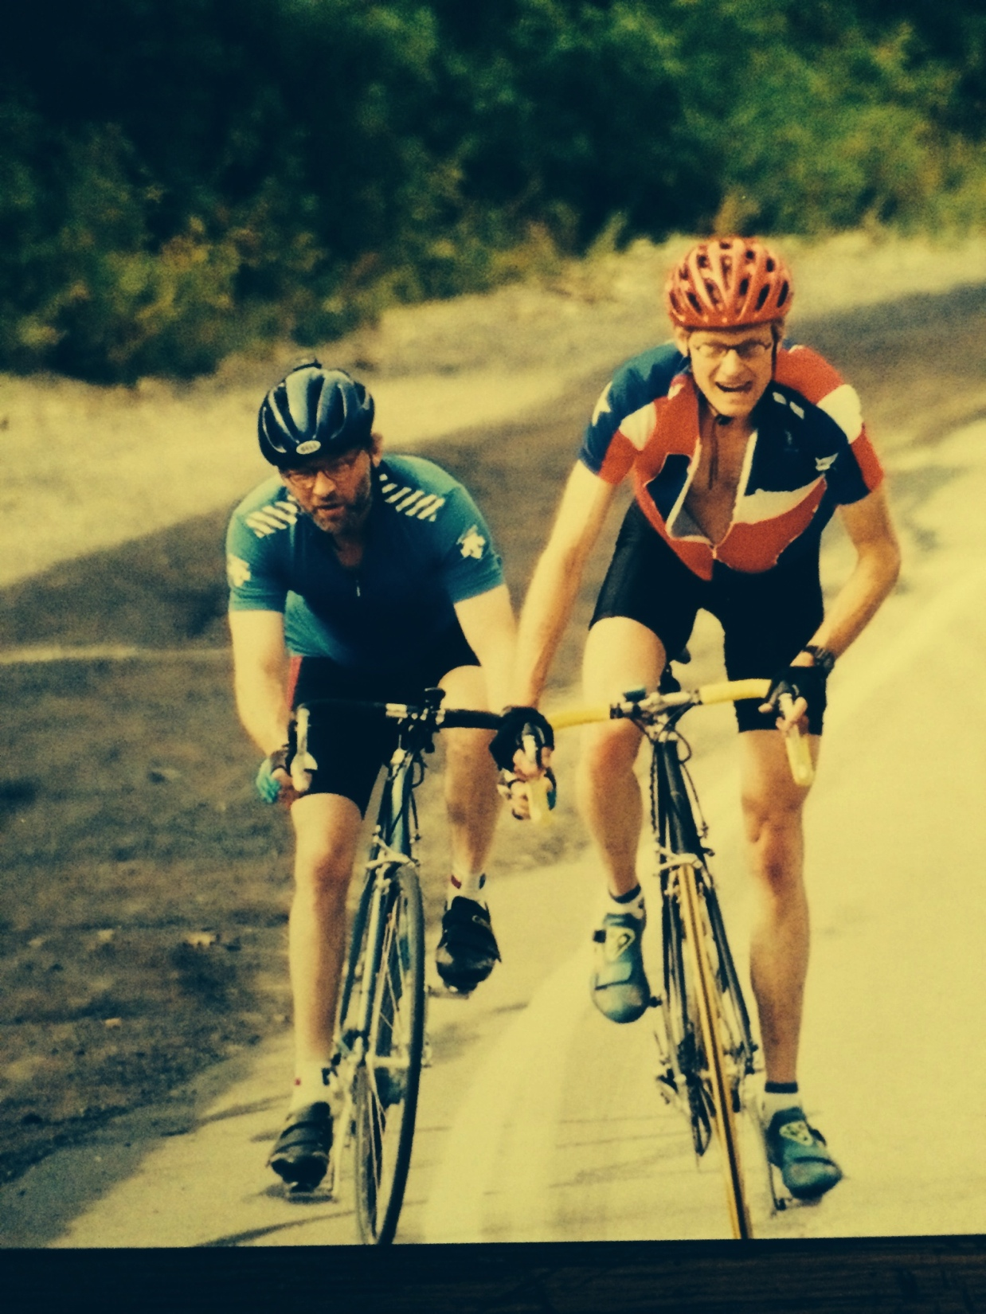
Annual Alta Hill-Climb
August 31 2003
Notes:
So tell you about a 8.2 mile unrelenting bike race- hill climb like theTour 10 months following 14 complicated hour transplant
Here are a Couple of Avid Cyclist: Members of the Team Donate Life The Honey Badgers
In 1999 my best friend my best friend Dr.Terry Box began to die from a vascular liver tumor
In 2002 the tumor had grown to 24 pound and he was in liver failure with high cardiac output failure
on oct 19 2002 he was called for OLT to remove the tumor
I said goodbye not knowing 10 months later we would be racing to the top of Alta
Who had a liver transplant Who won the race?
So I Am hear to end the confusion and talk about a simple items that improve survival

Slide 5
Objectives
Definition of Cirrhosis
Improved Survival-Begins with Basic Fundamentals
Pathophysiology
Timeline Of Compensated v Decompensated Cirrhosis
Approach to Hospitalized Cirrhotic
Understanding Listing Criteria

Slide 6
Cirrhosis: A Definition
Fifth Leading Cause - Adult Deaths
Cirrhosis - Abnormal Architecture - 2nd Deforming Fibrosis
Hepatocyes, Biliary Tree, and Vascular System
Measurable Manifestation ->Portal Hypertension (HVPG)
The most important lab to predict cirrhosis
åå

Slide 7
To Improve Survival:
Understand Basic Fundamentals
The Anatomy and Pathophysiology of Cirrhosis and Portal Hypertension
The Timeline of Compensated vs. Decompensated Cirrhosis
Apply Simple Strategies

Slide 8
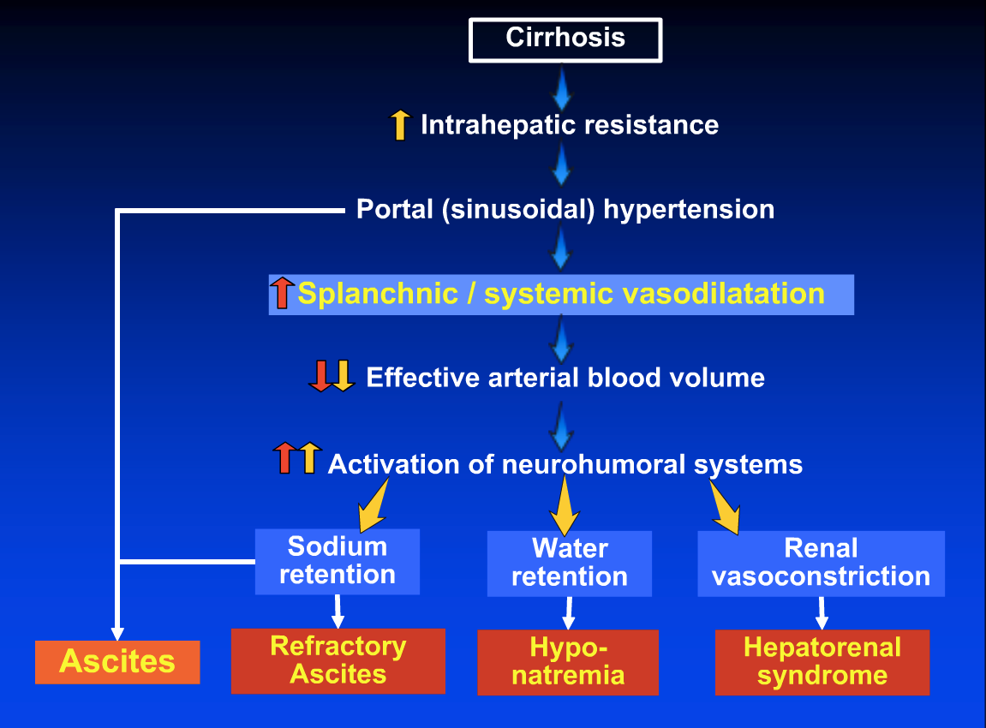
  Courtesy of Guadalupe Garcia-Tsao
Notes:
Cirrhosis is an architectural deformed organ particularily the delicate vascular system
Portal Blood cant easily flow in
Causes a back pressure in the portal system
MONEY
AND IT IS the COMPENSATORY MECHANISM that cause all the sx of decomp

Slide 9
Natural History–Chronic Liver Disease
Two Main Prognostic Stages
Based on Clinical Complications
Chronic
liver
disease
Compensated
cirrhosis
Decompensated
cirrhosis
Death
Development of complications:
Variceal hemorrhage
Ascites
Encephalopathy
Jaundice
Notes:
But what is important is The natural hx is defined by the Timeline of 2 main prognostic stages of Cirrhosis defined by the presence or absence of these complications
we go from compensated cirrhosis completely ASX to the development of symptomatic complications
ascites jaundice variceal bleed encephalopathy-define decompensated cirrhosis

Slide 10
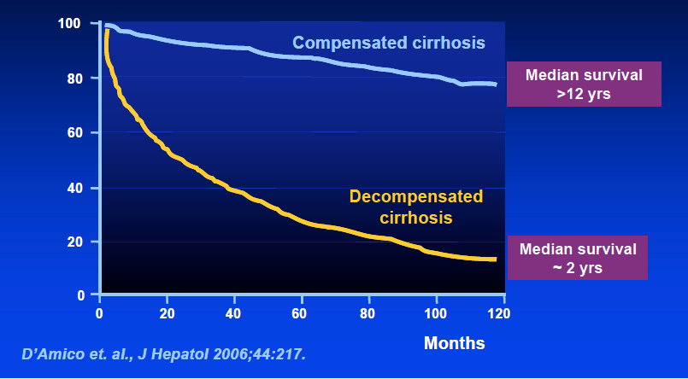
What is Median Survival:
Compensation vs Decompensation ?
Notes:
NOW MONEY SLIDE-
#1WHAT MEDIAN SURVIVAL
If compensated-12 yr
if decomp-HRS 2 weeks or 18 months
#2 If compensated is ASX How predict ???
SIMPLE PLATELET COUNT 150, 000 < 100,000
OK so its 2 am do you think get simple comp cirrh

Slide 11
Now Apply Strategies
1st-R/O Precipitating Causes
Portal Vein Thrombosis
Infection
DILI-herbs supplements
(www.livertox.nih.gov)
Acute Viral Hepatitis: ex.outbreak HepA
2nd-Treat the underlying Disease:
Stop the ongoing inflammation/Injury
3rd-Call any Transplant Hepatologist and Transplant Program
begin the dialogue regarding treatment options and
transplantablity
Notes:
After simple hx px imaging cultures
Turn tothe underlying chronic dz

Slide 12
Treat the Underlying Disease
Increasing liver
fibrosis
Chronic liver
disease
Compensated
cirrhosis
Decompensated
cirrhosis
Death
Alcohol
Hepatits C/B
NASH
Cholestatic
Autoimmune
Treating etiology
Notes:
If treat underlying dz
stop inflammation
cell death
stop stimulation of stellate cells
stop progressive fibrosis

Slide 13
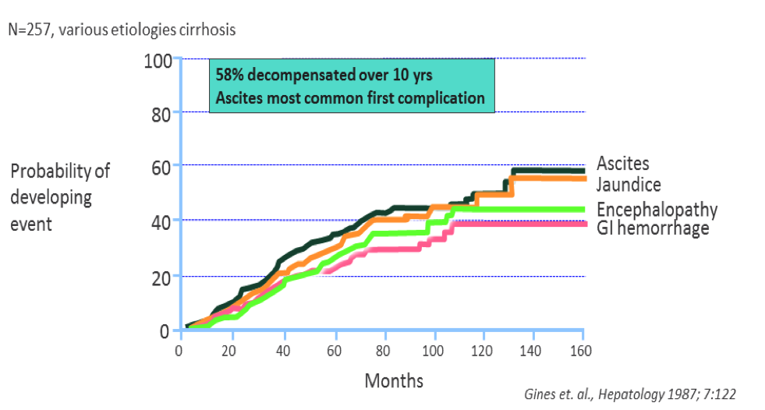
Development of Complications in Decompensated Cirrhosis
Notes:
Ascites is usually the 1st sign of decompensation

Slide 14
Strategies for Ascites
Low Salt Diet-avd Diuretics 40:100
Paracentesis: SAAG for the correct diagnosis
Antibiotics- For SBP
- For Prophylaxis
GI Bleed
Low Protein Ascites
Recurrent infections
Albumin- SBP-prevents renal insåuf-death
-with paracentesis: 8 gm/liter
-with diuretics difficult -50 grams weekly
TIPS- when all else fails

Slide 15
Dif Dx of Ascites use the SAAG Table
 | SAAG >1.1 | SAAG <1.1
Total Protein <2.5 | Cirrhosis-85% Acute Liver Failure | Nephrotic Syndrome Myxedema
Total Protein >2.5 | CHF Constrictive Pericarditis Budd-Chiari Syndrome Venocclusive Disease | Peritoneal Carcinomatosis Tuberculosis peritonitis Pancreatic Ascites Chylous Ascites
Notes:
15% not Hepatic

Slide 16
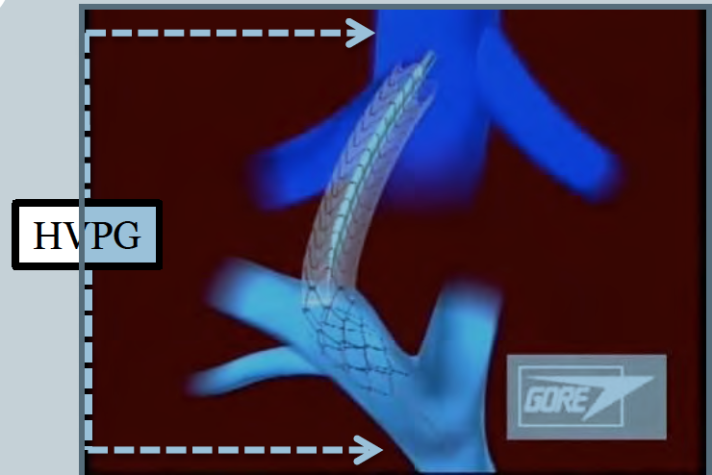
T I P S
HVPG:
HV-PV gradient:
3-5 mm Hg.: normal
>10 mm Hg.:PHTN

Slide 17
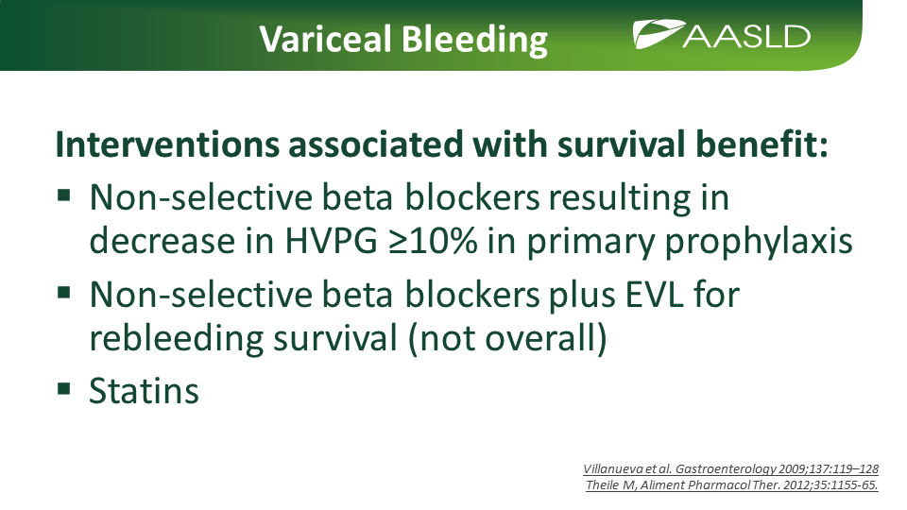

Slide 18
NSBB: The Sweet Spot
Too early: No benefit
Moderate decompensation: Proven benefit
Advanced disease with Increased Mortality
-Hypotension(SAP<100 mmHg)
-C.I. < 1.5
-Refractory Ascites
-SBP
-Pulmonary Hypertension

Slide 19
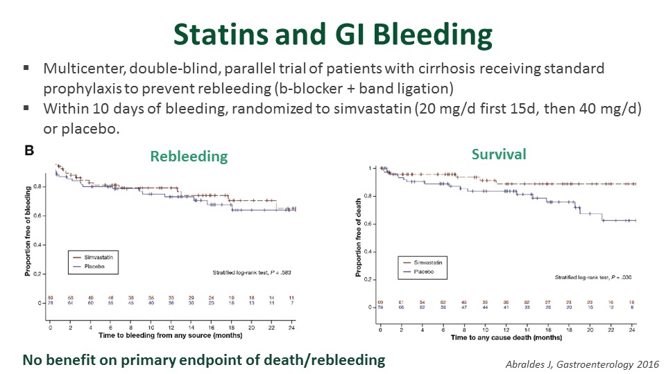
Notes:
ABRALDES 2016
NOEFFECT REBLEED BUT IMPROVE SURVIVAL
BBlock+Banding day 10 simvastatins

Slide 20
Statins: Highlights
Statins:
-decrease hepatic fibrogenesis,
-improve intrahepatic endothelial remodel
-improve liver perfusion and function
Statin users in HCV Cirrhosis:
-Had lower incidence of decompensation
(i.e. ascites and VH)
Statins-Lower mortality

Slide 21
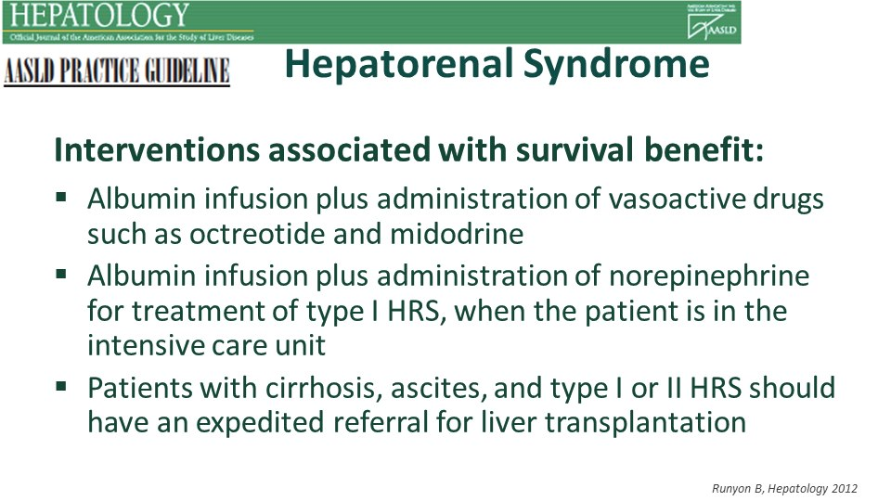
Notes:
Albumin + Vasoactive-octreotide and midodrine
Alb + norepi Type 1 –ICU
Referral Tx

Slide 22
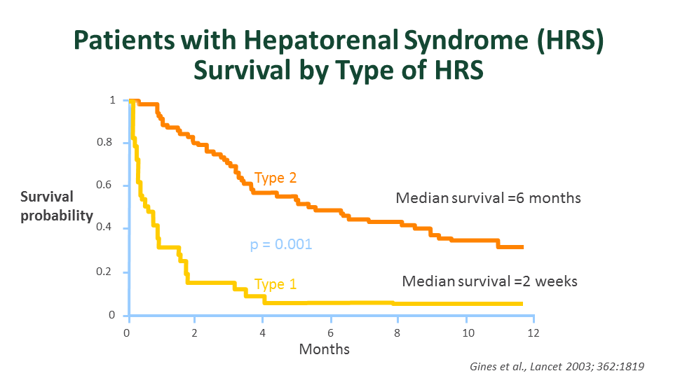
Notes:
Turn to Renal failure-
Type 1: 2 week median survival
Type 2: fact of life/liver failure

Slide 23
Strategies for Encephalopathy
Lactulose: 3 BM
Rifaximin: Begin in Hospital-$$ saving
HOB 30%
Don’t Allow to Feed Self: Aspiration
Avoid Narcotics/Sleepers
Treat Infection/Electrolyte Imbalance
Discharge: 40% Re-Admissions
Care-Giver Education

Slide 24

When Order Serum Ammonia?
Focus on the Image, Relax, and Listen
NEVER ORDER SERUM AMMONIA
Unless patient in a coma and your diagnosis is unsure
Notes:
I would like every ones attention and to focus on the next slide

Slide 25
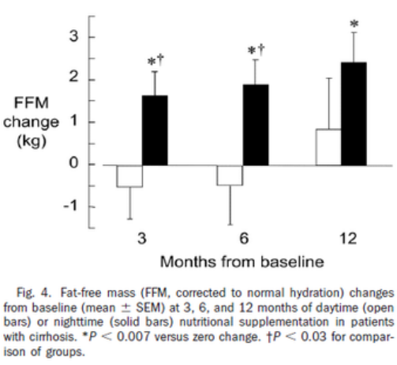
Timing of Protein Supplement

Slide 26

Coffee In Liver Disease
Saab’s recent review : Clear benefit of coffee consumption with a variety of liver chemistries, histology, diseases,
and HCC
Not only has coffee been associated with a decrease in a number of liver diseases, but its consumption may also decrease mortality
Saab S, Mallam D, Cox GA, 2nd, Tong MJ. Impact of coffee on liver diseases: a systematic review. Liver international : 2014;34(4):495-504
Freedman ND, , et al. Association of coffee drinking with total and cause-specific mortality. N Engl J Med 2012; 366: 1891-904
Notes:
Coffee consumption is global and is one of the most popular consumed beverages
Higdon JV, Frei B. Coffee and health: a review of recent human research.
CRIT Rev Food Sci Nutr 2006: 46: 101-23.
Over 50% of Americans consume coffee daily
National Coffee Association USA. http://www.ncausa.org. Accessed Feb 2, 2013

Slide 27
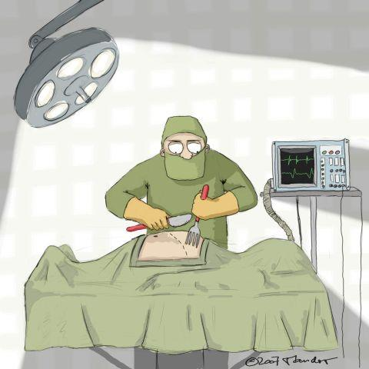
Surgical Risk in Cirrhosis
About 10% of patients with cirrhosis require surgery within the last 2 years of life
    Propst et al. Dig Dis Sci 1995;40:1805–15

Slide 28
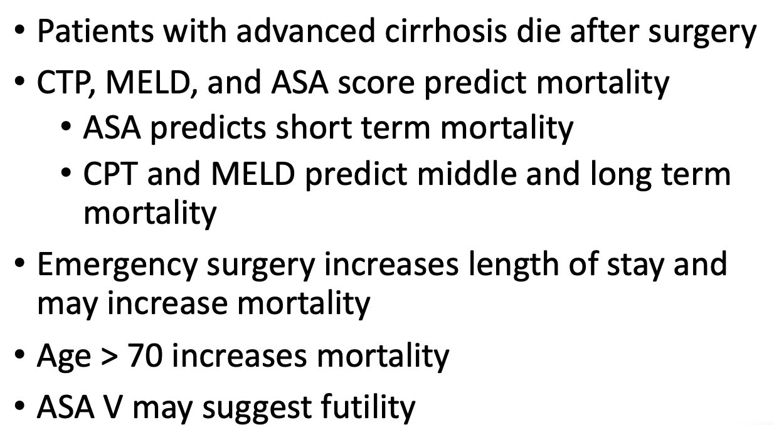
Avoiding Pitfalls: Beware of Surgery

Slide 29
Strategies to Improve Survival
Determine cause of Decompensation
PVT, Infection, DILI, Acute Viral Hepatitis
Treat Underlying Causes
Ascites: Marker of Progression
Refractory Ascites: TIPS
SBP Prophylaxis

Slide 30
Strategies to Improve Survival
Variceal Bleed: BB banding TIPS Antibiotics
HRS: Prevent Renal Injury: Avoid NSAID and IV Contrast
Maintain BP>90
Beta Blockers: Double Edge

Slide 31
Strategies to Improve Survival
Statins should not be avoided
Frailty/Sarcopenia
Never Order a Serum Ammonia
Educate Caregivers on treating Encephalopathy

Slide 32
Strategies to Improve Survival
Once Decompensate call a Transplant Hepatologist
We can help you understand your patients options
Refer Early for Higher Level of Care and Transplant Consideration
You are not Alone

Slide 33
Listing Criteria
Funding
Caregivers 24/7
No Diseases: That impair surgery/recovery
i.e. Cancer, Pulmonary or Cardiac Disease
No lifestyles issues: jeopardize the gift of life
Complete compliance with your medical team

Slide 34
What We Need from You
MELDNa
ABO Blood Group
Funding Documentation
Discharge Summaries from the Hospital
ETG
Drug Screen

Slide 35
How We Will Communicate with You
Hard Copy Letter-Decision of Listing Committee
E Mail

Slide 36
Resources:
www.AASLD/PracticeGuidelines.com
www.Livertox.NIH.gov
University Hospital: Call 801-581-2121
Ask for :
Transfer Call Center
Transplant Hepatologist

Slide 37
QUESTIONS
TEXT ME
Ray Thomason,MD
801-556-1228
THANK YOU

