Slide 1
Autoimmune Hepatitis advanced liver care
^{RAY THOMASON MD}

Slide 2
WHAT’s NEW
1. HEPATITIS E
2. END POINTS OF TREATMENT and WHY
3. BUDESONIDE-why- when- when not
4. NEW AGENTS

Slide 3
AUTOIMMUNE HEPATITIS
YOU MUST EXCLUDE
OTHER
VIRUSES

Slide 4
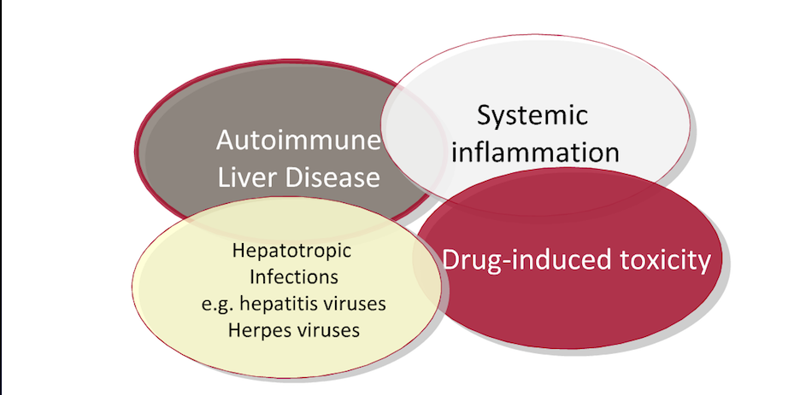
Differential Diagnosis of Hepatitis

Slide 5
Disease spectrum
Classic Hepatitis +_ Cirrhosis
“Burned out” Cirrhosis
Acute Hepatitis
Fulminant Hepatitis
Overlap Syndrome with PSC or PSC

Slide 6
Genetic Predisposition

Slide 7
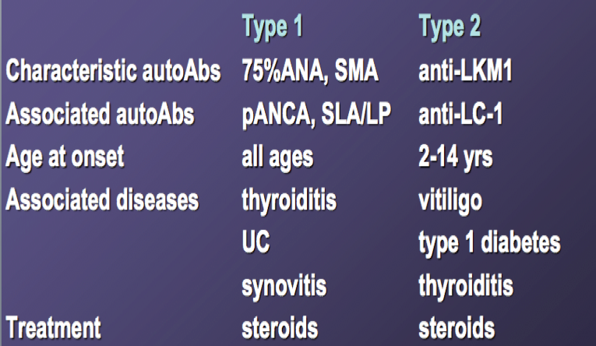
Subtypes of AIH

Slide 9
Demographics

Slide 10
PRESENTATION-AIH

Slide 11
DIAGNOSIS

Slide 13
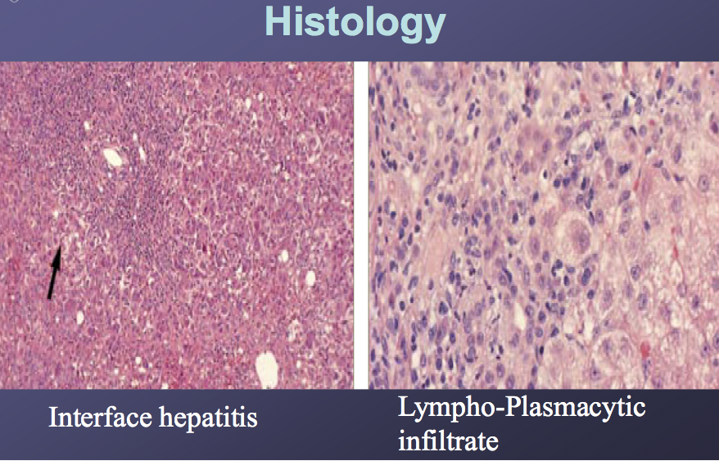
AIH-HISTOLOGY

Slide 14
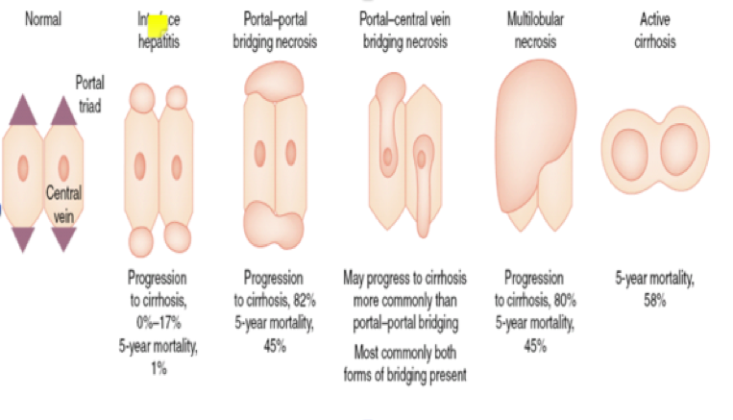
Natural History

Slide 17
AASLD - WHEN TO TREAT

Slide 18
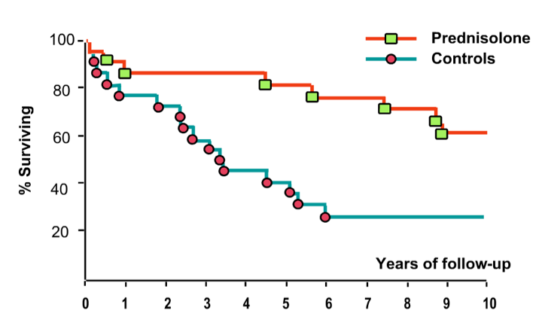
Steroid Therapy of Autoimmune Hepatitis Improves Survival

Slide 19
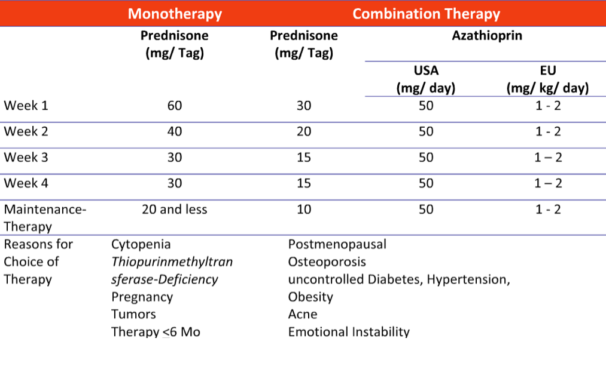
Treatment Regimens

Slide 20
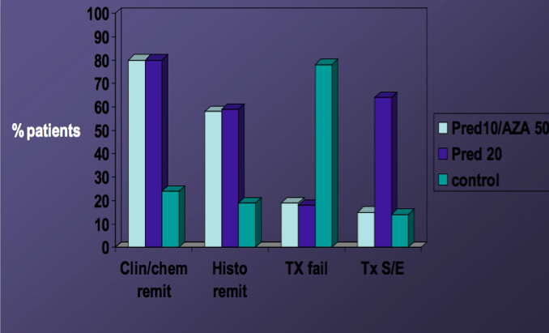
Treatment Responses
Summerskill, Gut 1975

Slide 21
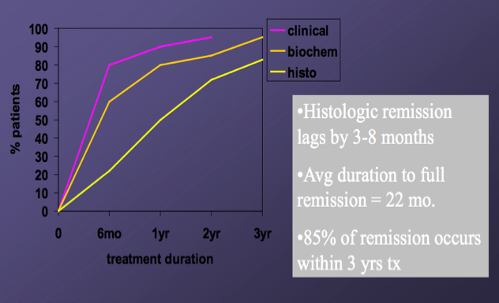
Remission What to Expect
Cjzaja.ClinLivDis.2002

Slide 22
WHAT’s NEW
1. HEPATITIS E
2. GUIDELINE CHANGES: End Points of Treatment an Why
3. BUDESONIDE-why- when- When Not
4. NEW AGENTS

Slide 24
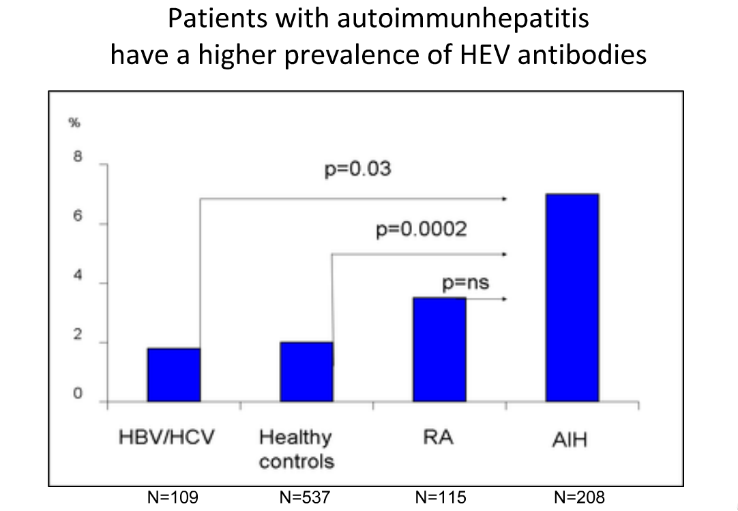

Slide 27
REASON FOR GUIDELINE CHANGES

Slide 30
Budesonide versus Prednisone RCT
Manns.Gastro 2010

Slide 34
ALTERNATIVE DRUGS WHEN STEROIDS FAIL-(refractory/intolerance)

Slide 37
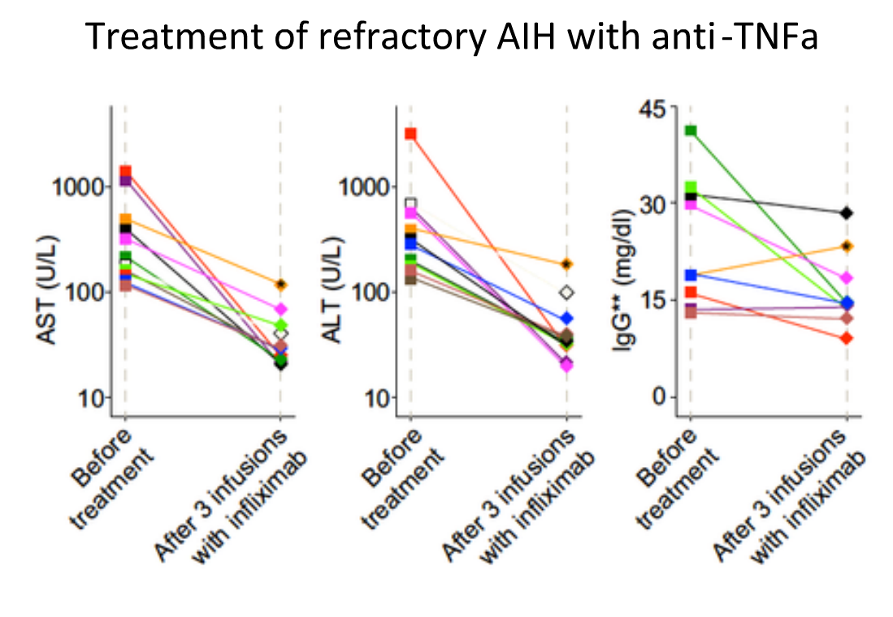

Slide 38
Autoimmune Hepatitis Transplantation
6% in US - 3% in Europe
Five year survival 83– 92%
Higher incidence of rejection
Disease recurrence 17 to 25%
De novo 3%

Slide 39
THANK YOU

