Slide 1

Notes:
Good Morning
I'd like to thank the organizers for the opportunity to speak to you today on this very impt topic
the approach to iron overload

Slide 2

An Approach to Iron Overload
Ray Thomason, MD
Assistant Professor of Medicine
Division of Gastroenterology and Hepatology
University of Utah School of Medicine
ray.thomason@hsc.utah.edu
March 11, 2017
Notes:
following absolutely perfect run down the pristine powder on the back side of Alta -I turned to gaze up and watch the beautiful form of DrSus-only to see the horror of
DrSus trying to out run an actual avalanche
In a rare moment I was able to capture this moment on film
as I watched my mind immed drift to livclin and thoughts of the avalanche of abnormal iron panels and gene testing crashing down on us all generated by the metabolicSyn,conceieg practprecision genomic seq 23 n me
what a manificient metaphore this avalanche of abn iron panels

Slide 3
Disclosures:
Clinical Trials:
Conatus
Mallinckrodt
Gilead
Genfit
Speaker bureau: Salix
Advisory Board: Alexicon
No Disclosures for this lecture

Slide 4
Learning Objectives
Review Normal Iron Metabolism to master of the genetics of HH
Explore Hemochromatosis as a prototypic model with an opportunity to change clinical outcomes through screening
Develop a Work-up of Iron Overload
Understand the types of iron overload- genetic and non-genetic
Call attention to areas of danger

Slide 5
Abnormal Genetics Consultation
50 year old female
referred from Concierge/Precision M.D.
requesting confirmation of the “Genetic”diagnosis of HH with iron overload
HFE+ H63D heterozygote
Ferritin:175 Iron/TIBC: / TS
US-diffuse steatosis
Notes:
Fe necessary basic cellular function
Excess Fe leads to free-ROS resulting in significant cellular damage
Total body Fe
Men 35-45 mg/kg
Women ~35 mg/kg
Distribution:
Hb 60%
Muscle myoglobin 15%
Enzymes & cytochromes 10%
Circulating plasma bound to transferrin 1%

Slide 6
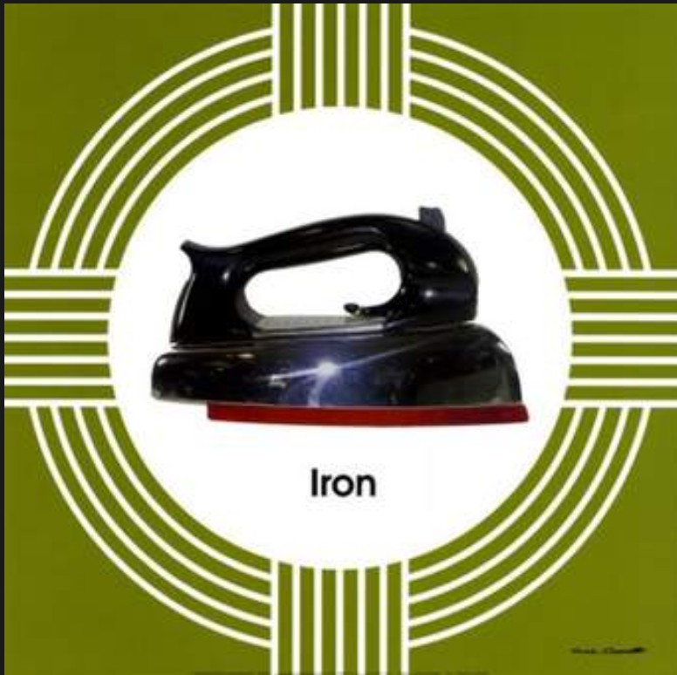
Normal Iron Physiology
Notes:
1-NL -body exquisite tuned to maintain iron stores-thru out time we have existed in Fe Def
so we do not have a mechanism to remove xs iron
-Fe necessary basic to cellular function
Excess Fe leads to free-ROS resulting in significant DNA and cellular damage
2-In order to understand iron overload the genetics and the w/u -
we need to start with nl iron metabolism
Men 35-45 mg/kg
Women ~35 mg/kg
Distribution:
Hb 60%
Muscle myoglobin 15%
Enzymes & cytochromes 10%
Circulating plasma bound to transferrin 1%

Slide 7
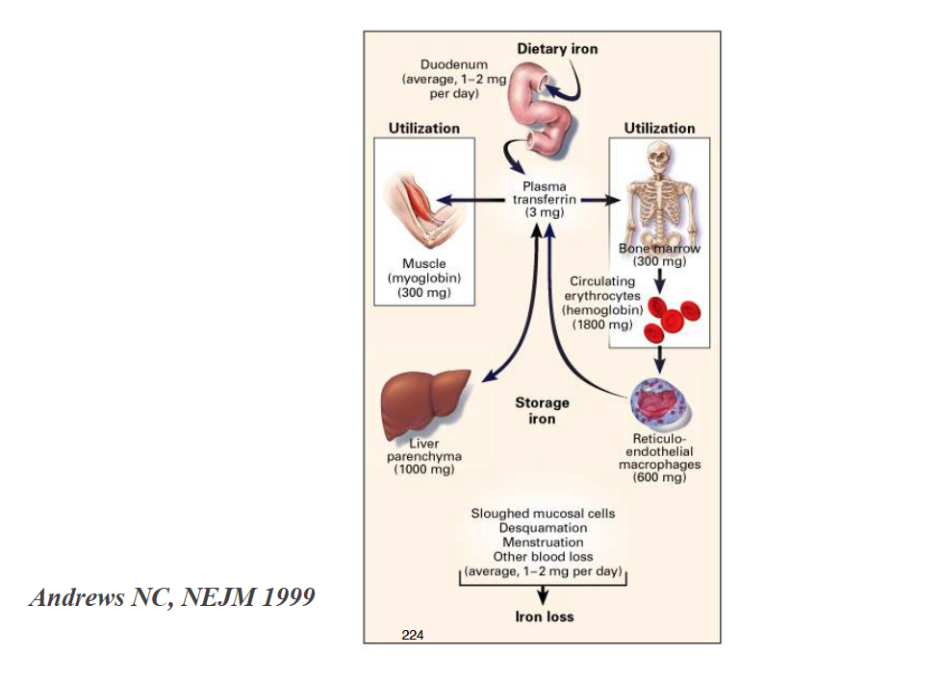
Notes:
normal iron stasis dietary iron is 1-2 mg/day
300mg-enters the muscle n the BM
3mg is in the circ bound to transferrin-THE DISTRIBUTOR
most is used for metabolic processes
Storage is 1 gm or less 2/3 in the RE -macrophages
1-2 mg lost desquamation menstral process

Slide 8
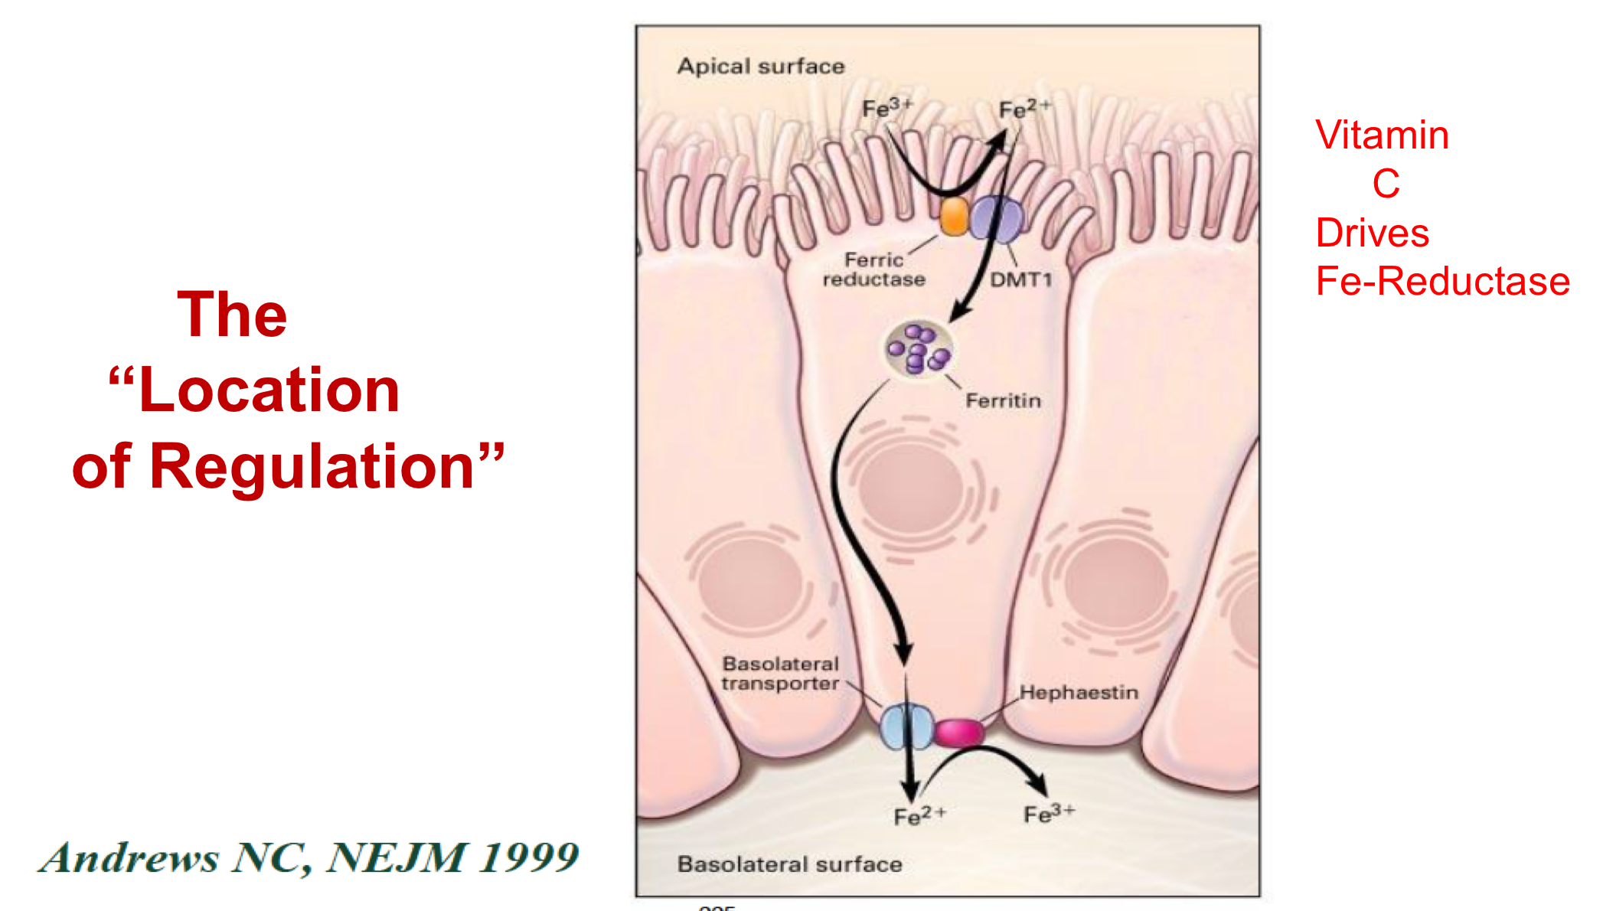
Intestinal Iron Transport

Slide 9
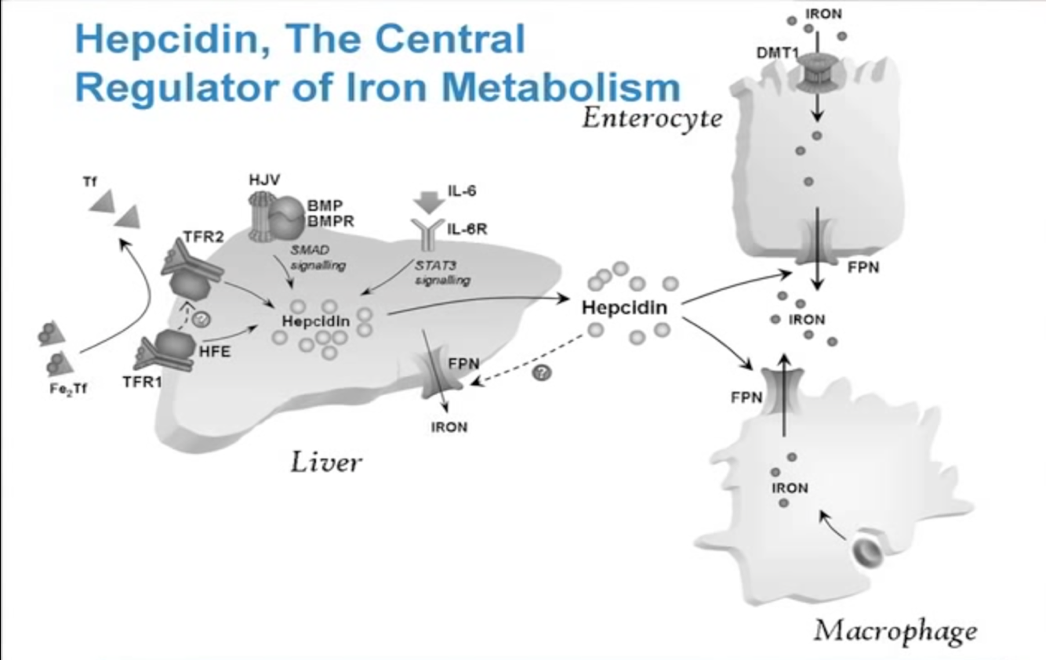

Slide 10
Hepcidin: The Master Regulator
Liver synthesized 25 aa peptide hormone
Downregulated : anemia and hypoxia
Upregulated : Fe overload/inflammation
Hepcidin Acts on Ferroportin to stop iron transport
Low Hepcidin = No Inhibition of Fe absorption= increase total body Fe
(potential Iron Overload State)

Slide 11
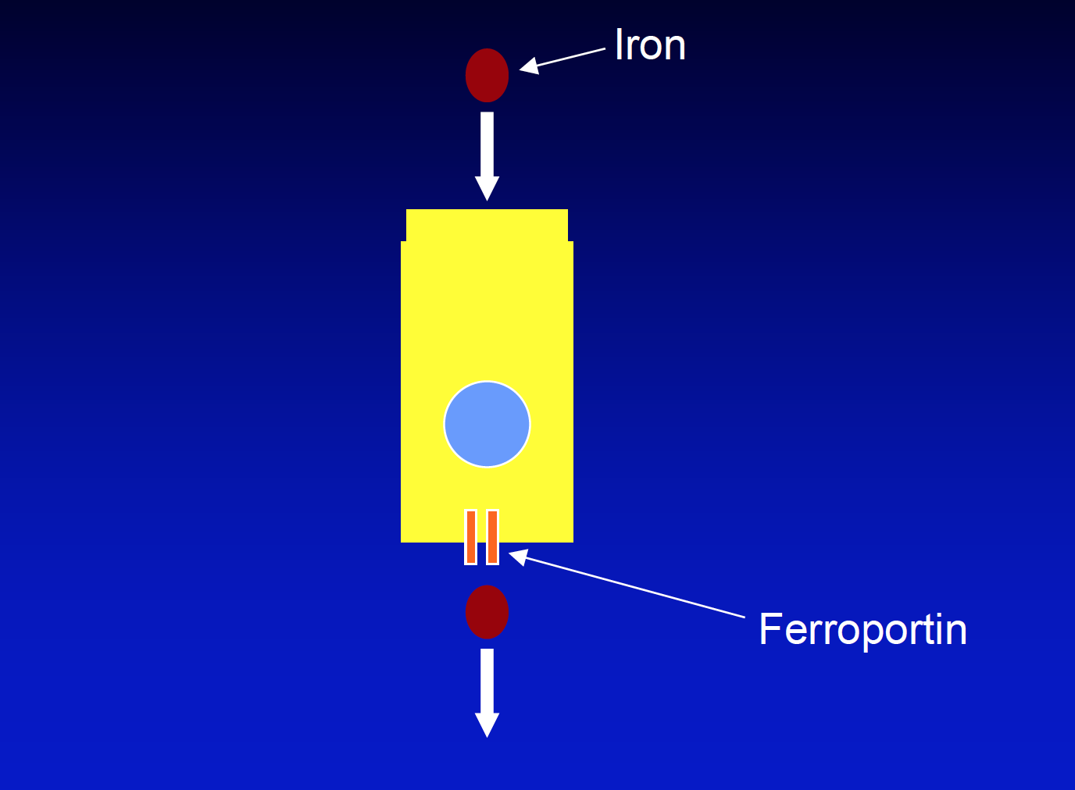
Normal Iron Intestinal Absorption

Slide 12
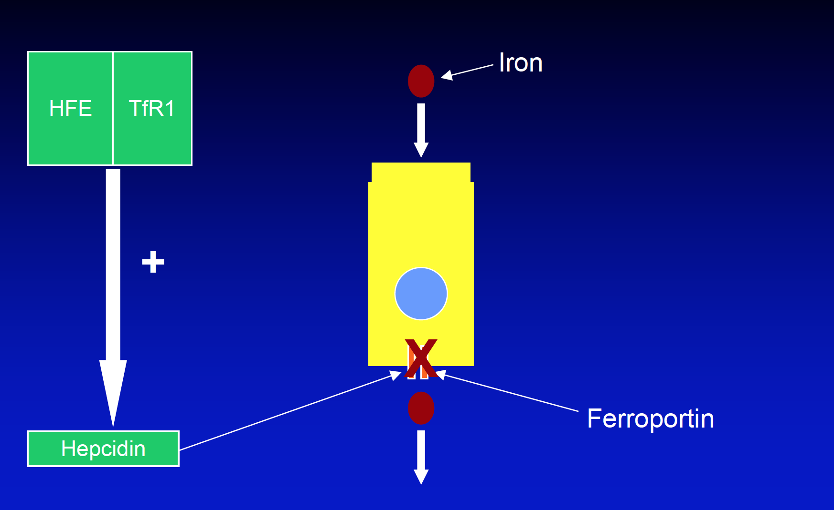
Normal Iron Regulation
Controlled by Hepcidin

Slide 13
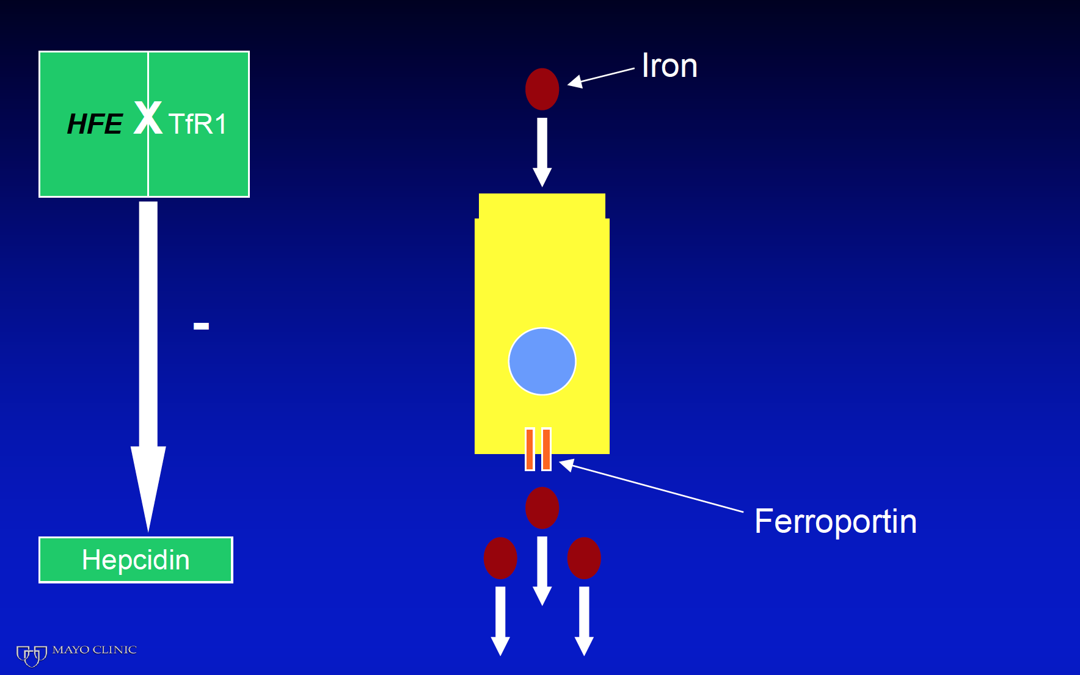

HFE Is Mutated
Reduced Hepcidin Level
Notes:
Iron Overload Exists in a LOW Hepcidin State

Slide 14
THE PROTOTYPIC DISEASE:
Demostrates how screening effects outcomes
HEREDITARY HEMOCHROMATOSIS:

Slide 15
HEREDITARY HEMOCHROMATOSIS
Abnormaly excessive deposition of iron in multiple organs
Increased Iron absorption by enterocytes-
due to a loss of the inhibitory loop
Mutant HFE or other transporter fails to respond to normal iron stores
Hepcidin Not Upregulated: so No Inhibition of iron absorption

Slide 16
Phenotypic Expression
Men>Women
Increases with age-50’s
Less than 10% demonstrate organ damage
Correlates with Iron in Diet plus Modifiers
Bacon,BR and Britton,RS 2002

Slide 17
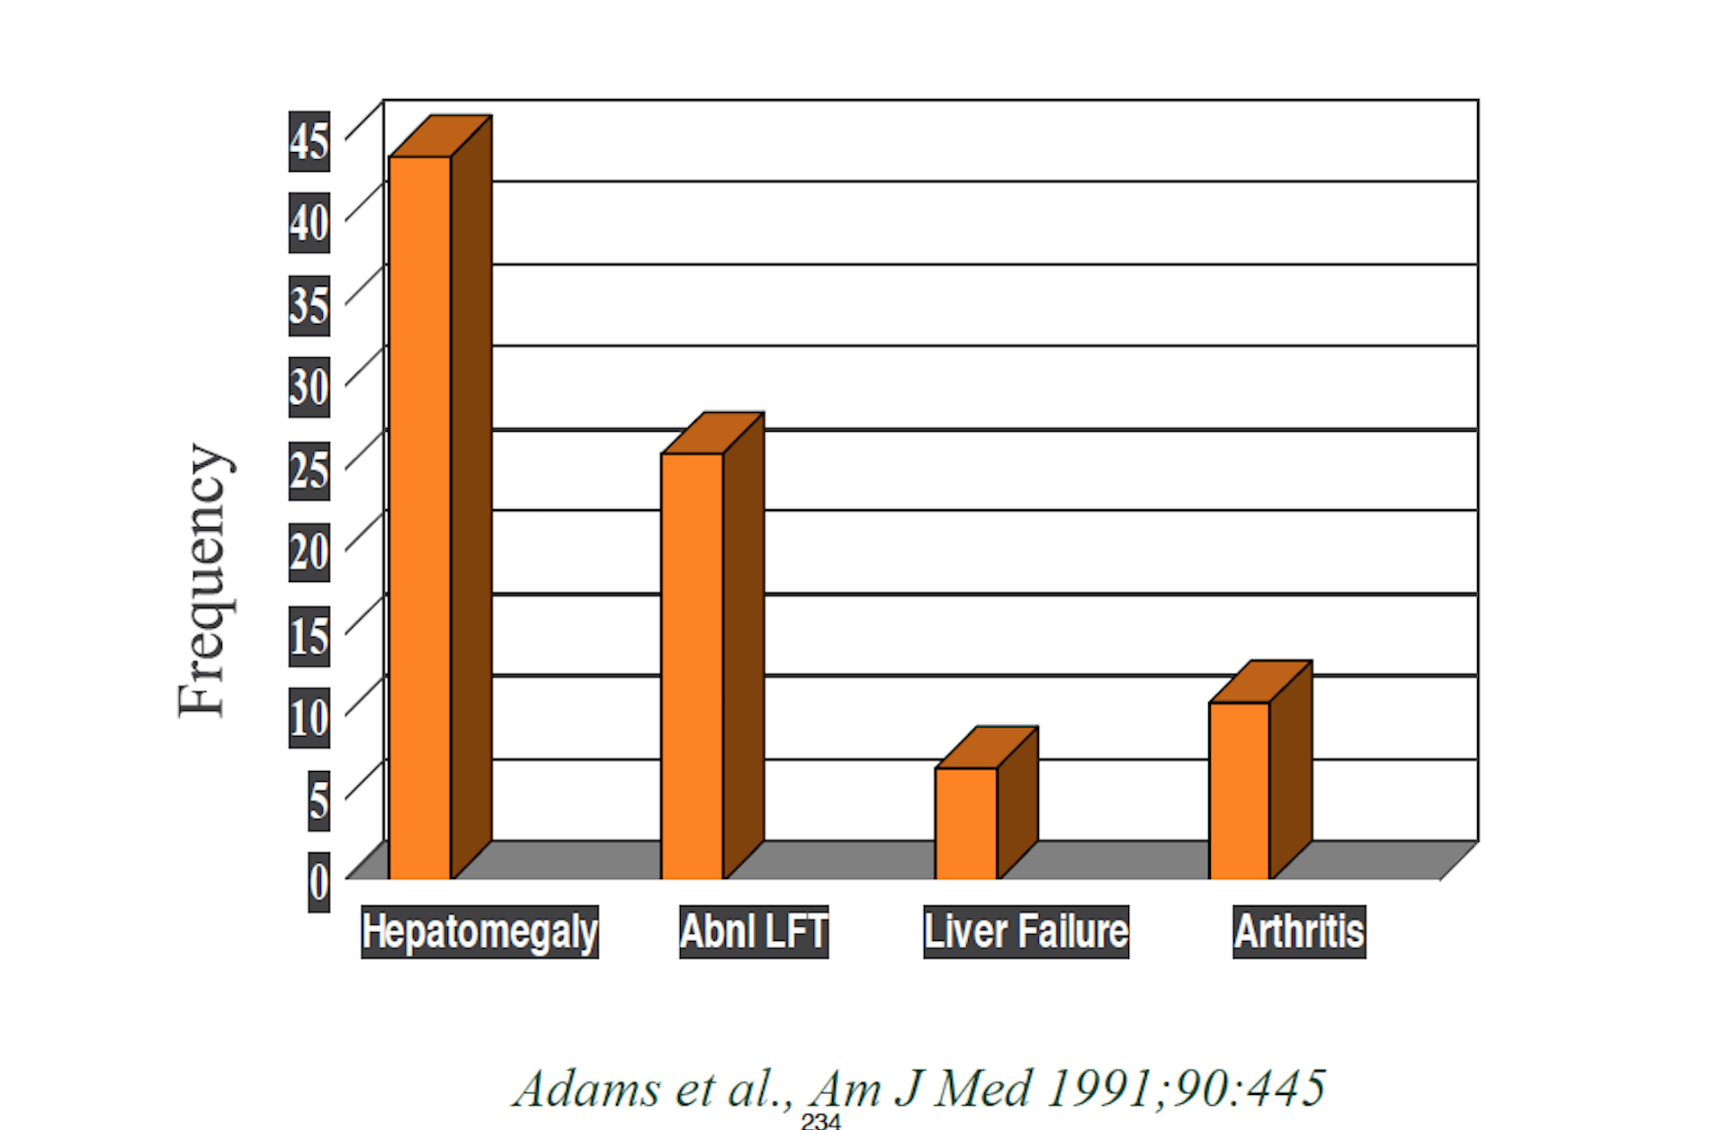
Presenting Symptoms

Slide 18
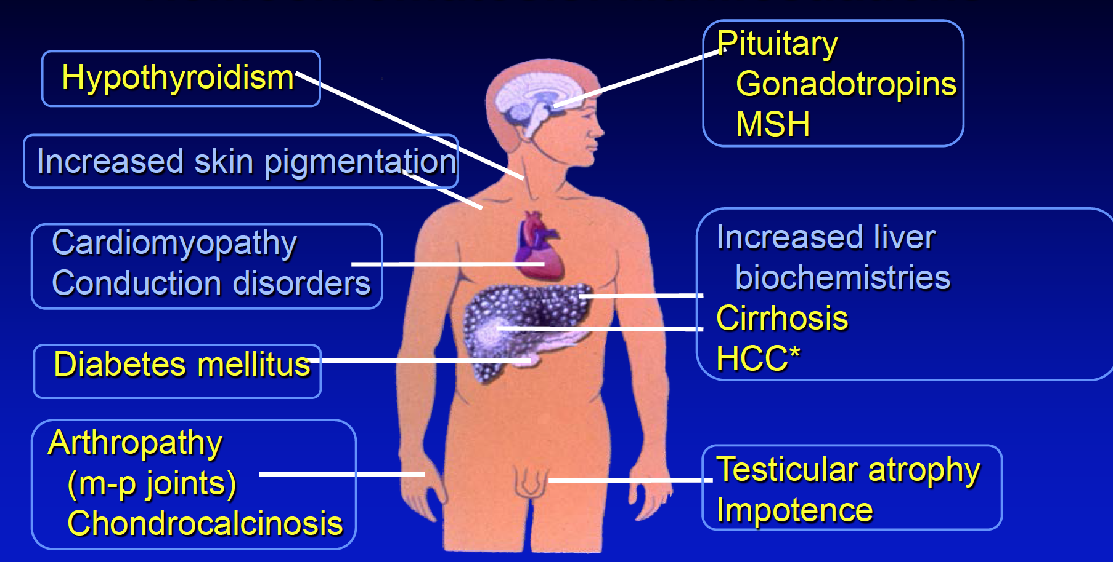
Hemochromatosis:Manifestations
Yellow :Not Reversible

Slide 19
Hepatocellular Carcinoma in HH
20 % Life time risk to develop HHC
Annual rate 3-4% per year
200x increase risk over Normal
Phlebotomy does not eliminate the risk

Slide 20
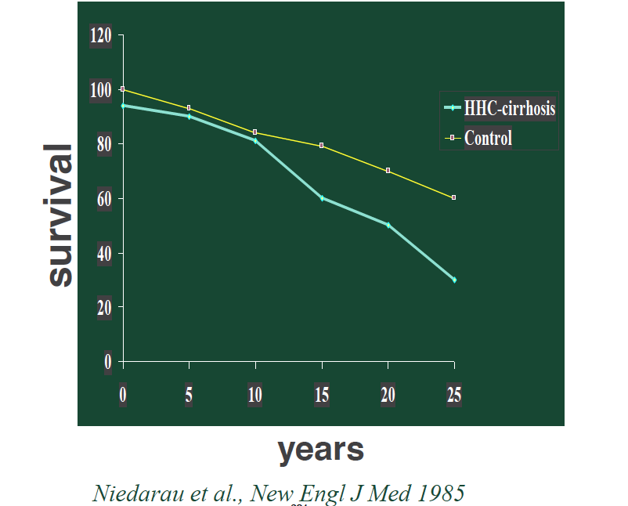
Survival in Cirrhotic HH

Slide 21
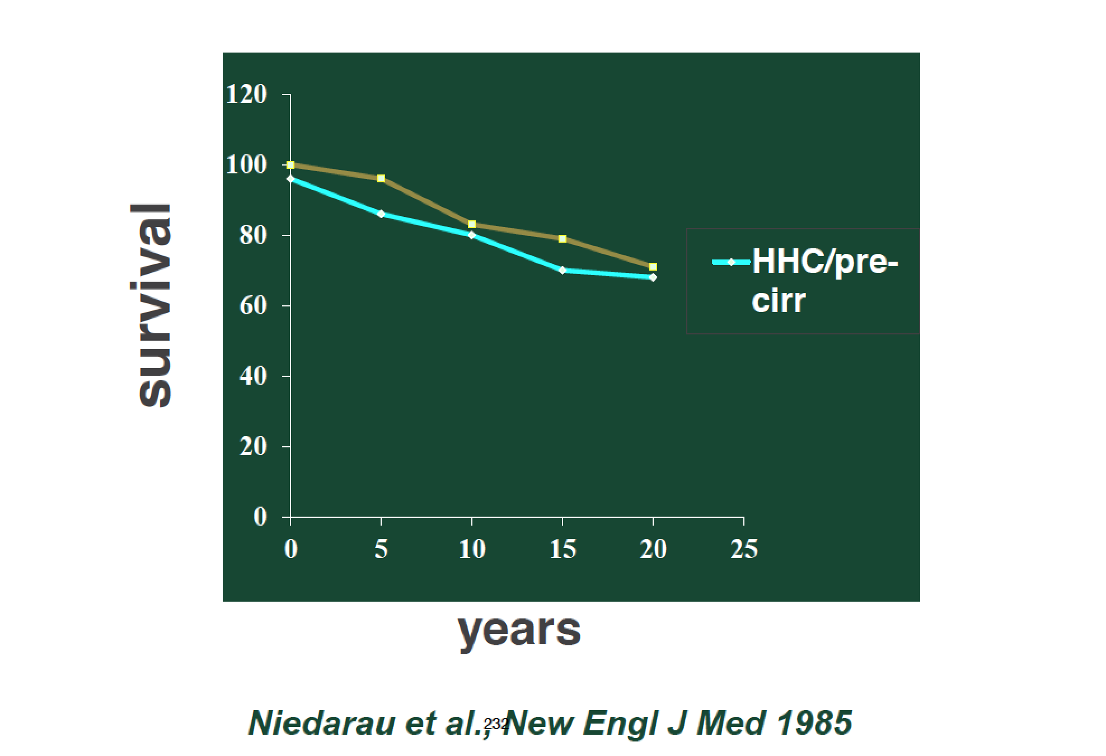
Survival in Non-Cirrhotic HH

Slide 22

The Genetics of HH
Appropriate
Genetic testing
Notes:
Let's talk about the genetics of Hemochromo
So we will understand how to
Appropriately USE GENETIC TESTING

Slide 23
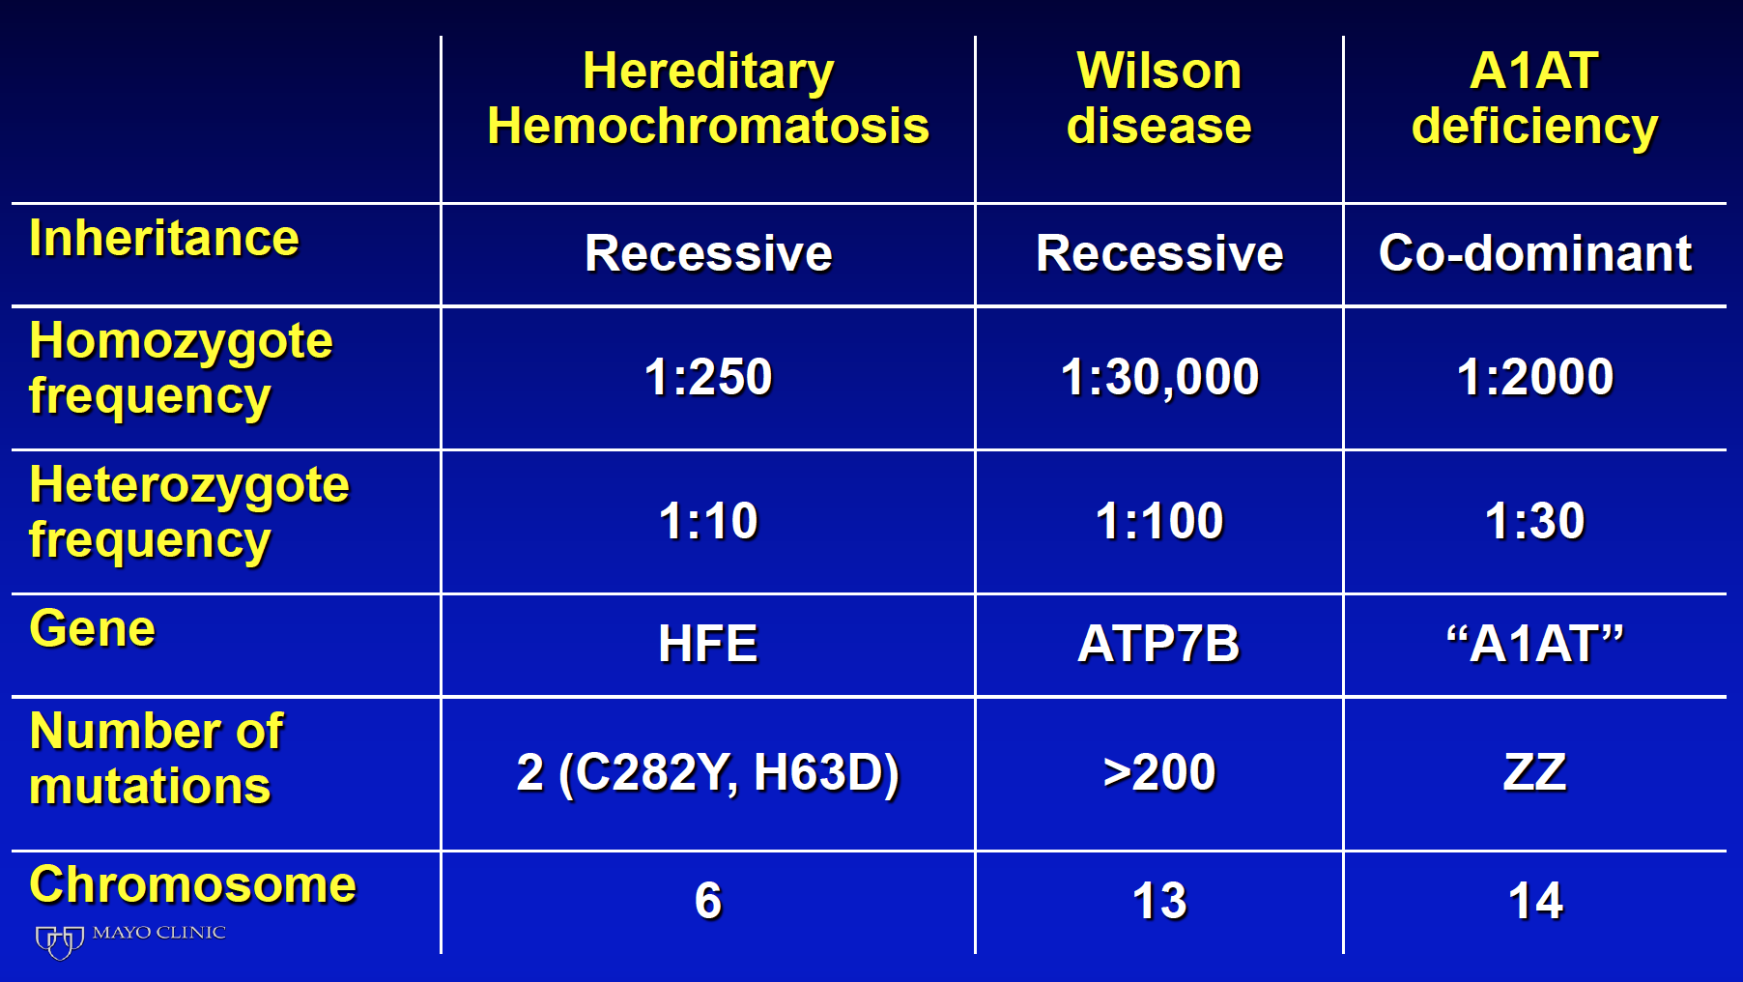
Adult Inherited Liver Disease
Notes:
#HH 1 Mendelian inherited gene mutation of the liver
can see the frequency compared to WD and A1AD
so here today of 100 attendees-10 carry mutation
so if you will think back on proteins involved in the expression of hepcidin then the classification of Genetic HH

Slide 24
OMIM Classification of HH
Type 1-Classical HH-(HFE mutation)
Type 2A: Juvenile HH(HJV mutation)
Type 2b: Juvenile HH(Hepcidin mutation)
Type 3: TfR2 mutation-associated HH
Type 4: Ferroportin-associated HH

Slide 25
Genetics of Type 1 HFE-HH
HFE gene mutations discovered in 1996 Chromosome 6-Gene between HLA A and B
HFE gene encodes a Class I protein that senses iron along with TtfR1 and
then initiates expression of Hepcidin
Initially 2 mutations identifed
Cys->Tyr at aa 282
His ->Asp at aa 63

Slide 26

How Do you Approach Iron Overload

Slide 27
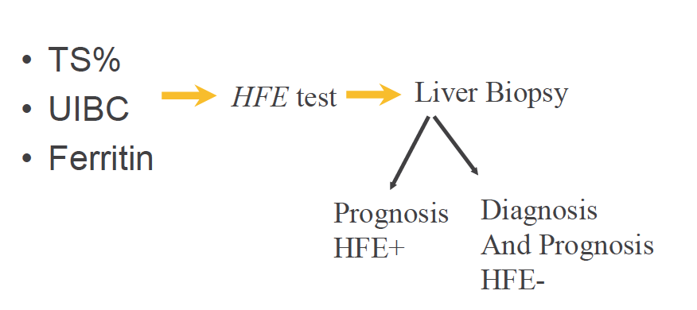

Screening for Iron Overload

Slide 28
Transferrin Saturation
Elevated TS more sensitive than SF
in screening because
a lesser degree of iron overload is required to raise the TS than to increase the plasma ferritin
TS > 60% m >50% f
accurate > 90% detect homozygote HH
Edwards CQ Kushner JP NEJM 1993:328:1616

Slide 29
Serum Ferritin monitoring: advantages and limitations
Advantages:
-serum Ferritin levels generally reflect the level of
body iron stores
- trends in serum ferritin assisted over
time can correlate with LIC
- Inexpensive and noninvasive method of monitoring
Limitations:
-levels may fluctuate in response to
inflammation, infection
liver – function abnormalities,

Slide 30
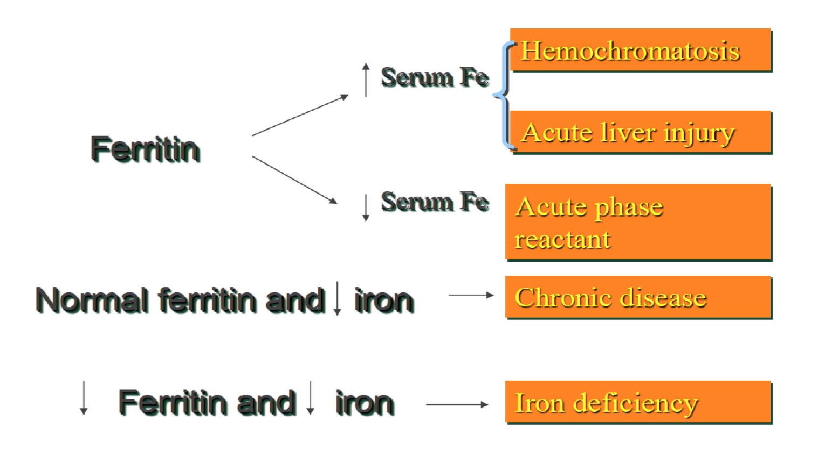
Interpretation of Ferritin with Serum Iron

Slide 31
Ferritin Levels at Time of Diagnosis
Serum Ferritin Baseline : Elevated: 84%m 65%f
Serum Ferritin 12 year follow-up:
SF-normal
SF 300-1000
males
females
Elevated SF>1000
37%male
3% females
<15% + elevation of SF
Progress SF>1000
males 25%(16-35%)
females 18%(15-22%)
Gastro 2008:135:1945-52

Slide 32
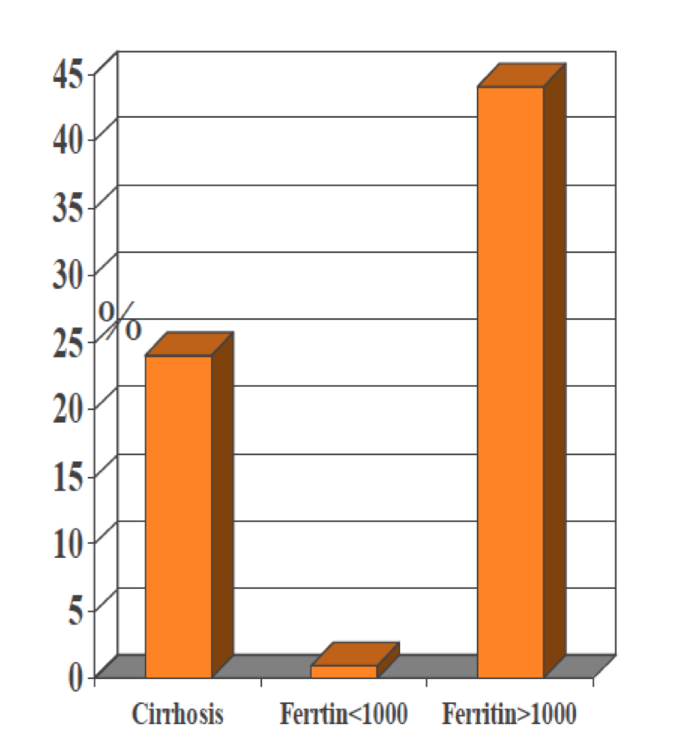
Ferritin Predicts Cirrhosis
182 pts with HHC
based on HIC being>4000mcg/g
Liver biopsies with bridging fibrosis or cirrhosis
Alcohol<20gm/day
No risk factors for NASH
Morrison et al. Ann Intern Med 2003.138;627-33

Slide 33
Gene Mutation Patterns in HFE-HH
C 282Y homozygotes most important mutation
Highest level of HIC
Uniform hepatic iron deposition
Majority of Caucasian patients (80-90%)
C282Y/H63D comprise 1.5-7%
lower HIC compared C282Yhomozygotes
S65C, H63D mutations unimportant
may lead to iron overload ONLY with another risk factor

Slide 34
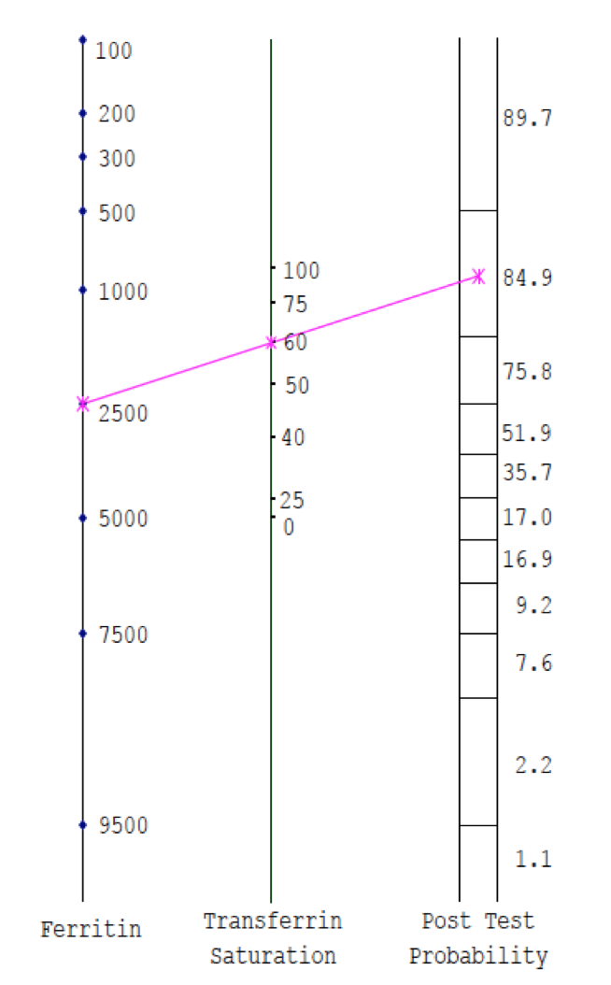
Normogram predict C282Y +/+
Relationship TS and SF
TS much more sensitive than SF
High Ferritin low TS
Low likelihood of HH
McGarth J et al, J Clin Med 2002

Slide 35
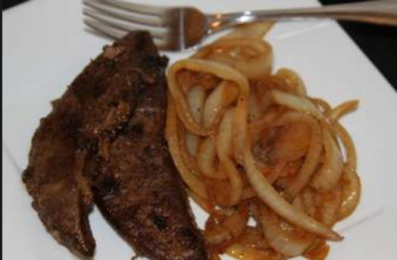
Liver Biopsy:
Who and When

Slide 36
Role of Liver Biopsy
HFE + HH Iron Overload
Non-HFE+ Iron Overload
Recommended to Stage the Liver Disease in
C282Y homozygote or
Compound C282Y/H63D
If LIT elevated
Ferritin>1000
Age >40
Not for family screen
Recommended for Staging and Prognosis in
phenotypic Iron Overload
with Neg HFE
In Non-HFE HH for:
HIC
Histopath Fe Staining,
to determine the degree and cellular distribution of iron overload
AASLD PG 2010

Slide 37
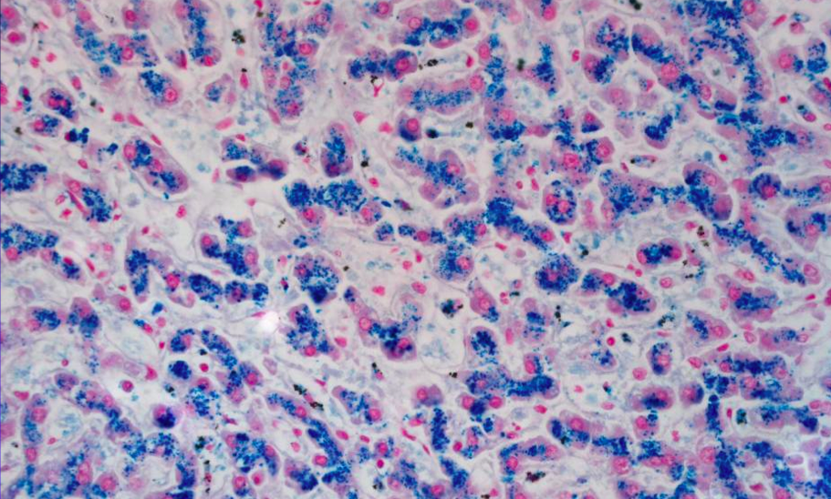
Classic Iron Staining: HH

Slide 38
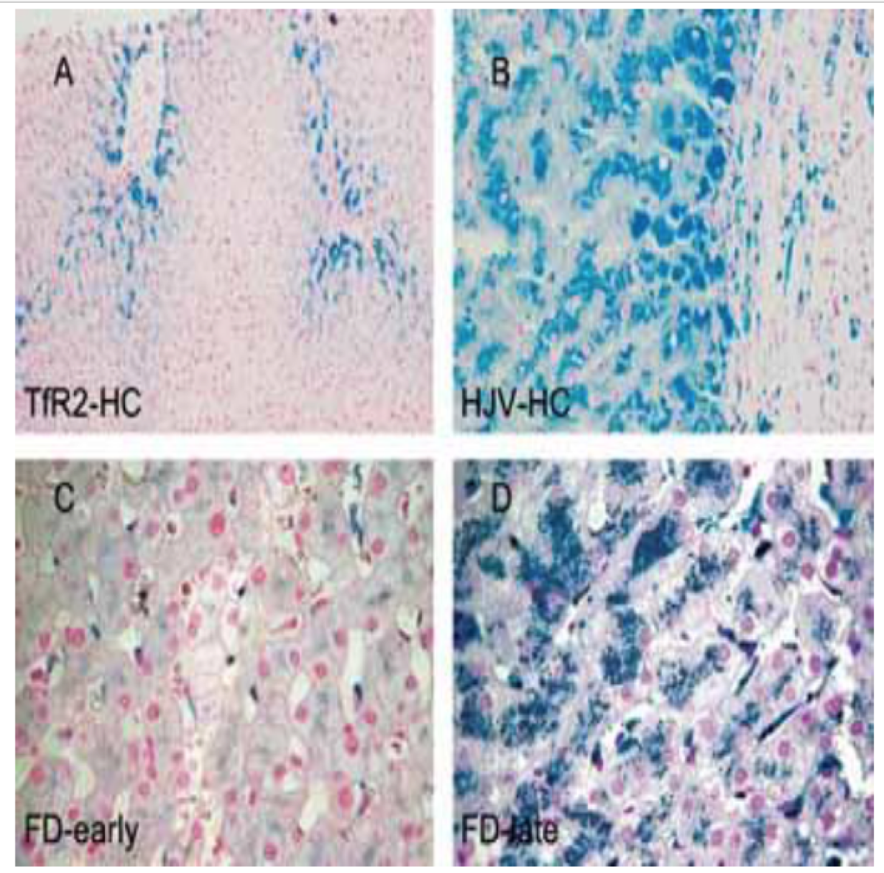
Hepatic Iron Staining
Non-HFE HH
Pietrangelo Sem Liv Dis 2006

Slide 39
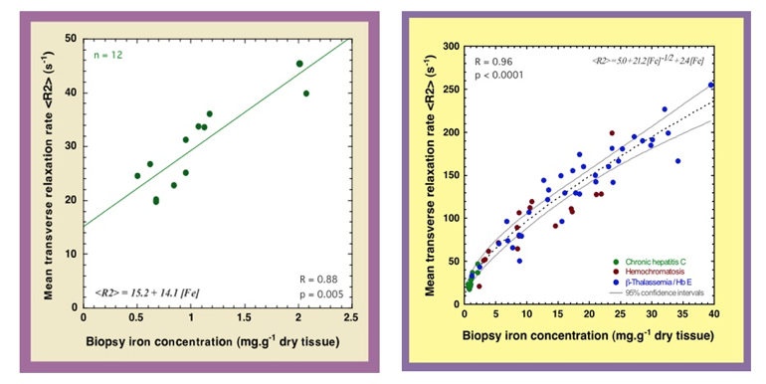
Alternative Tests to Assess Fibrosis and Iron
MRI T2*-
MR Elastogaphy
Fibroscan

Slide 40
Modifiers of Expression in HH
“Drive the Phenotype”
Alcohol consumption
Insulin resistance syndrome
Iron, vitamin C intake
Chronic blood loss
Celiac disease
Dietary factors

Slide 41
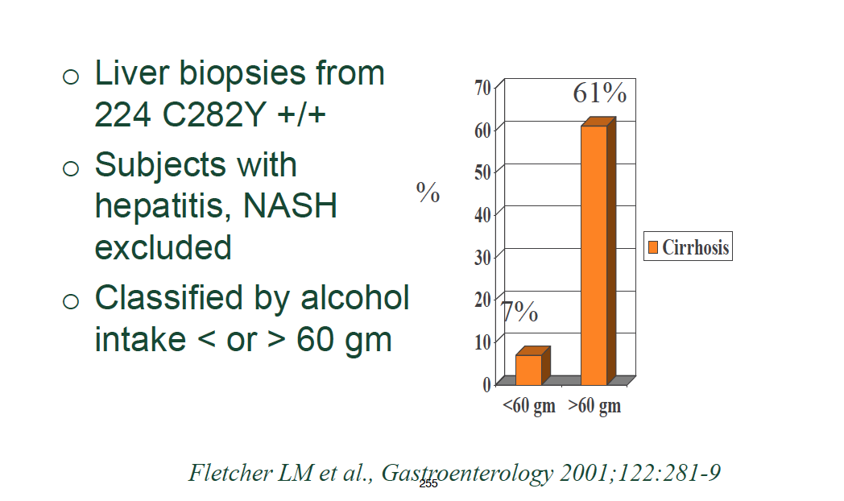
Alcohol Consumption and HH

Slide 42

Misdiagnosis of Hemochromatosis
Advanced liver disease
Hepatitis C
NAFLD
Alcohol use

Slide 43
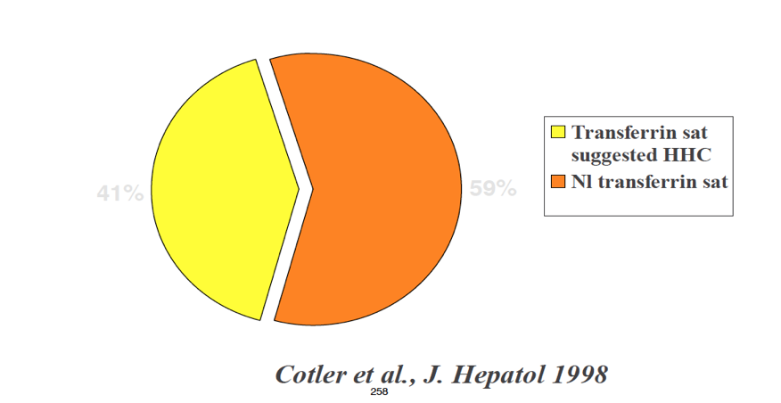
Prevalence of Elevated Transferrin Saturation in ESLD
41%
59%

Slide 44
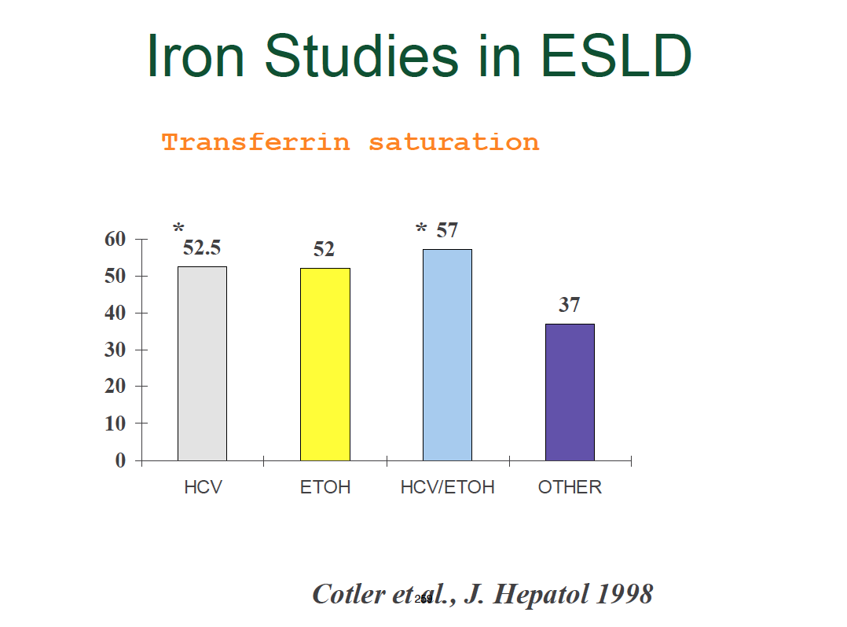

Slide 45
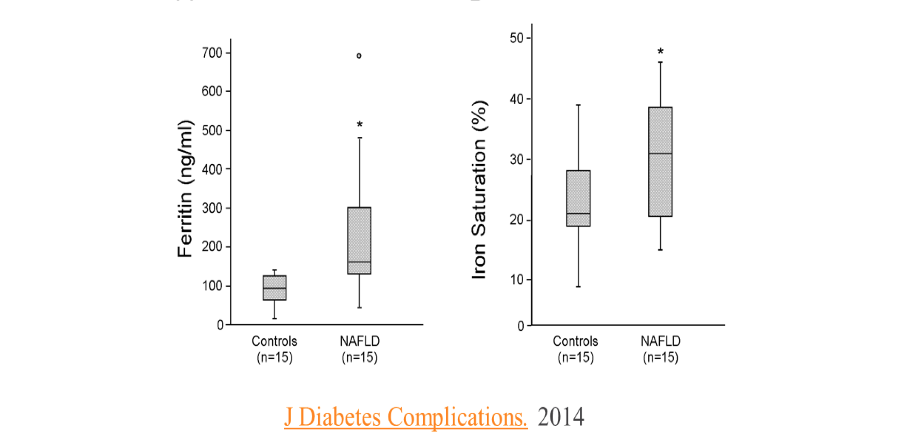
TS and Ferritin
NAFLD

Slide 46
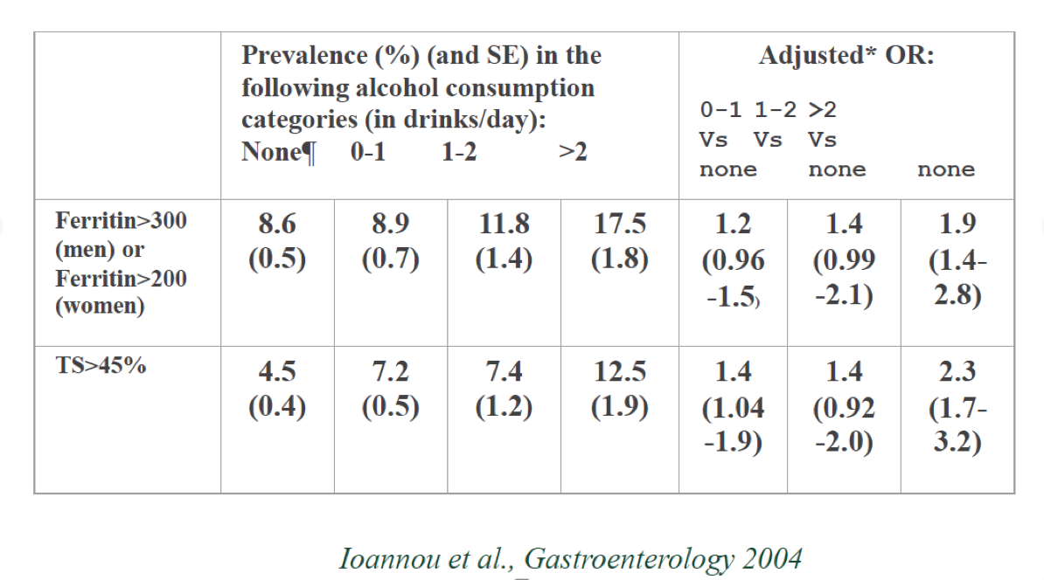
Alcoholic Consumption and Iron Stores:
NHANES III

Slide 47
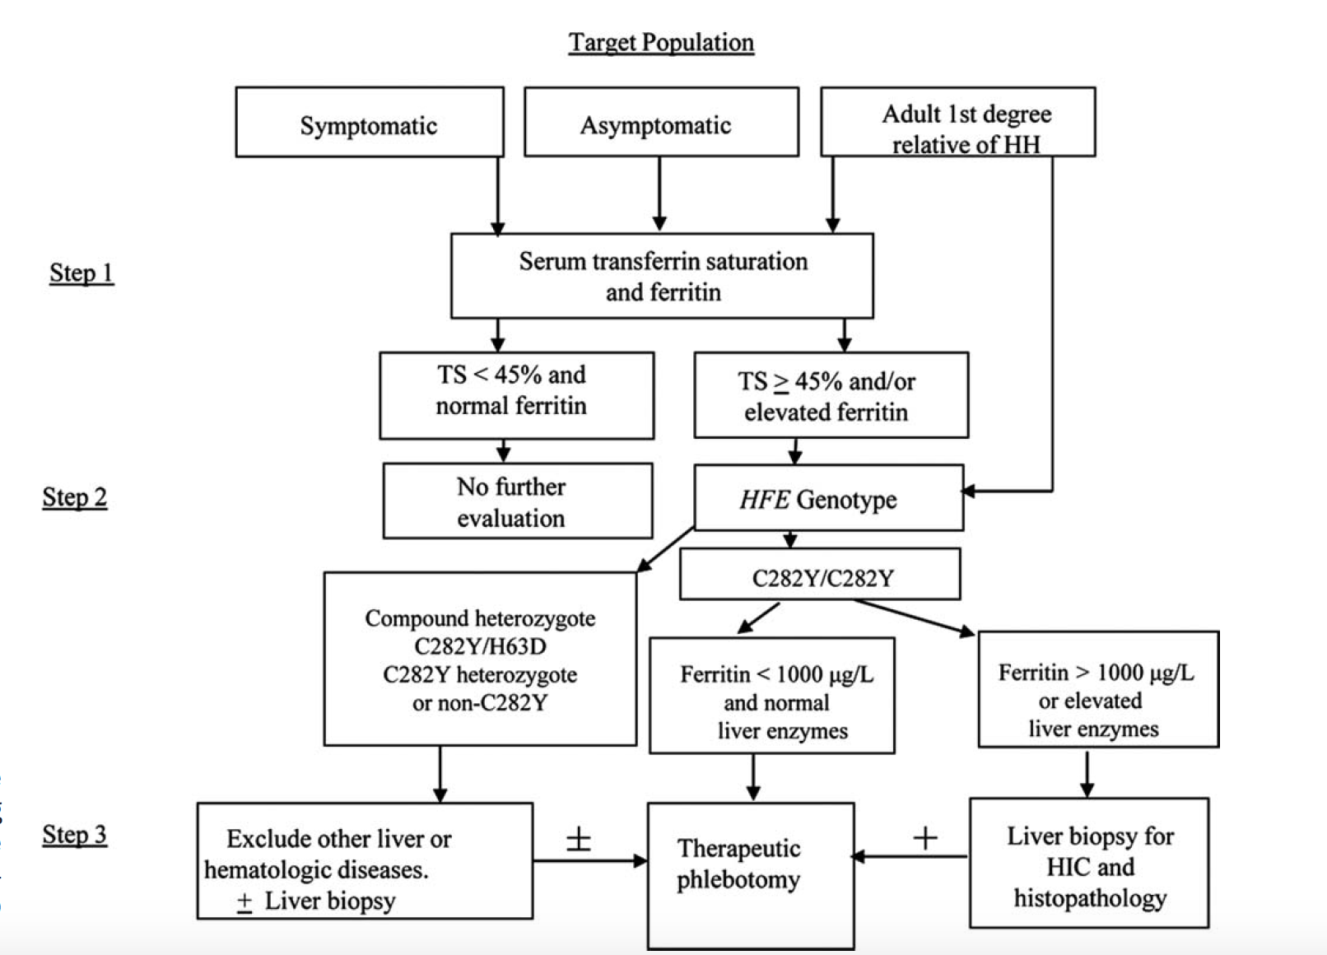
AASLD PG 2010

Slide 48
Causes of Iron Overload

Slide 49
Causes of Iron Overload
Genetic-HFE(C282Y) 85%
Genetic-Non HFE
Secondary Causes
15%

Slide 50
Secondary Iron Overload
Dietary iron overload
Parenteral iron overload
Ineffective Erythropoiesis
Long-term hemodialysis
Liver disease
End-Stage liver disease
Alcoholic Cirrhosis
Porto-Caval shunt
Porphyria Cutanea Tarda
Dysmetabolic Iron Overload Syndrome

Slide 51
Take Home
Many forms of Iron Overload
Always consider a secondary source
Alcohol and NAFLD are COMMON causes of elevated Ferritin
Always measure TS and Ferritin
Consider Liver Biopsy with Ferritin>1000
MRI T2*/Ferriscan is alternative for hepatic iron content

Slide 52
Take Home
Early Treatment: Opportunity to change prognosis and prevent cirrhosis
Be aware of modifiers-Alcohol, Vit C
Remember High Risk of HCC in HH
Screen:HFE and iron studies

Slide 53
End with 2 famous quotes/thoughts
Utah Supreme Court Justice:
Ronald E. Nehring
Thoughts on Friendship-and todays lecture

Slide 54
Slides Courtesy of:
Kris Kowdrey, MD
William Sanchez, MD

