Slide 1
Non-Alcoholic Fatty liver Disease Metabolism and Reproduction August 16, 2016
Ray Thomason, M.D.
Notes:
Hi Im RT
Your hepatology guide into a new world of Fatty liver DZ

Slide 2
NAFLD : Objectives
Metabolic Syndrome- Prevalence Definition Identify/Diagnosis Risk factor NAFLD- hepatic manifestation of MS NAFLD: Prevalence Etiologies Types Outcomes Implications
Case Studies

Slide 3
Metabolic Syndrome
Prevalence/Implications Definition
How identify clinically Visceral Fat-Altered Metabolism

Slide 4
Metabolic Syndrome an increasing prevalence in US
Parallels the increase in the obesity epidemic.
Two thirds of the US population is overweight or obese
One fourth of the population meets diagnostic criteria for the metabolic syndrome
US survey 1999– 2000 prevalence in adults -32% (previously 27% in the early 90s)
Prevalence increases with age: 40% in adults over 60 years of age
Children are becoming obese at triple the rate since 1960

Slide 5
Importance of identifying the Metabolic Syndrome: Represents an Increased Risks for :
Coronary Heart Disease
Diabetes
Stroke
Fatty Liver
Cancer
Notes:
Pool data from 37 studies involving more than 170,000 patients shown that the metabolic syndrome doubles the risk of coronary artery disease.

Slide 6
Metabolic Syndrome: definition
A group of interrelated metabolic risk factors
Diagnosis requires 3 of 5 Clinical Conditions/Risk Factors
Etio: Insulin Resistance accompanying Abnormal Adipose Deposition and Dysfuntion

Slide 7
Clinical identification of the metabolic syndrome
Abdominal obesity
Elevated triglyceride
Reduce a HDL cholesterol
Blood pressure
Fasting glucose
Men > 40 in. Women >35 in.
TG > 150 mg/dl or on treatment
HDL <40mg/dl men < 50mg/dl female or on treatment
BP >135/85 or on treatment
Fasting BG > 100mg/dl or on treatment
Notes:
American Heart Association – national heart, long, and blood Institute: Scientific statement– 2005

Slide 8
Insulin resistance: Primary mediator of the metabolic syndrome
Insulin promotes glucose uptake in the muscle, Fat, and liver cells
Insulin can influence lipolysis and glucose production by hepatocytes
Contributes to insulin resistance include: abnormalities in insulin secretion , Impaired glucose disposal, and pro-inflammatory cytokine

Slide 9
Adipose Tissue Dysfunction
Adipose tissue distribution of the affects its role in the metabolic syndrome Visceral fat correlates with inflammation-not subcutaneous
Macrophages Infiltrate enlarging adipose cell resulting release of pro-inflammatory cytokine and promote insulin resistance
Omental fat is more resistant to insulin resulting in a higher concentrations of toxic free fatty acids and the portal circulation
Harmful cytokines produced by abdominal fat include tumor necrosis factor, adicto neck pain, Leptin, resistance, And plasminogen activate torque inhibitor

Slide 10
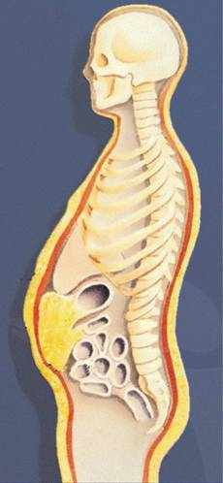
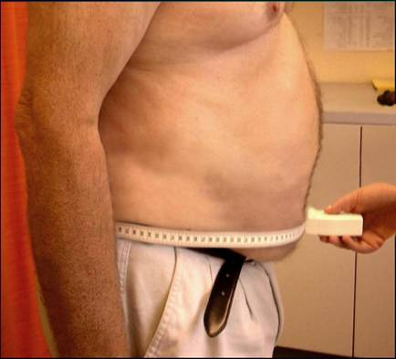
Abdominal Adiposity: The Critical Adipose Depot
Subcutaneous fat
Abdominal muscle layer
Intra-abdominal fat
Notes:
Epidemiologic and metabolic studies conducted over the past 15 years have noted that metabolic complications frequently found in obese patients appear to be associated with the location of the excess fat, specifically abdominally distributed obesity, rather than the excess weight per se.
The patient with abdominal obesity, or excess visceral adipose tissue, and the metabolic syndrome is at high risk for coronary artery disease, type 2 diabetes, and related mortality. Individuals who are obese and have a high concentration of visceral adipose tissue tend to have dyslipidemia in the form of elevated levels of triglycerides and decreased levels of high-density lipoprotein cholesterol (HDL-C), which place them at higher risk for cardiovascular disease.
A simple and practical screening tool such as a measurement of the waist circumference, can be used to assess risk by monitoring the accumulation or loss of visceral fat between office visits.

Slide 11
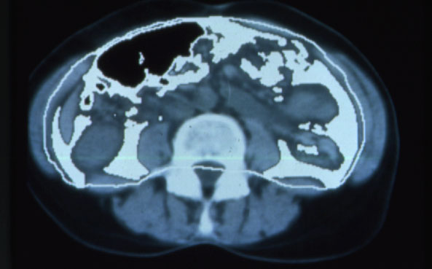
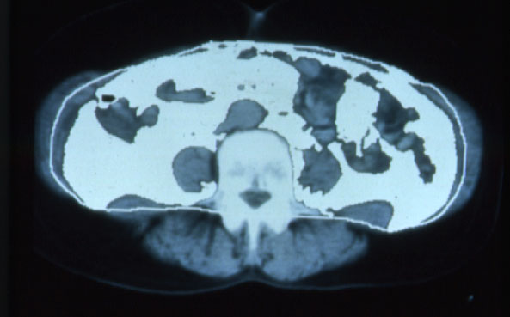
Visceral Fat Distribution: Normal Versus Type 2 Diabetes
Normal
Type 2 Diabetes
Notes:
Visceral obesity as determined from a CT scan is shown in a normal control as compared with a patient with type 2 diabetes. As illustrated, the area of intra-abdominal fat is greater in the type 2 diabetes patient than in the control.

Slide 12
Prevalence of Metabolic Syndrome in NAFLD
304 NAFLD cases w/o overt diabetes
36% MS
MS and female gender: OR, 3.08
18%
29%
67%
MS and age: OR, 1.54
26% in pts <40; 45% ≥40
Normal weight
Overweight
Obese
IR and MS: OR, 2.5
88% of NASH pts with MS are associated with high risk of fibrosis: OR, 3.5
Marchesini et al. Hepatology. 2003;37:917-923.
Notes:
The prevalence of the metabolic syndrome was determined in 304 consecutive nonalcoholic fatty liver disease (NAFLD) patients without overt diabetes, using criteria defined in the National Cholesterol Education Program’s Adult Treatment Panel III guidelines. (Marchesini, p917, abs, p919, c1, ¶1)
The metabolic syndrome was identified in 36% of the study cohort. Notably, the prevalence of the metabolic syndrome increased with increasing BMI, from 18% in normal-weight individuals, to 29% in overweight subjects, to 67% in obese subjects. The presence of the metabolic syndrome was also significantly associated with female gender (OR = 3.08; 95% CI: 1.57 to 6.02) and age (OR = 1.54; 95% CI: 1.23 to 1.93 for every 10 years) after adjusting for body mass index. Overall, the metabolic syndrome was found in 26% of patients under age 40 and 45% of those aged 40 and older. Finally, the presence of insulin resistance was associated with the metabolic syndrome (OR = 2.5, 95% CI: 1.5 to 4.2; P<0.001). (Marchesini, p920, c1, ¶2-c2, ¶1)
Liver biopsies were obtained in 163 cases, and 120 of these patients were classified with nonalcoholic steatohepatitis (NASH) and the remaining 43 patients classified with pure fatty liver disease. Notably, 88% of the patients with NASH had the metabolic syndrome. On logistic regression, the presence of the metabolic syndrome was associated with significantly higher risk for NASH (OR = 3.2; 95% CI: 1.2 to 8.9; P = 0.026) as well as severe fibrosis (OR: 3.5; 95% CI: 1.1 to 11.2; P = 0.032). Thus, the presence of the metabolic syndrome places patients at risk of NASH and further progression to cirrhosis and liver failure. (Marchesini, p921, c1, ¶2-c2, ¶1)
Reference
Marchesini G, Bugianesi E, Forlani G, et al. Nonalcoholic fatty liver, steatohepatitis, and the metabolic syndrome. Hepatology. 2003;37:917-923.

Slide 13
Identification of the M.S. by Clinical Manifestations:
Hypertension
Hyperglycemia
Hypertriglyceridemia
Reduced high density lipoprotein cholesterol - HDL
Abdominal obesity
Chest pain or shortness of breath
Acanthosis, Hirsuitism, peripheral neuropathy, and retinopathy
Xanthomas or xanthelasmas: in severe dyslipidemia.

Slide 14
NAFLD: Marker of Systemic Metabolic Dysfunction
Prevalence
Definition and the types of fatty liver disease Types
Review the etiologies Causes
Clarify factors that explain why outcomes are different Implications

Slide 15
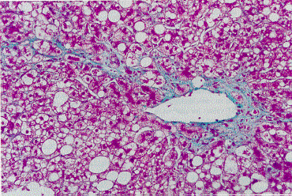
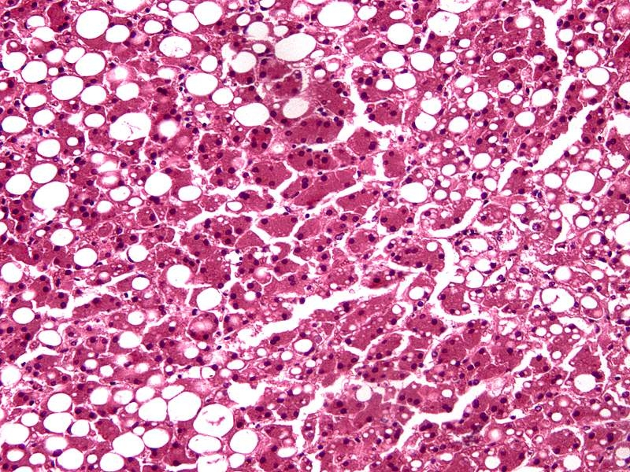
Estimated Prevalence of NAFLD in US General Population
~3%
NASH
Fatty liver without inflammation or fibrosis
~30%
Harrison et al. Drugs. 2003;63:2379-2394; Browning et al. Hepatology. 2004;40:1387-1395; Machado et al. J Hepatol. 2006;45:600-606.
Notes:
The actual prevalence of NAFLD in the United States is unknown, in part because a liver biopsy is required for the precise diagnosis. Data from the National Health and Nutrition Examination Survey (NHANES III) suggest that 24% of American adults may have NAFLD, whereas other studies peg the worldwide prevalence at 14% to 34%. Limited data suggest that 3% of the individuals with NAFLD may have nonalcoholic steatohepatitis (NASH), with rates rising to 37% among the morbidly obese. NASH is a histologic entity that can progress to cirrhosis and liver failure. (Harrison, p2380, c2, ¶3; Nomura, p144, c2, ¶3; Browning, 2004, p1387, abs; Machado, p600, abs)
The presence of steatosis on histologic examination of a liver biopsy is necessary for a diagnosis of NASH. The steatosis is most commonly macrovesicular in nature, although some microvesicular steatosis may be seen. In addition, a mixed inflammatory infiltrate consisting of neutrophils and mononuclear cells may be found within the lobule, predominantly in zone 3, with associated ballooning degeneration and hepatocyte necrosis. Mallory’s hyaline bodies may also be seen. (Harrison, p2382, c1, ¶5-c2, ¶1)
References
Browning JD, Szczepaniak LS, Dobbins R, et al. Prevalence of hepatic steatosis in an urban population in the United States: impact of ethnicity. Hepatology. 2004;40:1387-1395.
Harrison SA, Di Bisceglie AM. Advances in the understanding and treatment of nonalcoholic fatty liver disease. Drugs. 2003;63:2379-2394.
Machado M, Marques-Vidal P, Cortez-Pinto H. Hepatic histology in obese patients undergoing bariatric surgery. J Hepatol. 2006;45:600-606.
Nomura H, Kashiwagi S, Hayashi J, et al. Prevalence of fatty liver in a general population of Okinawa, Japan. Jpn J Med. 1988;27:142-149.

Slide 16
Notes:
It’s not just fatty liver
Its fatty liver disease

Slide 17
NAFLD Already Prevalent, Incidence Rising, Outcomes can be Deadly
~25%
~30%
NASH
Cirrhosis
5-10% of adults
~ 2% of adults
Childhood
Obesity epidemic
Incidence
rising!
NAFLD cirrhosis
will surpass
HCV cirrhosis as
leading cause for
OLT by 2020
NAFLD
already a
major risk factor
for HCC/ICC
Notes:
Population-based abdominal imaging studies reveal that at least 25% of American Adults have fatty livers. In most cases, hepatic steatosis is not due to excessive alcohol consumption and thus, it has been termed non-alcoholic fatty liver or NAFL. More than a quarter of patients with NAFL ,or 6-8% of the general population, are presumed to have nonalcoholic steatohepatitis (NASH) based on the presence of aminotransferase elevations. Small biopsy series of NASH patients consistently demonstrate that about a quarter of patients with NASH also have advanced fibrosis or cirrhosis. Therefore, only a small subset of patients with NAFLD are at risk for clinically significant liver disease. Nevertheless, because NAFLD is much more common than other causes of chronic liver disease, it is becoming the most common cause of cirrhosis in the United States. Current estimates suggest that NAFLD-related cirrhosis afflicts 2-3% of American adults; is 5 x more common than cirrhosis caused by hepatitis C; and will replace hepatitis C as the leading cause for liver transplantation within the next 5-10 years.
-----
At this point, it is not known why certain individuals with NAFLD develop clinically significant liver disease whereas most others are spared.

Slide 18
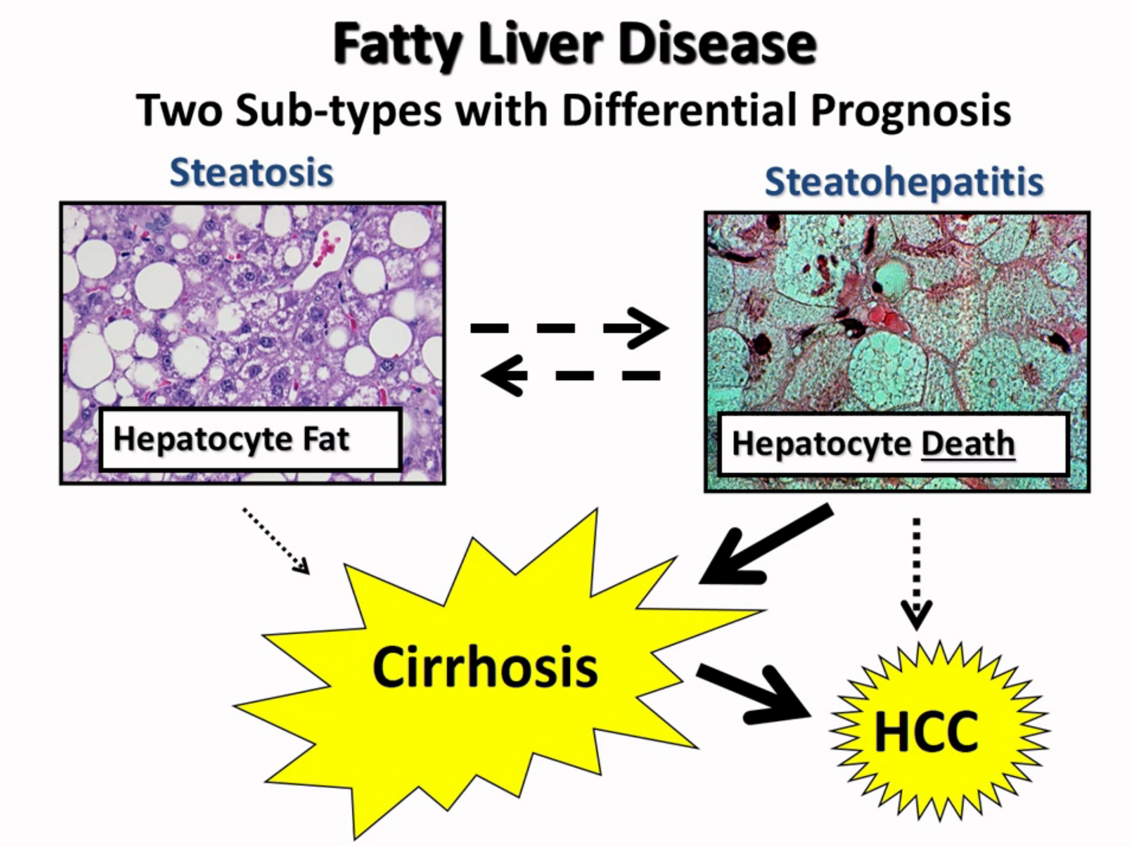
Notes:
2 types Type 1 is Steatosis characterized by the accumulation of triglycerides +/- minimal inflammation
type 2 is steatohepatitis The big difference is Conspicious cell death
It is those with cell death that risk to progress to cirrhosis or HCC

Slide 19
Development of Hepatic Steatosis
Molecular mediators of hepatic steatosis and liver injury
Jeffrey D. Browning, Jay D. Horton J. Clin. Invest. 2004; 114(2):147
Notes:
Metabolic alterations resulting in hepatic triglyceride accumulation in insulin-resistant states. Insulin resistance is manifested by hyperinsulinemia, increased hepatic glucose production, and decreased glucose disposal. In adipocytes, insulin resistance increases hormone-sensitive lipase (HSL) activity, resulting in elevated rates of triglyceride lipolysis and enhanced FFA flux to the liver. FFAs can either be oxidized in the mitochondria to form ATP or esterified to produce triglycerides for storage or incorporation into VLDL particles. In liver, hyperinsulinemia induces SREBP-1c expression, leading to the transcriptional activation of all lipogenic genes. Simultaneously, hyperglycemia activates ChREBP, which transcriptionally activates L-PK and all lipogenic genes. The synergistic actions of SREBP-1c and ChREBP coordinately activate the enzymatic machinery necessary for the conversion of excess glucose to fatty acids. A consequence of increased fatty acid synthesis is increased production of malonyl-CoA, which inhibits CPT-1, the protein responsible for fatty acid transport into the mitochondria. Thus, in the setting of insulin resistance, FFAs entering the liver from the periphery, as well as those derived from de novo lipogenesis, will be preferentially esterified to triglycerides. ACL, ATP citrate lyase; CPT-1, carnitine palmitoyl transferase-1; FAS, fatty acid synthase; LCE, long-chain fatty acyl elongase.

Slide 20
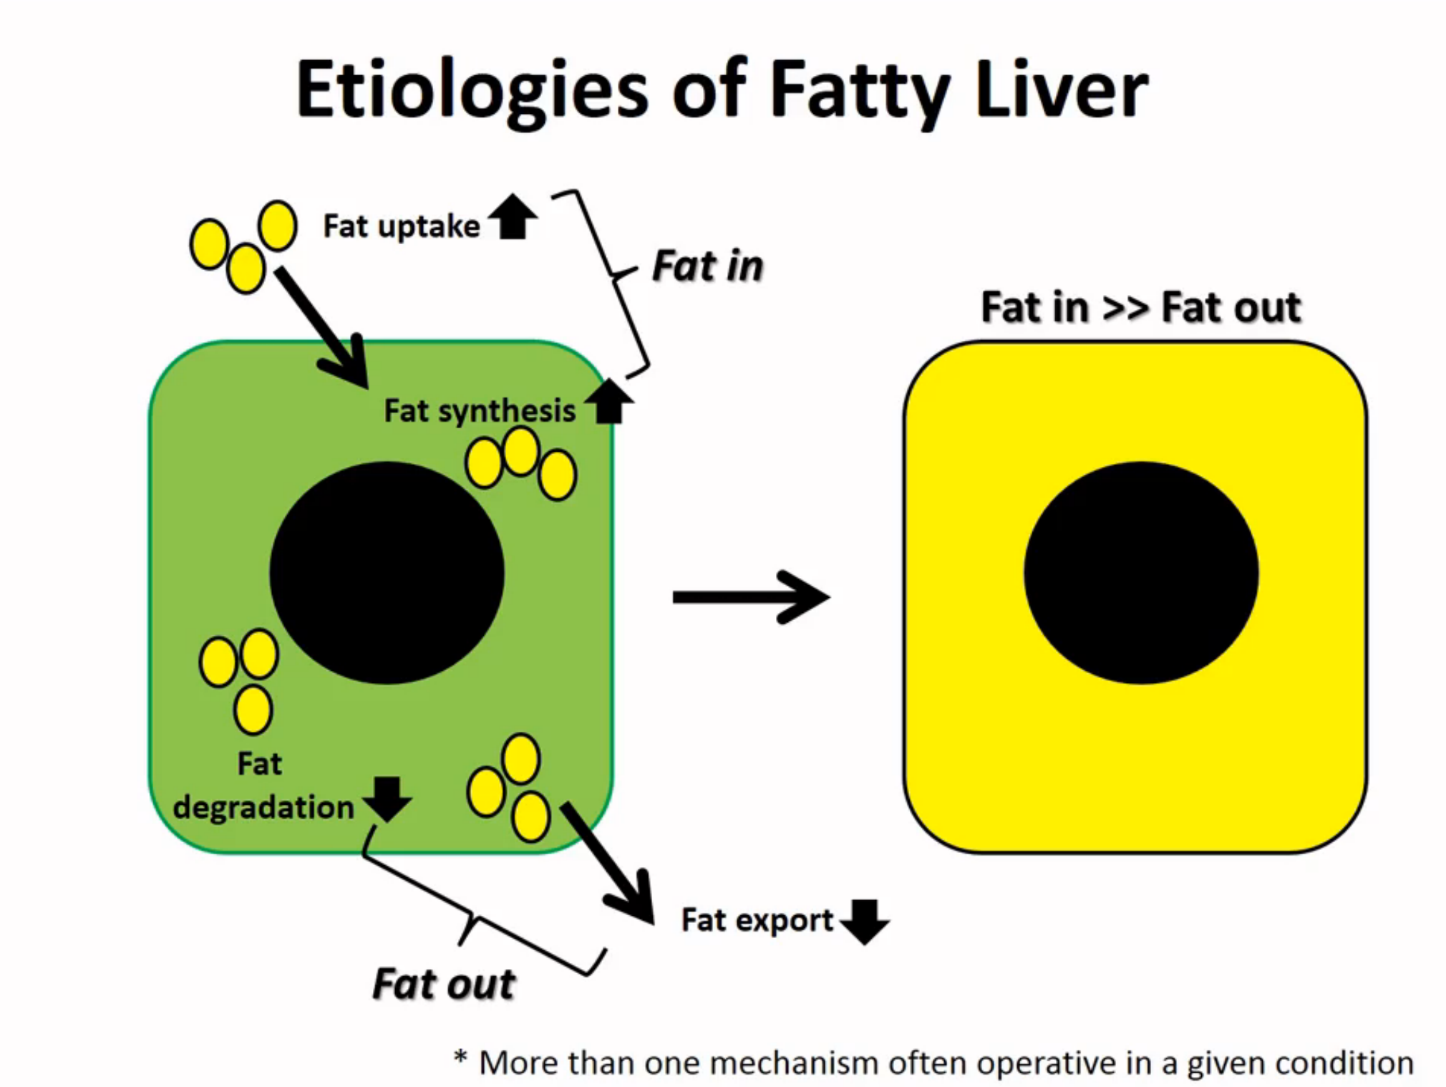
Notes:
Simply put-get fat hepatocyte when ther is more fat going in than going out
Fat goes in -2 mechanism-it can be taken up from the outside or can be sythesized denovo vs exported from the liver cell or degraded..
It is important to realize in real ilfe ther are usually multiple mechanisms in play-but in > out=fatty hepatocyte

Slide 21
Causes of NAFLD: Overfed-Underfed-Chemicals/Toxins
Metabolic | Drugs
Diabetes (type 2) | Amiodarone
Insulin resistance | Tamoxifen
Dyslipidemia | Valproate
Obesity | Nucleotide analogues
J-I bypass | Total parenteral nutrition
Weight loss | Toxins
Reye syndrome | Petrochemicals

Slide 22
Notes:
The top 2 – in bold font etoh and Non-alcoh are by far above the most common causes
But there list of many different thingsThe xx’s and arrow
Different mechanisms dominiant
Nafld mainl uptake and synthesis
While etoh is more degradtion
The etio

Slide 23
Notes:
it gets more complicated bez fat is heterogeneous
When you talk about fat u talk about TG but that’s a bit of a misnomer bez fat is heterogeneous-what u see primarily TG
What you don’t see is the the dif kinds of FA,dif levels of cholesterol

Slide 24
So What’s the big Deal Different Causes=Different Outcomes
Insufficient Degradation of Fat FFA accumulate(lipotoxicity:caspases,signaling Mitochondrial ROS/Damage
Lipotoxic Actions of Different Lipid Types ex: cholesterol
Notes:
So Why Care – dif kinds of fat have dif consequences
If you have more fat than you can degrade –this is ominous bez accumulation of toxic things like FA –active enzymes like caspase that causes cell death
Interfer with signaling if not able to degrade all of the fat
So you are running your fat deg systems very hard –like mitochondria –so generating reactive oxygen species ultimately the organells get damaged
Its just not neutral fat TG that accumulates its but other kinds of fat like cholesterol that effects signaling differently

Slide 25
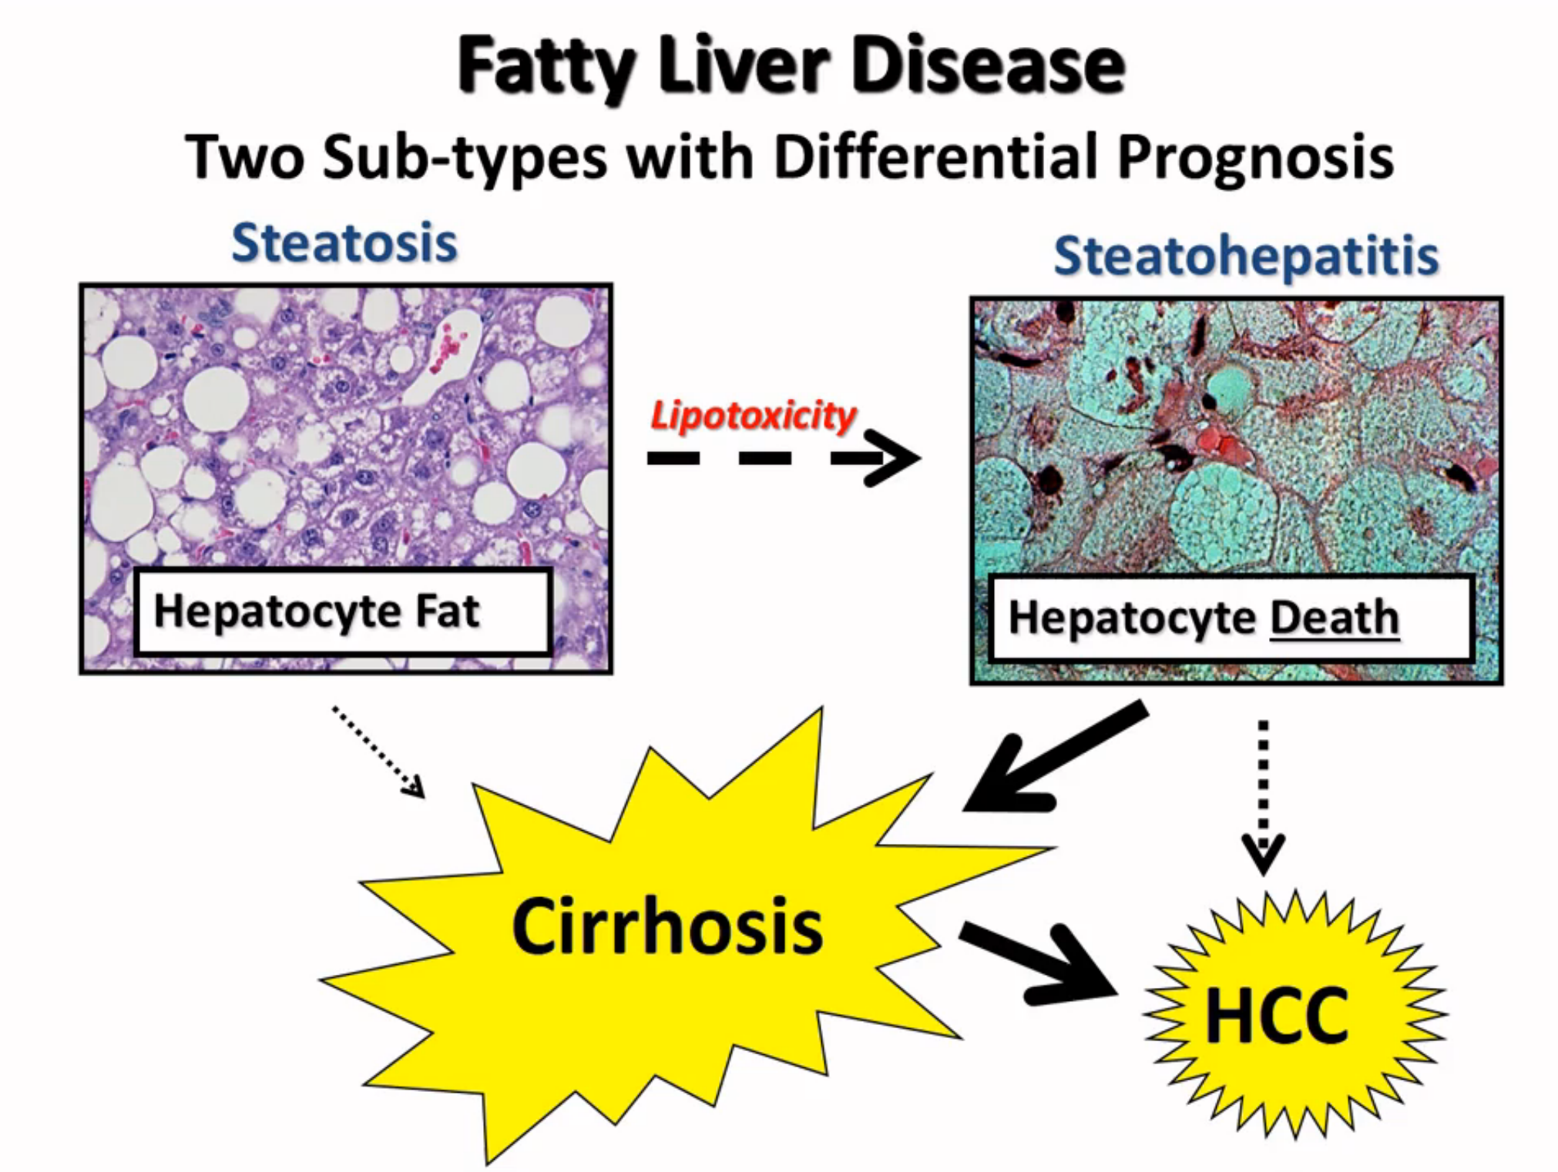
Notes:
WHY Care there are 2 dif kinds of Fatty liver and they have Dif Prognoses
If fat and no cell death
If cant degrade accumulate toxic fatty

Slide 26
Simple Steatosis : Not Benign ! ! ! !
Inflammation
Insulin Resistance
Mitochondrial or Peroxisomal Dysfx
Oxidative Stress
Biomarker of Metabolic Stress
Notes:
Not benign –it is a biomarker of metabolic stress
tell somewhere in the body there is inflammation IR mitoch dysfxfat somewhere in the body
Normally it is not normal to accumulate fat in the hepatocyte

Slide 27
Notes:
This is an example that fat accumulation is not normal-

Slide 31
Disease progression: Steatosis to NASH
Mechanisms of lipid-induced cellular injury in NAFLD
Molecular mediators of hepatic steatosis and liver injury
Jeffrey D. Browning, Jay D. Horton J. Clin. Invest. 2004; 114(2):147
Notes:
Mechanisms of lipid-induced cellular injury in NAFLD. ROS are formed through oxidative processes within the cell. In the mitochondria, impaired MRC activity leads to the formation of superoxide anions and hydrogen peroxide. The accumulation of fatty acids in the cytosol increases fatty acid oxidation in peroxisomes and the ER. The initial reaction in peroxisomal β oxidation is catalyzed by acyl-CoA oxidase (AOX) that forms hydrogen peroxide through the donation of electrons to molecular oxygen. Microsomal w oxidation is catalyzed by cytochrome P450 (CYP) enzymes 2E1, 4A10, and 4A14, which form ROS through flavoprotein-mediated donation of electrons to molecular oxygen. PUFAs are extremely susceptible to lipid peroxidation by ROS. By-products of PUFA peroxidation are aldehydes, such as HNE and MDA. These aldehydes are themselves cytotoxic and can freely diffuse into the extracellular space to affect distant cells. ROS and aldehydes induce oxidative stress and cell death via ATP and NAD depletion, DNA and protein damage, and glutathione depletion. Additionally, they induce inflammation through the production of proinflammatory cytokines, leading to neutrophil chemotaxis. Within the extracellular space, HNE and MDA are themselves potent chemoattractants for neutrophils. Finally, ROS and products of lipid peroxidation can lead to fibrosis by activating hepatic stellate cells, which synthesize collagen and perpetuate the inflammatory response.

Slide 32
NAFLD Diagnosis
Injury
Repair
Goal = Identify risk for liver-related morbidity/mortality
Grade injury (NASH versus NAFL)
Evaluate repair (Stage fibrosis)
Approach: Select high risk population for diagnostic testing
Older age +/- T2DM, overweight-obese
Family history (cirrhosis, liver cancer, T2DM)
Evidence of end-organ damage (portal HTN, NASH, PCOS, hypothalamic-pituitary tumors)

Slide 33
NAFLD Diagnosis
Injury
Repair
Test(s)
Exam (portal HTN, liver mass)
Blood tests (liver injury/function, portal HTN, comorbidities)
Imaging/Fibroscan* (liver mass, portal HTN, scar severity)
Biopsy (grade injury, stage fibrosis)
Biomarkers (subject of intense research)
* Predictive capabilities under investigation in NAFLD

Slide 34
My Approach to NAFLD Diagnosis
H&P
Blood tests (AST, ALT, platelets, INR, bili, albumin)
+/- Imaging/Fibroscan (looking for cancer/scar)
+/- Biopsy (“two-for” but risky/imperfect)
NAFL
Not-NASH
NASH
(F0-1)
NASH
(F2)
NASH
(F3-4)
Cancer
(F0-4)
Worry
Intervene

Slide 35
Natural History of NASH
Mortality higher than general population
(SMR:1.34)
NAFLD
~30% of western populations
1-2% risk of progression over 15-20 years
~3% general population; 20-40% of pts w/BMI >35 kg/m²
NASH
Significant variability in progression rate: Diabetes, high BMI assoc with more rapid progression
~12-20% risk of progression over 8 years
Cirrhosis
Adams LA et al. J Hepatol. 2005;42:132-138; Dam-Larsen S et al. Gut. 2004;53:750-755; Sanyal AJ et al. Hepatology. 2006;43:682-689; Adams LA et al. Gastroenterology. 2005;129;113-121.
Notes:
Linked with the increased incidence of obesity and diabetes, rising rates of NAFLD is emerging as the most common cause of liver disease. It is estimated that approximately 30% of adults in western populations have steatosis and 3% of the general population have NASH. NASH is more prevalent in the setting of obesity (20-40% of patients with BMI >35 kg/m² ). Progression from NAFLD to cirrhosis is slow, and studies have shown a generally low risk of progression. More rapid progression is associated with diabetes and obesity. The risk of progression from NAFLD to cirrhosis is 1-2% over 15-20 years, whereas the risk of progression from NASH to cirrhosis is 12-20% over 8 years.
References
Sanyal AJ Banas C, Sargeant C et al. Similarities and differences in outcomes of cirrhosis due to nonalcoholic steatohepatitis and hepatitis C. Hepatology. 2006;43:682-689.
Dam-Larsen S, Franzmann M, Andersen IB, et al. Long term prognosis of fatty liver: risk of chronic liver disease and death. Gut. 2004;53:750-755.
Adams LA, Sanderson S, Lindor K, et al. The histological course of nonalcoholic fatty liver disease: a longitudinal study of 103 patients with sequential liver biopsies. J Hepatol. 2005;42:132-138.
Adams LA, Lymp JF, St. Sauver J, et al. The natural history of nonalcoholic fatty liver disease: a population-based cohort study. Gastroenterology. 2005;129;113-121.

Slide 36
Natural History of NASH
Prognosis similar to HCV-related cirrhosis once Class B or C Child-Turcotte-Pugh
Cirrhosis
39-62%
End-Stage Liver
Disease Complications
Ascites most common
22-33%
5-6.8 years
Mortality higher than general population
(SMR:1.34)
Liver-Related
Death
Hui J et al. Hepatology. 2003;38:420-427; Dam-Larsen S et al. Gut. 2004;53:750-755; Adams LA, Gastro. 2005; Sanyal AJ, Hepatology. 2006.
Notes:
The progression of cirrhosis to end-stage liver disease is 39-62% in patients with NASH. Of these patients, 22-33% will experience liver disease-related mortality. The survival time of these patients is 5-7 years. The development of ascites is the most common liver-related morbidity. The mortality rate is higher than in the general population (standard mortality ratio,1.34; 95% CI: 1.003-1.76; P = 0.03) Adams LA et al. Gastroenterol. 2005;129:113-121 abst. The study by Sanyal et al compared outcomes in patients with cirrhosis in NASH vs cirrhosis in HCV, using the Child-Turcotte-Pugh (CTP) score. The CTP score assesses the severity of liver disease by scoring bilirubin, ascites, prothrombin time (INR), encephalopathy grade, and serum albumin. NASH patients with CTP class A had a lower mortality rate than HCV patients. Mortality rates were similar in NASH and HCV at CTP class B and higher. These results corroborate the Hui et al study which found that NASH-associated cirrhosis had a similar prognosis to HCV cirrhosis.
References
Sanyal AJ, Banas C, Sargeant C, et al. Similarities and differences in outcomes of cirrhosis due to nonalcoholic steatohepatitis and hepatitis C. Hepatology. 2006;43:682-689.
Adams LA, Lymp JF, St. Sauver J, et al. The natural history of nonalcoholic fatty liver disease: A population-based cohort study. Gastroenterology. 2005;129;113-121.
Hui JM, Kench JG, Chitturi S, et al. Long-term outcomes of cirrhosis in nonalcoholic steatohepatitis compared with hepatitis C. Hepatology. 2003;38:420-427.

Slide 38
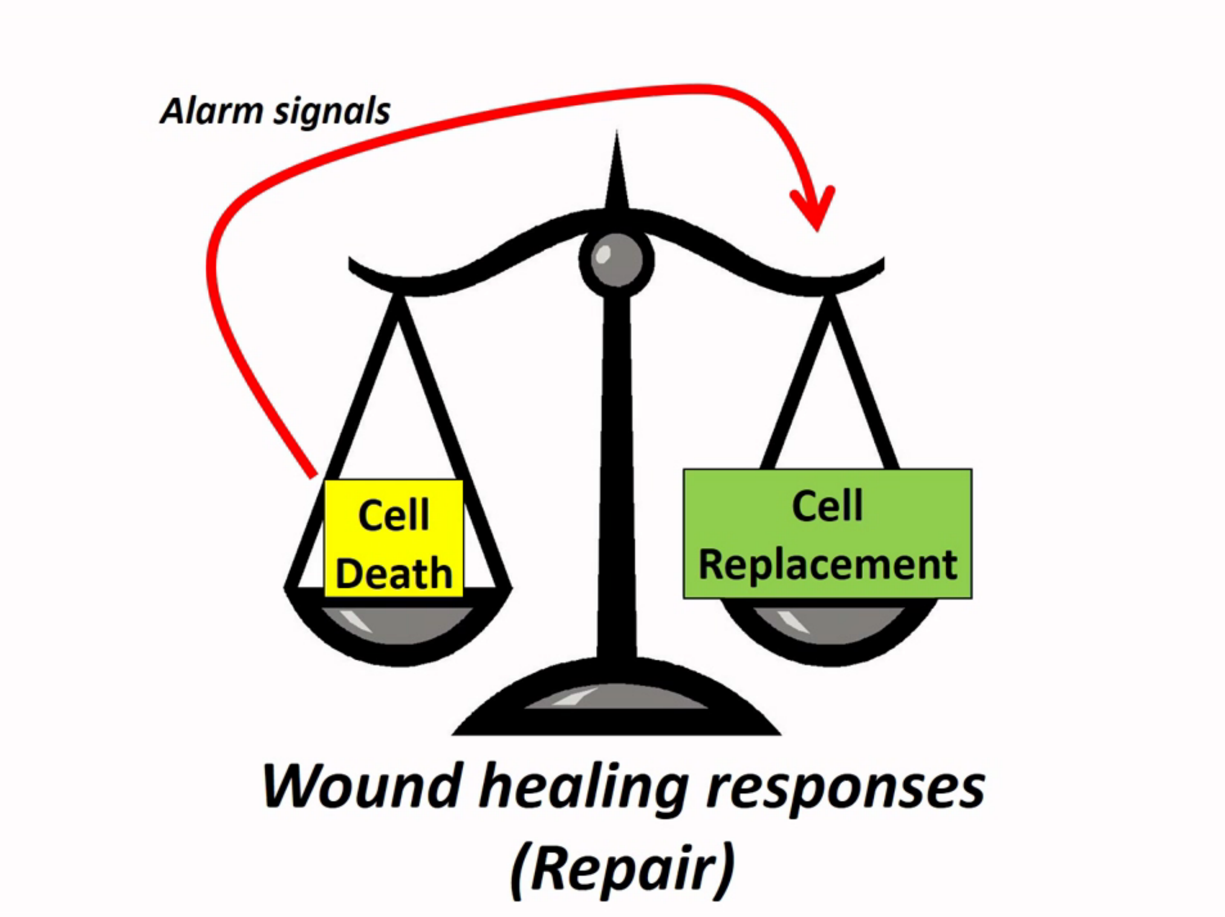

Slide 40
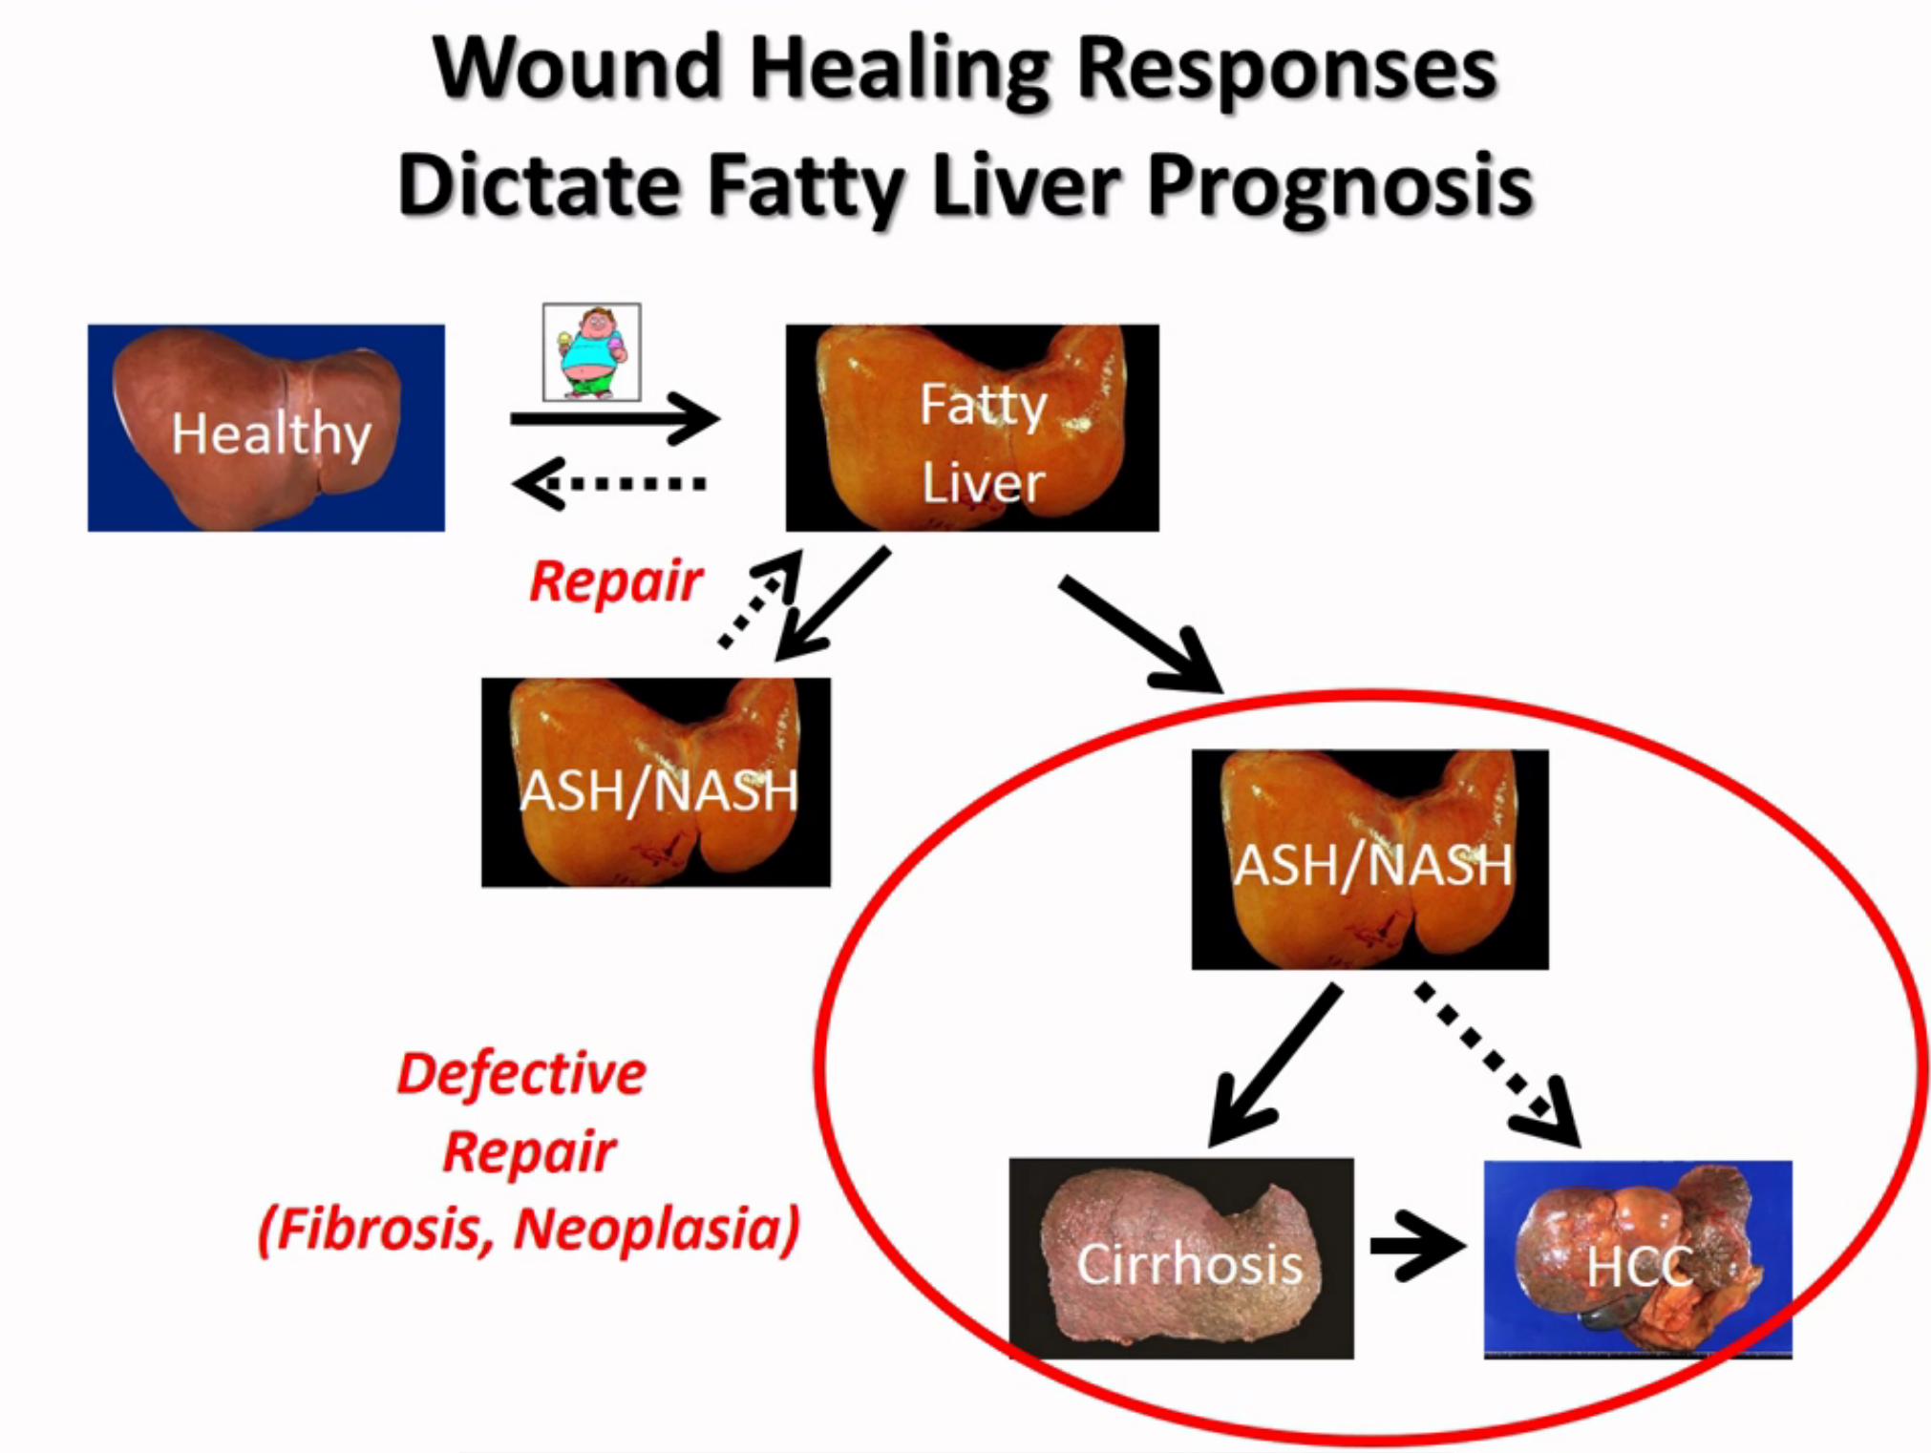

Slide 41
Prognosis
Decrease survival –more so with steatohepatitis than steatosis
Cause of Death in NASH Cardiovascular Cancer Cirrohsis

Slide 42
Take Home Messages
NAFLD = common, heterogeneous, ~10-15% patients develop life-threatening liver outcomes (cirrhosis, liver cancer)
Severity of liver fibrosis is ONLY independent predictor of bad liver outcomes in NAFLD
Only age & severity of cell death/inflammation predict fibrosis risk
Focus diagnostic efforts on identifying individuals at risk for fibrosis, detecting & staging fibrosis to determine prognosis & guide rx
Anti-fibrotic efficacies of currently available NAFLD treatments are not well-established
New anti-fibrotic approaches are coming
Microbiome might be a new diagnostic/therapeutic target because it conveys susceptibility to NASH, liver fibrosis, liver cancer in rodent models

