Slide 1
A Transplant Patient Was Just Admitted to My Hospital Service
Now What Do I Do?
Ray Thomason,MD

Slide 2
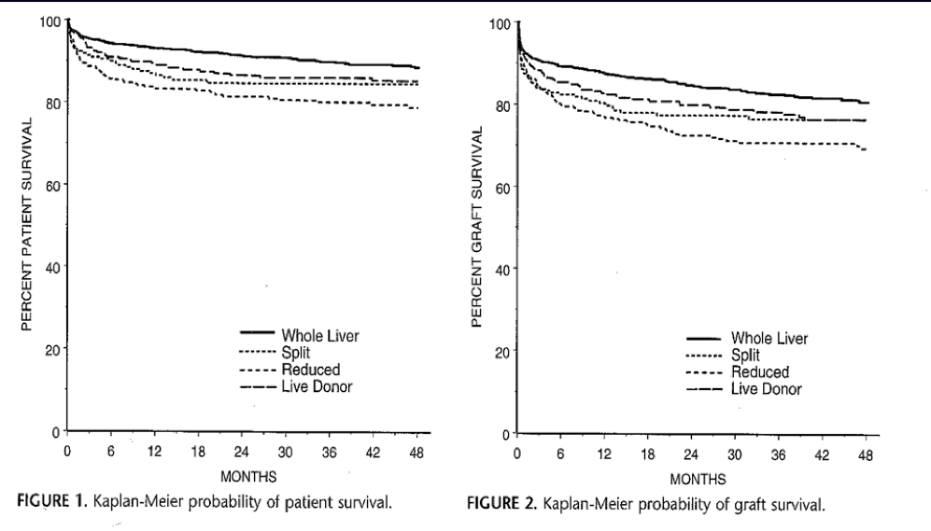
Survival Post Transplant-SRTR

Slide 3
Transplant is a Team Sport and The Patients are just People that get Common Diseases
Liver Transplantation Is a Team Sport made of of many Members
Team made up of the TX Center Providers and Staff- Surgeons, Hepatologists, Radiologist, Infectious Disease, Pathologists
Built on an Infrastructure- Nurse coordinators, Pharmacists, SW, Financial and Data specialists, and Administrators
Then finally the Glue: Hospitalist and the Community Providers
Remember Transplant Patients are just people that get Common Diseases a
Never Forget Basic Fundamentals

Slide 4
How to Think about These Pt:
1st and foremost : Knowledge of the Four Anastamosis and timeline of their complications
Immunosuppression: Unique Side Effects
The “Net State” of Immunosuppresion
Infection Timeline
The Post Transplant Timeline
Transplant Coordinator on 24/7

Slide 5
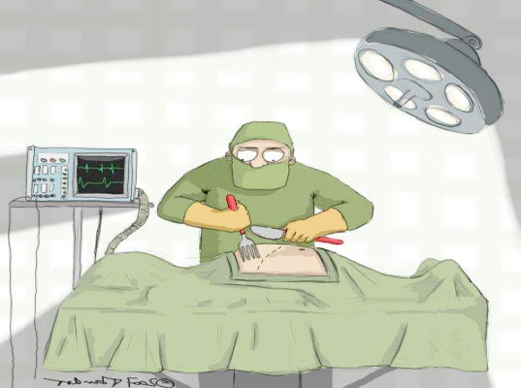
To Approach the Surgical Issues You must understand: “THE OPERATION”
Notes:
Once decide to move forward ----Then let the big run you must understand the operation

Slide 6
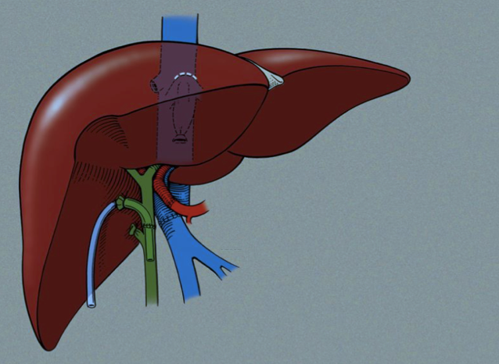
4 Anastamosis:
Hepatic Artery
Bile Ducts
Hepatic Vein and Portal Vein
Hepatic Artery
Portal Vein

Slide 7
Immunosuppresion:
Common agent with their unique Side effect profile
Net State of IS

Slide 8
Side Effects of Immunosuppressive Drugs
Calcineurin Inhibitors
Cyclosporin
Tacrolimus
Renal toxicity
Hypertension
Diabetes
Hyperlipidemia

Slide 9
Side Effects of Immunosuppressive Drugs
MTOR’s Rapamycin
Everolimus
Sirolimus
lABS: Hyperlipidemia - 80%
Cytopenia-Nuetropenia Pt Compliants Peripheral edema/Fluid Retention
Aphtous ulcers
Wound Healing
Cellcepi/Mycophenolate acid
GI side effects
Neutropenia
Campath
Profound lymphocyte and monocyte depletion, increased risk of infections

Slide 10
Corticosteroid Side Effects
Hypertension, edema
Diabetes mellitus
Hyperlipidemia
Osteoporosis
Altered mental status
Cataracts
Acne
Peptic ulcers
Infections - CMV, fungal

Slide 11
Timeline of Infection

Slide 12
Issues 1 yr Post Transplant
Malignancies-Skin, Colon, PDLT
Metabolic Syndrome
Hyperlipidemia: Statins are Great
Avoid ACE and ARB
DDI
Herbs/Supplements: Red Bull

