Slide 1
Wilson’s Disease
RAY THOMASON

Slide 2
Adult Inherited Liver Diseases

Slide 3
WILSON’S DISEASE
Notes:
ATP7B-causes not only the inability to excrete copper into the bile ductules but it also decreases the amount of ceruloplasm made

Slide 4
WILSON’S GENETICS
Notes:
ATPase – 2 functions
1-aid in biliary excretion of copper
2- aid in the synthesis of ceruloplasm
Absorb small bowel
Need 0.9 diet has 2-5 mg /day

Slide 5
WILSONS - PRESENTATIONS

Slide 6
Hepatic Features of Wilson disease
• Asymptomatic hepatomegaly
• Isolated splenomegaly
• Persistently elevated serum aminotransferase activity
(AST, ALT)
• Fatty liver
• Acute hepatitis
• Resembling autoimmune hepatitis
• Cirrhosis: compensated or decompensated
• Acute liver failure

Slide 7
Neurological Features in Patients with Wilson’s
• Movement disorders (tremor, involuntary
movements)
• Drooling, dysarthria
• Rigid dystonia
• Pseudobulbar palsy
• Dysautonomia
• Migraine headaches
• Insomnia
• Seizures

Slide 8
WD-NEUROLOGIC DISEASE

Slide 9
Psychiatric Features in Wilson’s
• Depression
• Neurotic behaviours
• Personality changes
• Psychosis

Slide 10
Other systems in Wilson’s
• Ocular: Kayser-Fleischer rings, sunflower cataracts
• Cutaneous: lunulae ceruleae
• Renal abnormalities: aminoaciduria and
nephrolithiasis
• Skeletal abnormalities: premature osteoporosis and
arthritis
• Cardiomyopathy, dysrhythmias
• Pancreatitis
• Hypoparathyroidism
• Menstrual irregularities; infertility, repeated
miscarriages

Slide 11
WD-DIAGNOSIS

Slide 12
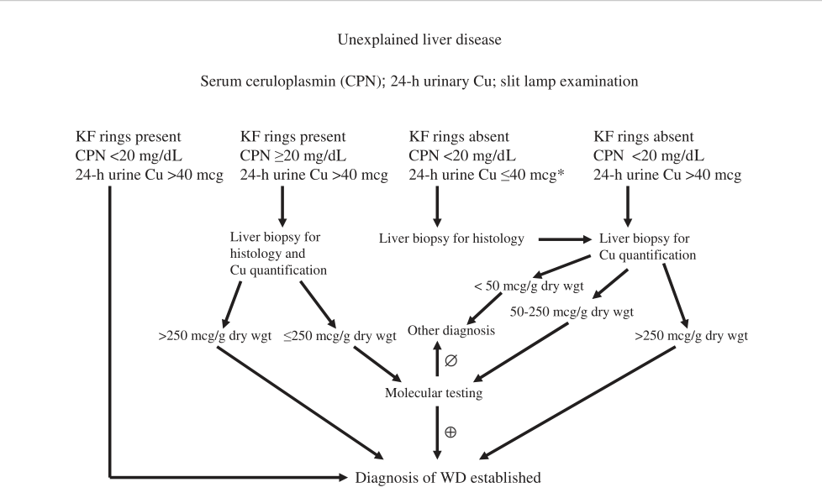
AASLD GUIDELINES FOR DIAGNOSIS

Slide 13
WD-DIAGNOSIS

Slide 14
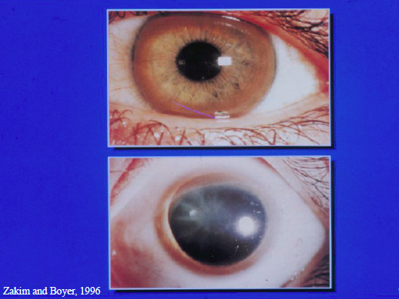

Slide 15
WD-LAB FEATURES

Slide 16
WD- LIVER BIOPSY

Slide 17
WD-HISTOLOGY

Slide 18
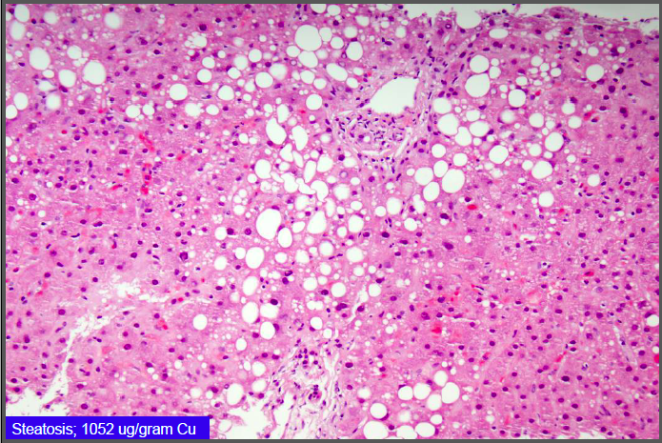

Slide 19
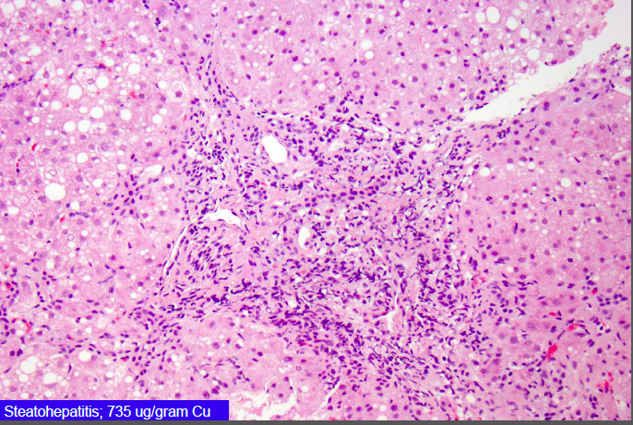

Slide 20
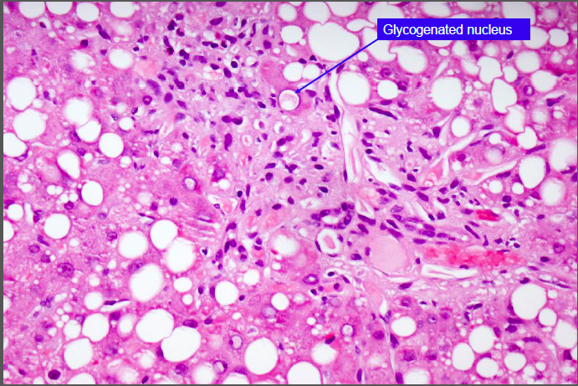

Slide 21
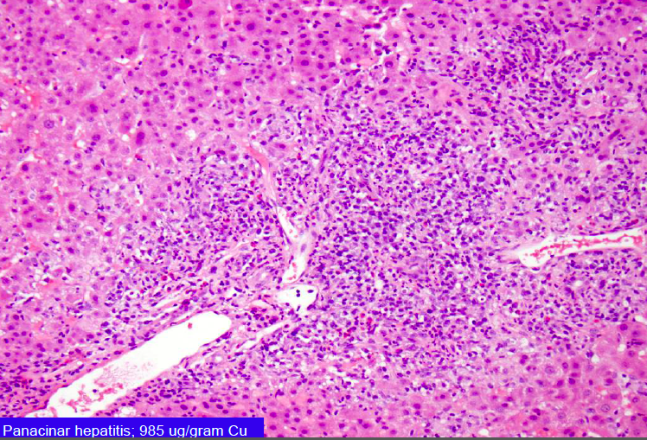

Slide 22
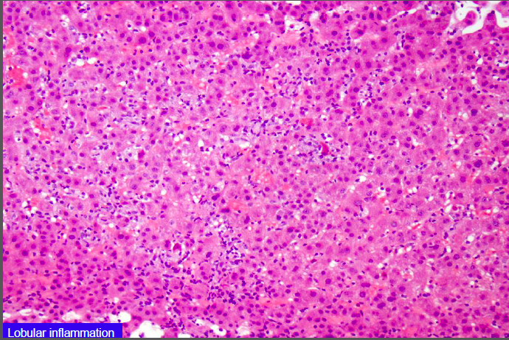

Slide 23
QUANITATIVE COPPER ANALYSIS

Slide 24
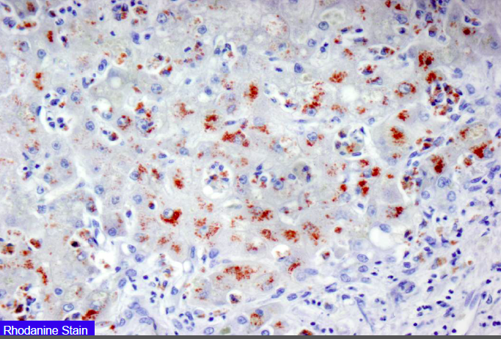

Slide 25
WD-Family Screen

Slide 26
WD-THERAPY
• Treatment is lifelong
• D-penicillamine
• “Decoppering” Agent
• Start 250-500 mg/d and increase to 1-2 g/d qid
• administer with pyridoxine
• 20% drug toxicity/neurologic deterioration
• Trientine
• same dose, similar efficacy
• fewer side effects
• Assess Rx response by following urine copper

Slide 27
WILSON’S DISEASE-THERAPY

Slide 28
WD-THERAPY-ZINC

