Slide 1
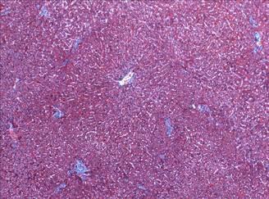
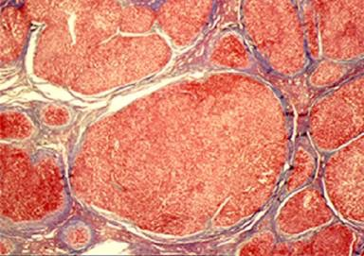
How to Improve the Survival of Your Hospitalized Cirrhotic Patients
Ray Thomason,M.D. No Financial Disclosures
Notes:
Good Afternoon-
I'm RT-senior Transplant hepatoligist
Thank Dr Wanner this opportunity
Share you
My Outreach program my Educational Mission Ive developed 3 years
Ive been giving around the western US rural hospitals
HOW To IMprove Survival Hosp decompemsated
Unfortunately No Financical Disclosures
SLOW

Slide 2
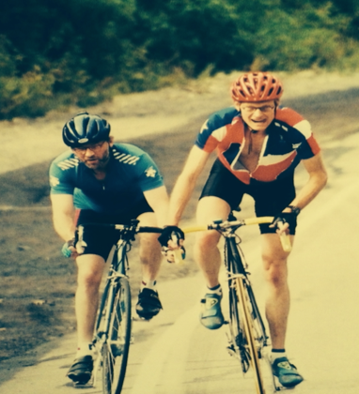

To Understand Why I Created this Talk
Must Understand My Journey
First Hospitalist in Preston Idaho
President of the State of Utah Emergency Physicians
ED/Trauma Physician Established Trauma and Instacare
Member of the First Liver Transplant Team in Utah
Best Friend had a Liver Transplant
Notes:
SLOW
But to Understand Why I'm Here and Why I Care Livers.
Know my Journey SLOW
Began
Preston Id ist Hospitalist -GRAN PRIX. then
ED physician First President of Utah Emerg Physicians
LDS-10 yr-helped develop a Trauma I and set up first instacares
Know what like dying pt 2 am cant get return calls ive been in your shoes
1986 Honor/Privil-Utah's first LTx Team at LDS Hosp
2002 Ironically best friend TDB- Father LT 26# vascular
Picture Important -10 months poat tx
2012- Opportun 2 return to the UU and joined our new LTx team Which Leads us into the Origin Talk n
Lessons Learned from the Transfer Call Center

Slide 3
Historical Team Sport Perspective
Dallas Cowboys and UUMC Transplant Team
Dallas Cowboys
UU Liver Transplant Team
1989 - Won 1/ Lost 15
1992 - Won Super Bowl
2011- Ranked 140th
2013- Ranked 3rd
2014- Ranked 2nd
^{Since 2014-often Ranked 1st}
Survival results out of
140 programs
Notes:
Need Perspective

Slide 4
So How Did We Make The Change?
Liver Transplantation Is a Team Sport
Team that had depth in every position
Basic Fundamentals
Team made up of the best Physicians
Surgeons, Hepatologists, Hospitalists, Radiologist,
Infectious Disease, Pathologists
Equally Importantly- Infrastructure-the glue
Nurse coordinators, Pharmacists, SW, Financial and Data specialists, and Administrators

Slide 5
Transfer Call Center Lessons
New Partners Caring for ESLD: Hospitalist
Non-Gastroenterologist Not Trained in Liver Disease or Liver Transplantation
New Mission: Teach Basic Fundamentals of Liver Disease
From identification of Liver disease to the development and prevention of Cirrhosis
Bring Clarity to Confusion about Transplantation
Listing Criteria -Who When How does MELD
Alcohol, Cancer, Age
How to initiate Listing Evaluation
Living donor
Willing Family Members

Slide 6
Objective: To Improve Survival Hospitalized Decompensated Cirrhotic
Basic Fundamentals
-Review the Natural History of liver disease
-The Definition Cirrhosis-compensated vs decompensate
-The Anatomy and Pathophysiology of Cirrhosis and Portal Hypertension
Understand the Timeline of
Compensated vs. Decompensated Cirrhosis
Review the Evidence Based Strategies
to Improve the Survival of Decompensated Cirrhotics
created by AASLD PG
Eliminate Confusion regarding the Transplant Process
with cases and questions
Notes:
by using Standardized Care Model Endorsed in the PG AASLD that we employee at the UUMC
Pathophysiology
Timeline Of Compensated v Decompensated Cirrhosis
Approach to Different Components of Decompensation Data Based

Slide 7
Cirrhosis: A Definition
Fifth Leading Cause - Adult Deaths
Cirrhosis - Abnormal Architecture - 2nd Deforming Fibrosis
Hepatocytes, Biliary Tree, and Vascular System
Measurable Manifestation ->Portal Hypertension (HVPG)
What is most important lab to predict cirrhosis ???
Platlet Count: < 150k Think Potential Compensated Cirrhosis
<100k Think Cirrhosis with PortalHypertension

Slide 8
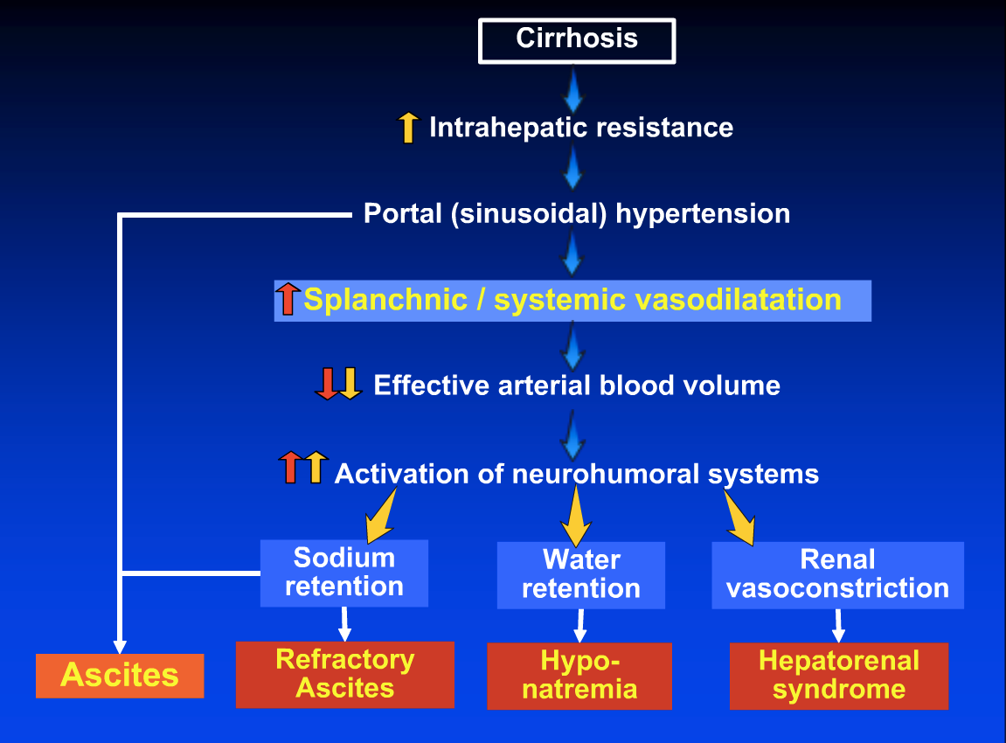
  Courtesy of Guadalupe Garcia-Tsao
Notes:
Cirrhosis is an architectural deformed organ particularly the delicate vascular system
Portal Blood can’t easily flow in
Causes a back pressure in the portal system
MONEY AND IT IS the COMPENSATORY MECHANISM that cause all the sx of decomp
Pathogenesis of ascites and related complications of cirrhosis. The central event consists of
effective arterial underfilling as a result of splanchnic vasodilation leading to activation of vasoconstrictor
(e.g., renin-angiotensin) and antidiuretic (e.g., arginine vasopressin) factors. Portal hypertension leading
to increased sinusoidal hydrostatic pressure and increased gut permeability allowing bacterial
translocation, contributing further to the pathogenesis of complications associated with ascites, including
hyponatremia, acute kidney injury, and hepatorenal syndrome and spontaneous bacterial infections

Slide 9
Natural History–Chronic Liver Disease
Two Main Prognostic Stages
Based on Clinical Complications
Chronic Liver -> Disease
Compensated ->
cirrhosis
Decompensated ->
cirrhosis
Death
Development of complications:
Variceal hemorrhage
Ascites
Encephalopathy
Jaundice
Notes:
But what is important is The natural hx is defined by the Timeline of 2 main prognostic stages of Cirrhosis defined by the presence or absence of these complications
we go from compensated cirrhosis completely ASX to the development of symptomatic complications
ascites jaundice variceal bleed encephalopathy-define decompensated cirrhosis

Slide 10
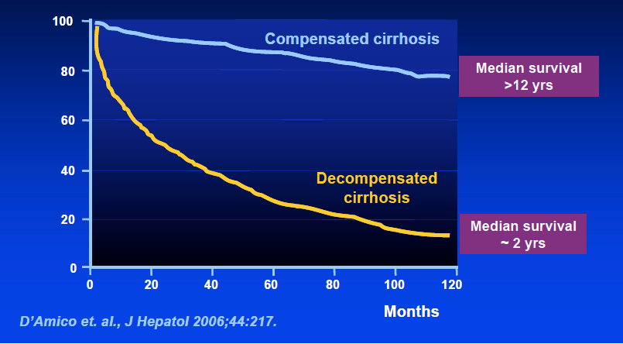
What is Median Survival:
Compensation vs Decompensation ?
Notes:
NOW MONEY SLIDE-
#1WHAT MEDIAN SURVIVAL
If compensated-12 yr
if decomp-HRS 2 weeks or 18 months
#2 If compensated is ASX How predict ???
SIMPLE PLATELET COUNT 150, 000 < 100,000
OK so its 2 am do you think get simple comp cirrh

Slide 11
Approach and Strategies
1st-R/O Precipitating Causes
Portal Vein Thrombosis
Infection
DILI-herbs supplements
(www.livertox.nih.gov)
Acute Viral Hepatitis: ex. outbreak Hep A
2nd-Use evidence-based data to treat the underlying disease and
and the decompensating events
Stop offending agent and ongoing Inflammation/Injury
Treat Ascites, Variceal Hemorrhage, HE with AASLD PG
3rd- Finally must answer only one question->
Is the patient a Transplant or Comfort Care patient
4th- Call any Transplant Hepatologist and Transplant Program
Investigate treatment options and possible transplantation
Notes:
After simple hx px imaging cultures
Turn tothe underlying chronic dz

Slide 12
Strategies for Ascites
Diagnostic Paracentesis:
SAAG for the correct diagnosis
Cell Count-SBP
Low Salt Diet - Diuretics
Antibiotics- For SBP
- For Prophylaxis
GI Bleed
Low Protein Ascites
Recurrent infections
Albumin- SBP-prevents renal insufficiency-death
-with paracentesis: 8 gm/liter
-with diuretics difficult -50 grams weekly
TIPS- when all else fails

Slide 13
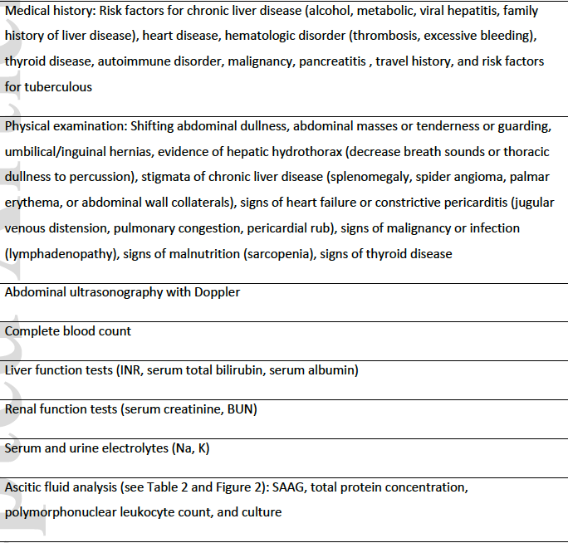
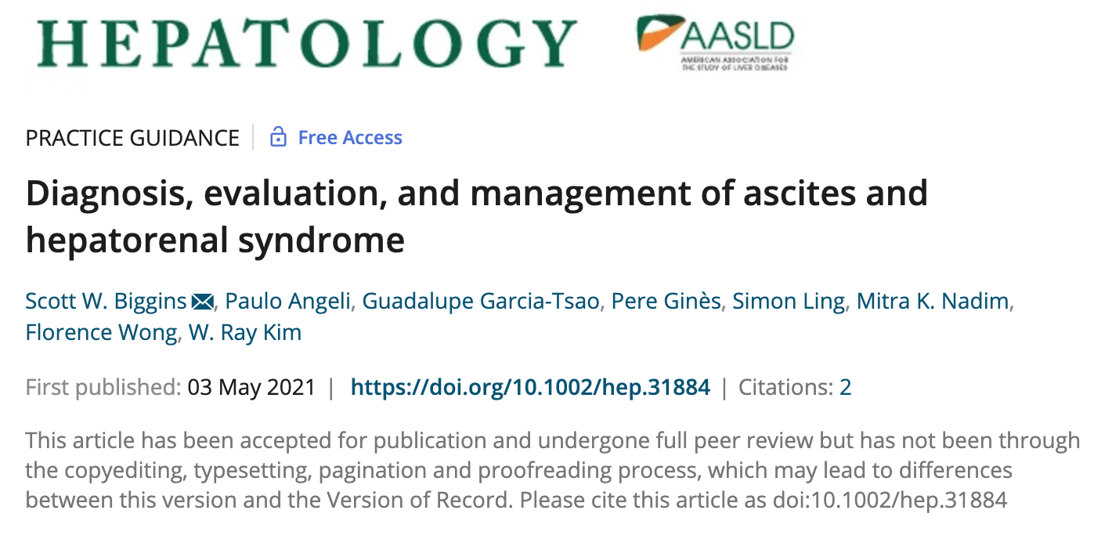
Initial evaluation of patients with ascites
Released 7/12/21
Released 7/16/21

Slide 14
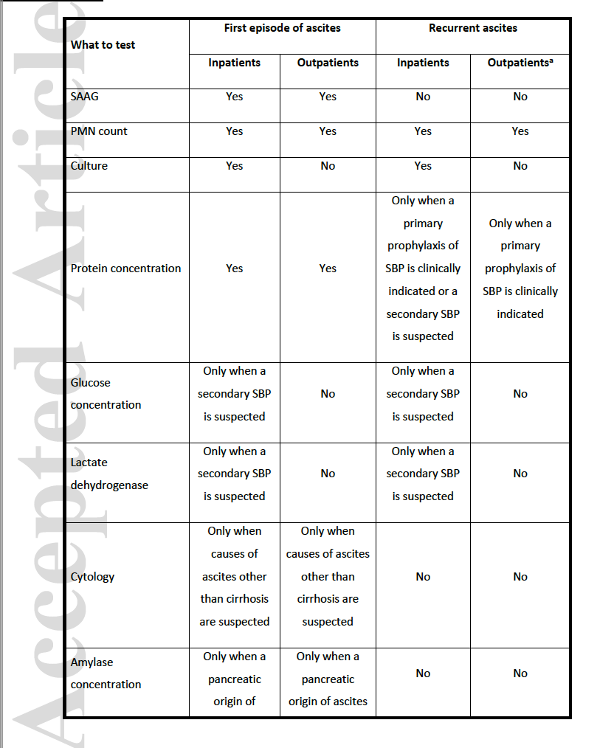
Guidance to diagnostic paracentesis in patients with cirrhosis

Slide 15
Dif Dx of Ascites use the SAAG Table
 | SAAG >1.1 | SAAG <1.1
Total Protein <2.5 | Cirrhosis-85% Acute Liver Failure | Nephrotic Syndrome Myxedema
Total Protein >2.5 | CHF Constrictive Pericarditis Budd-Chiari Syndrome Venocclusive Disease | Peritoneal Carcinomatosis Tuberculosis peritonitis Pancreatic Ascites Chylous Ascites
Notes:
15% not Hepatic

Slide 16
May 2021 Guidance: Ascites-R/O SBP
Patients with ascites due to cirrhosis emergently admitted to the hospital should undergo a
diagnostic abdominal paracentesis to rule out SBP even in the absence of symptoms/signs of
infection.
The ascitic fluid should be cultured at the bedside in aerobic and anaerobic blood culture
bottles before initiation of antibiotics.
The diagnosis of SBP/SBE is established with a fluid Polymorphonuclear (PMN) leukocyte count >250/mm
AASLD PG May 2021

Slide 17
Guidance Recommendations for SBP
IV antibiotics - start empirically in all patients with an ascites/pleural fluid PMNMcount >250/mm
First-line empirical antibiotic therapy for community-acquired SBP/SBE is IV third-generation
cephalosporin.
In patients with a health care-associated or nosocomial infection or recent exposure to broadspectrum
antibiotics or who are admitted with sepsis or septic shock, empirical therapy with
broad-spectrum antibiotics should be initiated as the first line.
Response to empirical antibiotic therapy may be assessed by repeating diagnostic
paracentesis/thoracentesis 2 days after initiation. A decrease in fluid PMN <25% from baseline
indicates lack of response and should lead to broadening of antibiotic coverage and further
evaluation to rule out secondary bacterial peritonitis.
Treat with IV albumin in addition to antibiotics (1.5 g/kg at day 1 and 1 g/kg at day 3).
NSBBs should be temporarily held in patients with SBP who develop hypotension (mean arterial
pressure <65 mmHg) or AKI.

Slide 18
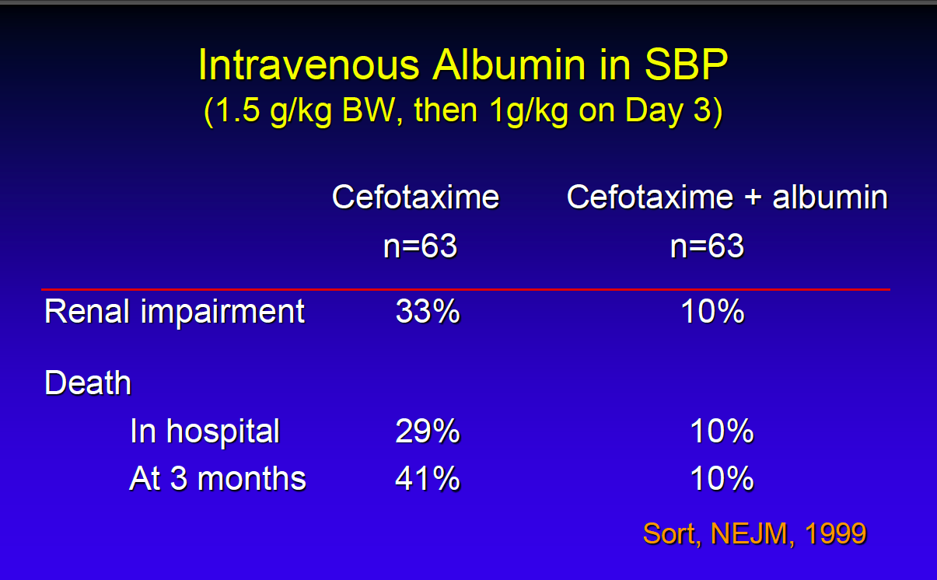
Albumin Improves Renal Dysfunction and Short Term Survival in SBP

Slide 19
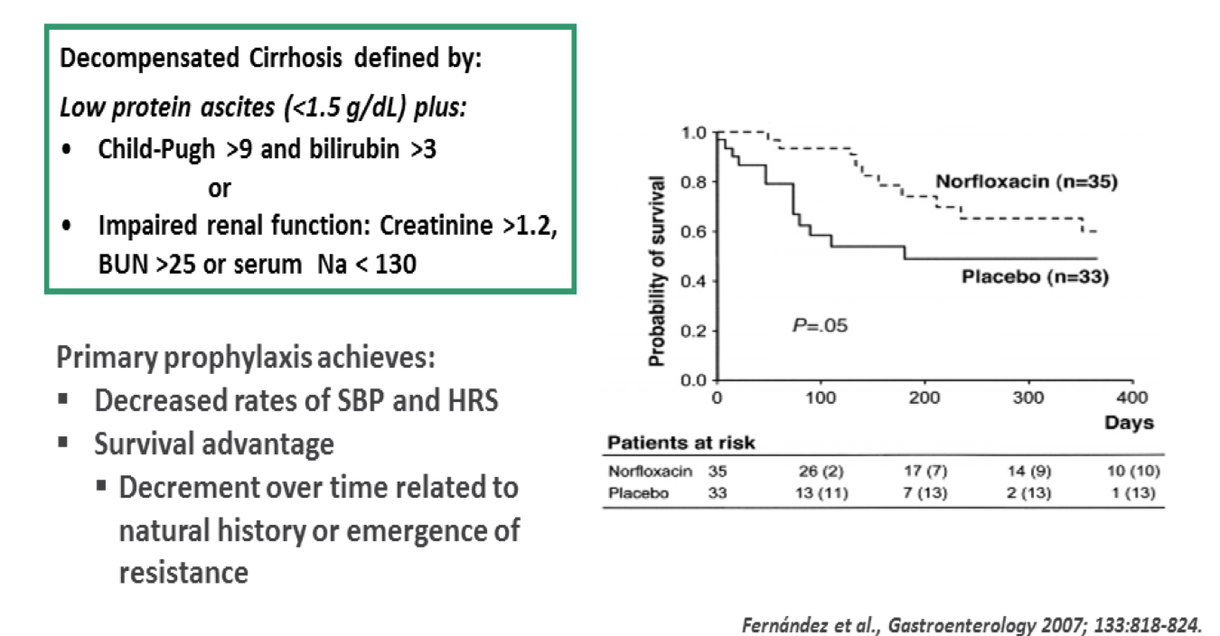
Primary Antibiotic Prophylaxis in Decompensated Cirrhosis Is Beneficial

Slide 20
Diuretics
Grade 1 Ascites-Dx - imaging
Low Salt Diet-2 Gm
Spironolactone 100mg/day
Grade 2 –Dx - Physical exam
Low Salt Diet
Dual- loop diuretic and spironolactone :40/100-once daily
Grade 3- Dx – ascites never resolves
Diuretic resistant or Refractory
1st-LVP
2nd TIPS
3rd Transplant

Slide 21
Guidance Statements: Hyponatremia
Mild hyponatremia (Na 126-135 mEq/L) without symptoms
No specific management apart from monitoring and possible water restriction.
Moderate hyponatremia (120-125 mEq/L)
Water restriction up to 1,000 mL/day and cessation of diuretics
Severe hyponatremia (<120 mEq/L)
more severe restriction of water intake with albumin infusion
Vaptans -vasopressin receptor antagonists can raise serum sodium –only 30 days
Hypertonic saline -short-term treatment of symptomatic or severe hyponatremia patients or those with imminent LT.
When correction of chronic hyponatremia is indicated
Slow speed of correction to prevent central pontine myelinosis/PRESS
AASLD PG 5/2021

Slide 22
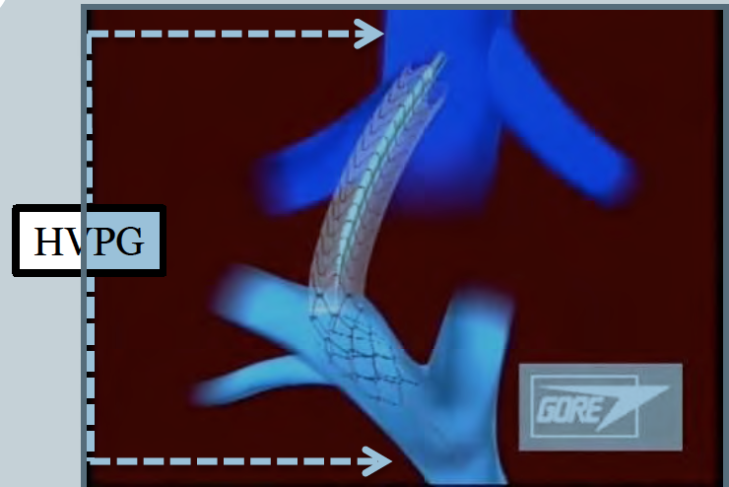
T I P S: Refractory Ascites and Variceal Bleed
HVPG: measure of PHTN
HV-PV gradient:
3-5 mm Hg.: normal
>10 mm Hg.:PHTN-EV Bleed

Slide 23
Contra-Indications of TIPS
CPT>11, Bili >7, MELD >18
Age > 60
Severe Renal Failure: creatinine > 3.0
Heart Failure
Pulmonary Hypertension
PA >35 mmHg
Recurrent Persistent Uncontrolled Encephalopathy

Slide 24
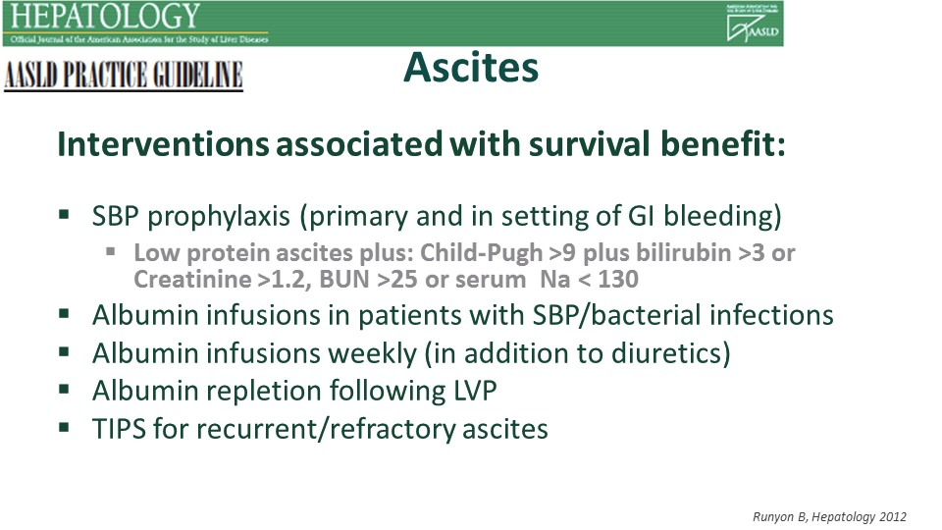
Notes:
Antibx and ascites
Albumin sbp-prevent HRS
Albumin to enhance diuretic tx
Albumin repletion following LVP
TIPS-SOC

Slide 25
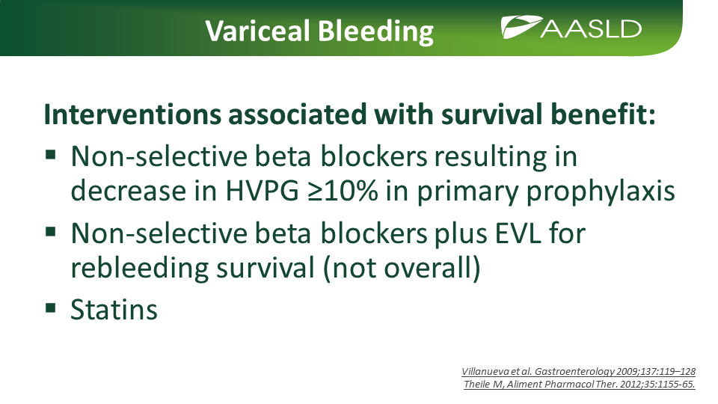

Slide 26
NSBB: The Sweet Spot-Goldilocks
Too early: No benefit
Advanced Disease with Increased Mortality
-Hypotension(SAP<100 mmHg)
-C.I. < 1.5
-Refractory Ascites
-SBP
-Pulmonary Hypertension
Moderate decompensation: Proven benefit

Slide 27
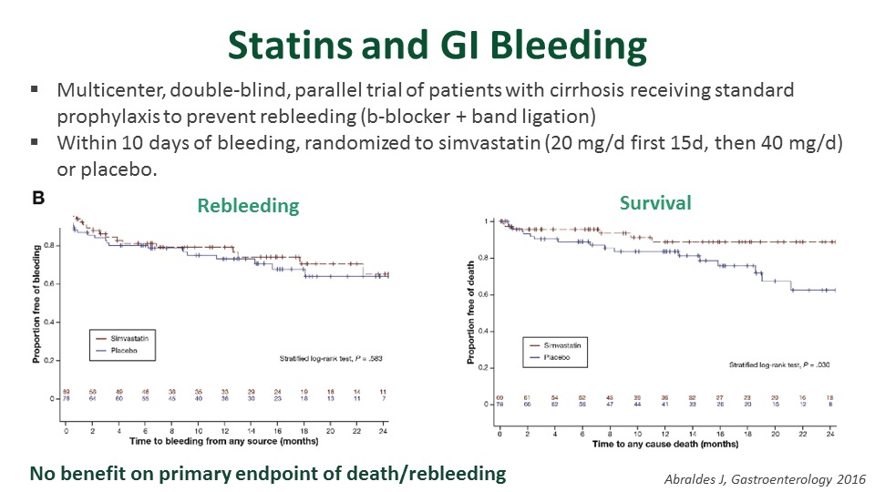
Notes:
ABRALDES 2016
NOEFFECT REBLEED BUT IMPROVE SURVIVAL
BBlock+Banding day 10 simvastatins

Slide 28
Statins: Highlights
Statins:
-decrease hepatic fibrogenesis,
-improve intrahepatic endothelial remodel
-improve liver perfusion and function
Statin users in HCV Cirrhosis:
-had lower incidence of decompensation
(i.e. ascites and VH)
Statins-lower mortality

Slide 29
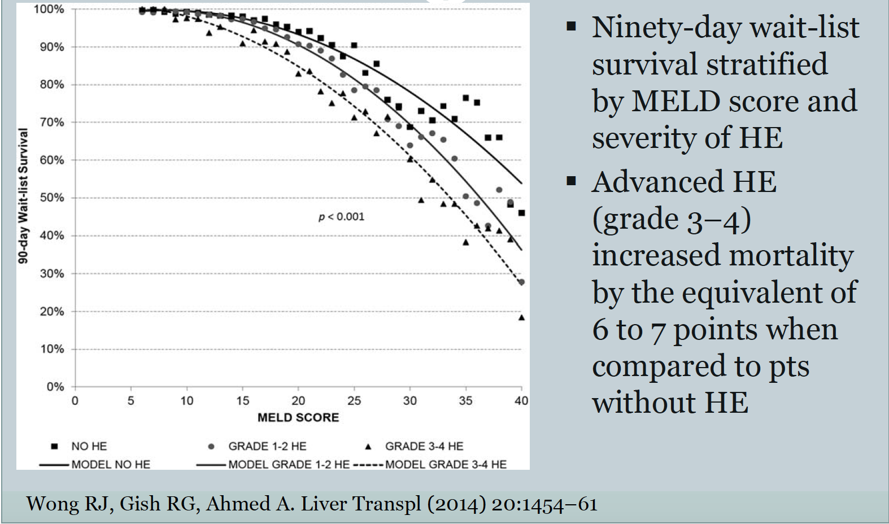
Impact of Encephalopathy
30 day readmission rate:40%
Notes:
Turn to the one of the most frustrating sx to tx HE
Wong Gish Ahmed 2014 advanced HE-equivalent to adding 6-7 MELD points to pts no HE

Slide 30
Strategies for Encephalopathy
Lactulose: 3 BM
Rifaximin: Begin in Hospital-$$ saving
HOB 30%
Don’t Allow to Feed Self: Aspiration
Avoid Narcotics/Sleepers
Treat Infection/Electrolyte Imbalance
Discharge: 40% Re-Admissions in 30 days
Care-Giver Education

Slide 31

When Order Serum Ammonia?
Focus on the Image, Relax, and Listen
NEVER ORDER SERUM AMMONIA
Unless patient in a coma and your diagnosis is unsure
Notes:
I would like every ones attention and to focus on the next slide

Slide 32
Renal Complications of Cirrhosis
AKI
HRS
Dx-
Mortality Implications
Albumin
Dx- Creatinine rise 0.3 –in 48 hours
Stop diuretics
Albumin 1 mg/Kg x 2 days
Terlipressin still FDA not approved
Vasoactive Midodrin and Octreotide

Slide 33
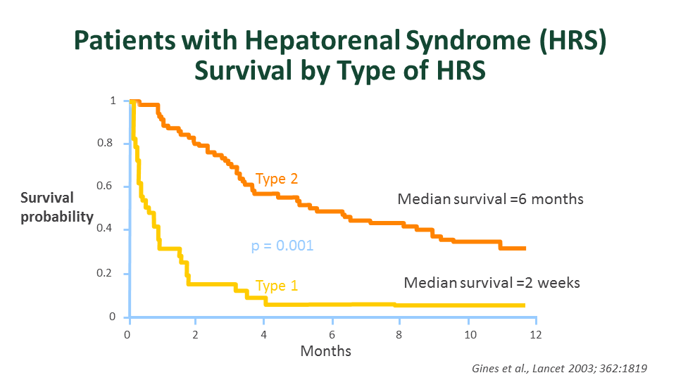
Notes:
Turn to Renal failure-
Type 1: 2 week median survival
Type 2: fact of life/liver failure

Slide 34
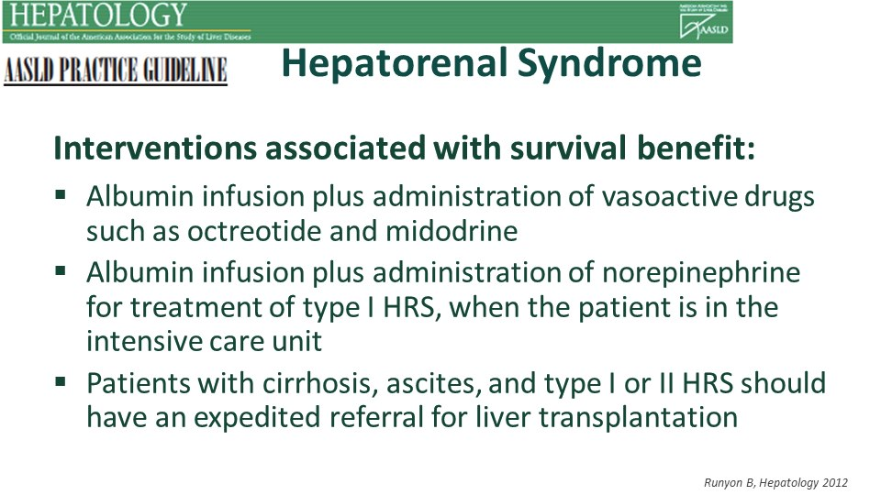
Notes:
Albumin + Vasoactive-octreotide and midodrine
Alb + norepi Type 1 –ICU
Referral Tx

Slide 35
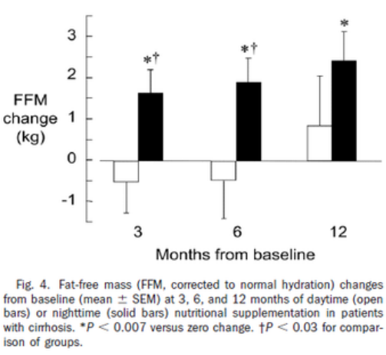
FRALITY:
Timing of Protein Supplement to Prevent Muscle Breakdown

Slide 36
Evidence Based Strategies to Improve Survival
Determine cause of Decompensation
PVT, Infection, DILI, Acute Viral Hepatitis
Treat Underlying Causes
Ascites: Marker of Progression
type, cause, infected
Refractory Ascites: TIPS
SBP Prophylaxis

Slide 37
Strategies to Improve Survival
Variceal Bleed: Bblockers- Banding- TIPS- Antibiotics
HRS: Prevent Renal Injury-
Avoid NSAID and IV Contrast
Maintain BP>90
Beta Blockers: Double Edge

Slide 38
Strategies to Improve Survival
Statins should not be avoided
Frailty/Sarcopenia-bed time protein supplement-prevent muscle breakdown
Never Order a Serum Ammonia
Educate Caregivers on treating Encephalopathy

Slide 39
Strategies to Improve Survival
Once Decompensate call a Transplant Hepatologist
We can work together to determine your patients options
Refer Early for Higher Level of Care and Transplant Consideration
You are not Alone

Slide 40
Listing Criteria
Funding
Caregivers 24/7
No Diseases: That impair surgery/recovery
i.e. Cancer, Pulmonary or Cardiac Disease
No lifestyles issues: jeopardize the gift of life
Complete compliance with your medical team

Slide 41
What We Need from You/Case Manager:
MELDNa
ABO Blood Group
Funding Documentation
If Significant Alcohol or Drug History:
ETGs, Relapse/Rehab Programs/AA
Drug Screens

Slide 42
Resources:
www.AASLD.org/PracticeGuidelines
Livertox.NIH.gov
optn.transplant.hrsa.gov/resources/allocation-calculators/meld-calculator/
https://physicians.utah.edu/transplant/refer-patient/index.php
University Hospital: Call 801-581-2121
Ask for :Transfer Call Center
Transplant Hepatologist

Slide 43
Confusion about Transplant Candidates
When refer- is there a MELD
Age
Alcohol
Cancer
BMI
Too Sick
Coffee
Milk thistle

Slide 44
End with 3 thoughts: On patients, friendship, and what it means to be a Liver Physician
Every Patient You Meet Will Have A Liver
When You Loose Your Liver You Loose a Friend
Paraphrase Supreme Court Justice Ronald E. Nehring retirement speech: You are given the Power to be Gracious, Kind, and Compassionate

Slide 45
QUESTIONS TEXT ME
Ray Thomason,MD
801-556-1228
THANK YOU

