Slide 1
Surgical Risk in Cirrhosis
About 10% of patients with cirrhosis require surgery within the last 2 years of life
Propst et al. Dig Dis Sci 1995;40:1805–15

Slide 2
Avoiding Pitfalls: Beware of Surgery

Slide 3
Surgical Mortality with Cirrhosis: CPT score
Risk of death after surgery
Class A = 10%
Class B = 30%
Class C= 76–82%
Garrison et al. Ann Surg 1984; 199:648-655
Mansour et al. Surgery 1997; 122:730-735

Slide 4
MELD and Surgical Mortality
772 patients undergoing surgery at Mayo
Excluded laparoscopic cholecystectomy
Two study populations
1980–1990 = 426
1994–2004 = 346
Type of surgery
Digestive (n=586)
Orthopedic (n=107)
Cardiovascular (n=79)
Patients typically had platelet >60,000 and INR <1.5
Controls
Ambulatory cirrhotics (n=582)
Patients undergoing minor surgery (n=303)
Teh et al. Gastro 2007;132:1261–1269

Slide 5
MELD and Surgical Mortality
 | Mortality, % (number of patients at risk)
MELD Score | 7 Days | 30 Days | 90 Days | 1 Year
0-7 (n=351) | 1.9 (314) | 5.7 (301) | 9.7 (287) | 19.2 (253)
8-11 (n=257) | 3.3 (236) | 10.3 (219) | 17.7 (200) | 28.9 (170)
12-15 (n=106) | 7.7 (94) | 25.4 (78) | 32.3 (69) | 45.0 (56)
16-20 (n=35) | 14.6 (29) | 44.0 (19) | 55.8 (15) | 70.5 (10)
21-25 (n=13) | 23.0 (7) | 53.8 (4) | 66.7 (3) | 84.6 (2)
>25 (n=10) | 30.0 (6) | 90.0 (1) | 90.0 (1) | 100 (0)
Teh et al. Gastro 2007;132:1261–1269

Slide 6
MELD and Surgical Mortality Univariate Analysis
MELD was the most important variable – a single point increase over MELD 8 was associated with:
14% increase in mortality in the first 30 & 90 days
15% increase in mortality in the first year
6% increase in mortality for subsequent years
Teh et al. Gaastro 2007;132:1261–1269

Slide 7
American Society of Anesthesiologists’ (ASA) Classification of Physical Health
Patient is a completely healthy fit patient
Patient has mild systemic disease
Patient has severe systemic disease that is not incapacitating
Patient has incapacitating disease that is a constant threat to life
A moribund patient who is not expected to live 24 hour with or without surgery

Slide 8
Listen to your Anesthesiologist
ASA class for patients in the major surgery group
II (n=67) – cirrhosis usually Dx at surgery
III (n=563)
IV (n=132)
V (n=10) – all emergency procedures
The best predictor of 7 day mortality
Median survival for class V was 2 days
Mean MELD = 21
Excluded from analysis of other risk factors
Teh et al. Gastro 2007;132:1261–1269

Slide 9
MELD and Post-operative Mortality Multivariable Analysis MELD, Age, ASA Class
Age
No patient < 30 died within 90 days postoperatively
Age > 70 – equivalent to 3 MELD points
Male sex → increased mortality during the first year
Emergency surgery
Not an independent predictor of mortality
The only independent predictor of length of stay
ASA class IV – equivalent to 5.5 MELD points
Teh et al. Gastro 2007;132:1261–1269

Slide 10
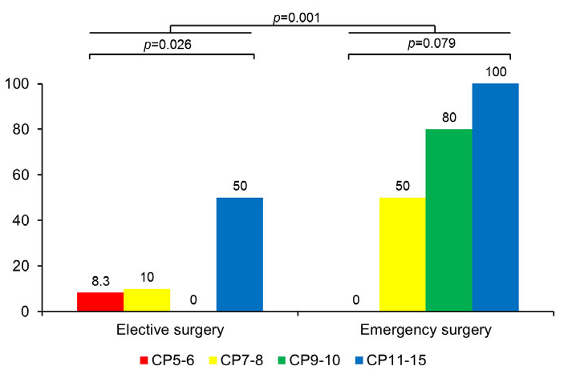
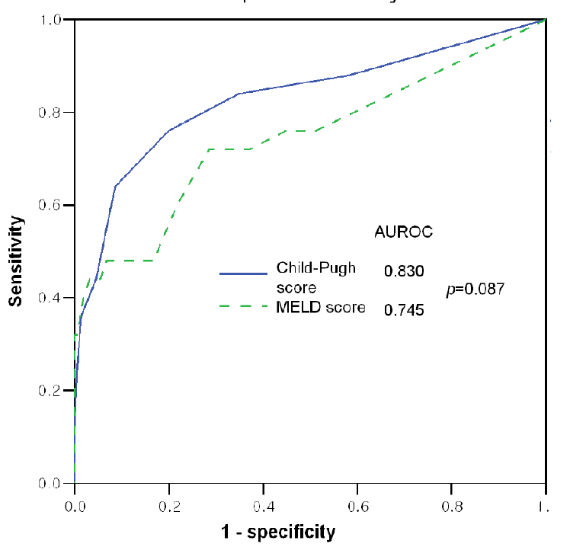
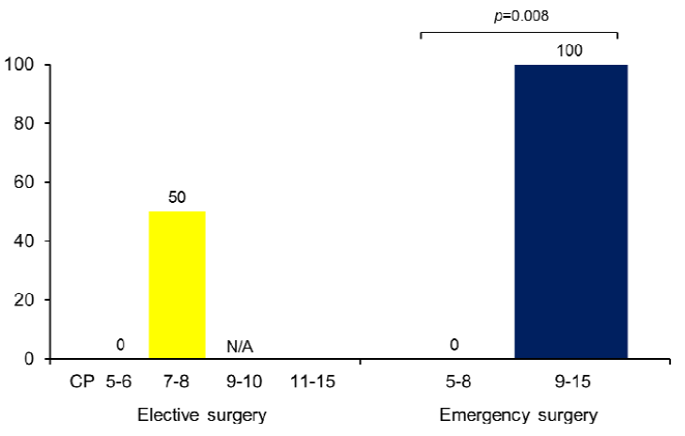
Child-Turcotte-Pugh Score and Surgical Risk Mortality
Post-op Mortality
Kim et al. Liver International 2014 [epub]

Slide 11
Approach to Liver Disease – Elevated LIT
History and Physical
Labs: Viral –Hep A,B, C Autoimmune- AIH, PBC, AIC Metabolic-Iron, Copper NAFLD - Lipids Synthetic Function-INR, TB, Albumin Platlet Count
Determine if Advanced Fibrosis Indirect Method-APRI Direct Imaging-Fibroscan

