Slide 1
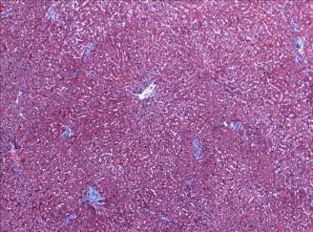
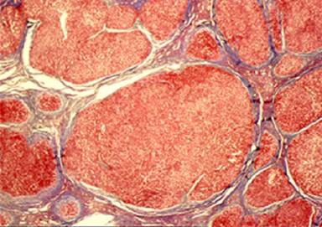
Cirrhosis in 2018: Updates
Cirrhosis
Ray Thomason, MD
Assistant Professor of Medicine
Division of Gastroenterology and Hepatology
University of Utah School of Medicine
February 24 2018

Slide 2
Cirrhosis
Cirrhosis is an abnormal hepatic architecture deformity
Portal Hypertension is the measurable manifestation of cirrhosis
Fifth-leading cause of adult deaths
Eighth in economic cost among the major illnesses
Garcia-Tsao, G. et al. Hepatology 2017 65: 310–335

Slide 3
Baveno VI (April 10-11, 2015): Stratifying risk and individualizing care for portal hypertension
Roberto de Franchis. J Hep(2015); 63:743-752

Slide 4
Updates in Cirrhosis Portal Hypertension
Notes:
Baveno VI was shortly followed by AASLD PG giving us

Slide 5
Salt Lake City IV (Feb 21-22 2015) Jimmy Buffet Margaritville Consensus Group Risk Stratification and Management of Male Ownership Issues
1-We don’t know the reason we stayed here all season
2-Some people claim there is a woman to blame but we know… it’s nobodys fault or our own damn fault, or Buddy Sussman’s fault
3-Where is Margaritivlle?
Notes:
Many will say these updates really began in Italy at the Baveno Beg to differ Group of internationally renowned Hepatologist came together for a special weekend to tackle the heady controversies in Jimmy Buffetts Margaritiville_ie why we did we stay all season with nothing to show but this new tattoo albeit it’s a real beauty a Mexican cutie
And whose fault is it
Tackled really heady questions
I thinke we threw down the gauntlet –really raising the bar for Baveno to follow

Slide 6
Objective: Update and Apply our current understanding of PH
Updates-specifically related work on PH Baveno VI Conference – 4/2015 AASLD PG PHTN – 10/2016
Risk stratification of Portal Hypertension
Measurements of PH
Pathophysiology Cirrhosis
Natural History of Cirrhosis
Clinical Case: Apply current Guidance Endoscopy Use of B-Blockers: VH Use of B-Blockers: Ascites Role for Early TIPS Albumin
Notes:
based on current Literature and PG

Slide 7
Portal Hypertension Risk Stratification based on HVPG
HVPG (mm Hg)
Clinical Manifestations
3-5 Normal
5-10 Mild PH
10 CSPH
>12 EV Bleed
> 20 Rebleed or CPT class C

Slide 8
Pathophysiology of Cirrhosis
Notes:
Decompensated cirrhosis is about the Consequences of increase intrahepatic resistance is Portal Hypertension

Slide 9
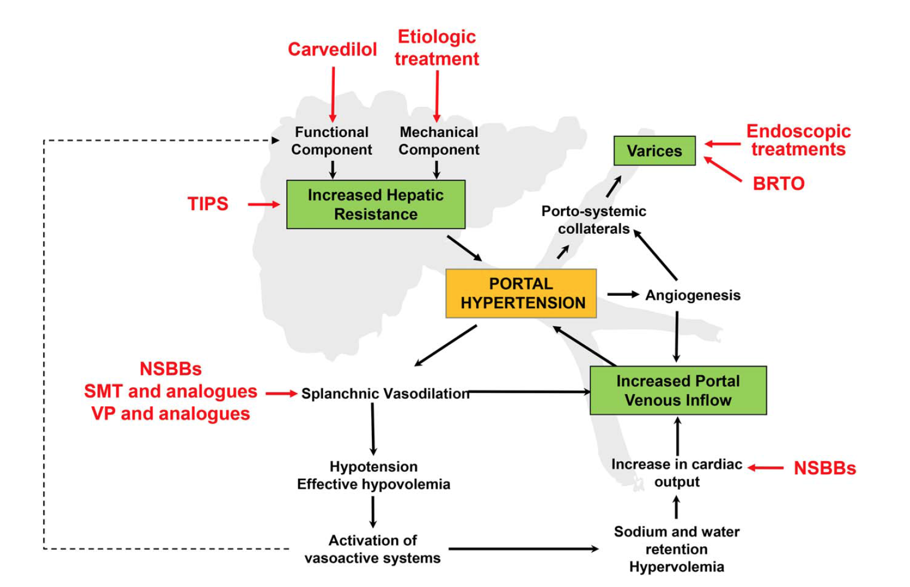
Notes:
Important to remember hepatic resistance:70% mechanical-ie fibrous bands and micr/macro nodules 30% vascular tone

Slide 10
Natural History –Chronic Liver Disease
Two main prognostic stages: based on clinical complications
Chronic
liver
disease
Compensated
cirrhosis
Decompensated
cirrhosis
Death
Development of complications:
Variceal hemorrhage
Ascites
Encephalopathy
Jaundice
Notes:
Involves around two main Prognostic stages based on clinical complications The defining characteristic separating the 2 entities is asx vs sx as defined by the Degree of portal HTN and clinical complications of ascites, VH, encephalopathy and jaundice

Slide 11
Survival: Compensated vs Decompensated
Notes:
2 prognostic types of cirrhosis
How predict---Important –simple platelet count consultants surgeons –ok 150, 000 < 100,000

Slide 12
Natural History Update: CSPH
Late de-compensation: foreshadows impending death
>12 years median survival
18 months-2 years
CSPH: Foreshadows impending decompensation
Garcia-Tsao, G. et al. Hepatology (2017) 65: 310–335
Notes:
Compensated Cirrhosis is not homogenous but rather Heterogeneous-which leads to the 1st update : we now acknowledge this heterogenous condition and using the degree of portal HTN –talk about a CSPH
Clinically significant portal hypertension that can be further divided into 2 more subsets based on the presence or absence of varices Why is this important? This Subset more quickly develops clinical events
As does the subsets of decompensated cirrhosis explained by more vasodilation and higher portal pressures with a short fuse to death or liver transplantation

Slide 13
CSPH: Clinically Significant PH
CSPH: HVPG 10mm Hg- a direct method
CSPH : can be identified by noninvasive tests
Subclass of Compensated Cirrhosis: Asymptomatic
LS>20-25 kPa, alone or combined with platelet count or spleen size
Imaging documenting he presence of portosystemic collaterals is sufficient to diagnose CSPH
Garcia-Tsao, G. et al. Hepatology (2017) 65: 310–335
Notes:
HYPERTENSION
In a step-wise diagnostic approach, specific signs of
PH should be first looked for on physical examination.
They include spider nevi or visible abdominal portosystemic
collaterals. The absence of physical signs cannot
be used to rule out CSPH.
Among laboratory data, a low platelet count is the
most common laboratory sign of PH; it correlates
slightly with HVPG and with the presence of GEV.

Slide 14
Measuring Portal Hypertension
Direct Method
Indirect Methods
HVPG-Gold Standard
Px: Spider nevi Abdominal Wall veins
Labs: Platlet Count 150 k
TE-LSM >20 Kpa
Imaging: portosystemic collaterals splenomegaly

Slide 15
Clinical Case
55 yr. old woman with HCV Cirrhosis with CPT B 9 cirrhosis with a MELD of 15
Presents with a large esophageal varices bleed.
The patient has a history of having undergone three large large volume paracentesis in the last six months
She’s been on a beta blocker but taken only sporadically.
Notes:
Let’s use a very common clinical case to discuss the updates

Slide 16
Questions on Varices:
1-Do we do an endoscopy on this patient?
2-What types of varices require treatment? 3-What is the timing and frequency for endoscopy in Compensated vs. De-Compensated Cirrhosis? 4-Is there a role for EVL and NSSBs in this patient with a VH? 5-Is it important to obtain an HVPG prior NSBB initiation? 6-What are the types and use of NSBBs? 7-What is the patients prognosis with her Acute Variceal hemorrhage? 8-Is there a standardized approach to AVH? 9-What is role for “Early” TIPS
Notes:
First to the case-first time bleed Yes needs an endoscopy –that easy – with ligation til obliteration

Slide 17
AASLD guidance 2016 Prevention: First Hemorrhage EVL vs. NSBBs
Both NSBBs or EVL can be used as first-line therapy in patients with large varices
Garcia-Tsao, G. et al. Hepatology (2017) 65: 310–335

Slide 18
AASLD Guidance 2016 Prevention: First Hemorrhage Endoscopy?
All patients with decompensated cirrhosis should undergo an upper endoscopy to access for the presence of varices
Patients with compensated cirrhosis and a LSM by TE <20 KPa and a platelet count >150k have a very low risk (< 5% ) of varices needing treatment and screening endoscopy can be avoided
Garcia-Tsao, G. et al. Hepatology 2017 65: 310–335
Notes:
1-Do we do an endoscopy on this patient?-yes

Slide 19
Baveno’s recommendations: Endoscopy in Compensated Cirrhosis
No need for screening endoscopy in patients with liver stiffness<20kPa and platelet count>150,000 (1b;A)
Follow up with annual elastography and platelet count (5;D)
Screening EGD is indicated if liver stiffness increases or platelet count declines (5;D)
Ongoing liver injury and varices determines timing of next egd
Roberto de Franchis. J Hep 2015; 63:743-752

Slide 20
Baveno’s Endoscopy: Recommendations in Management of AVH:
Resuscitate, use vasoactive agents, and do EGD within 12 hours
Transfusion goal Hgb 7-8 g/dL
EVL is first choice
Consider N-butylcyanoacrylate for IGV
Expandable stent may work as well as S-B tube
Re-bleeding in 5 days- repeat EGD vs TIPS
Consider TIPS for patients with high risk of re-bleed
Spurting at the time of EGD
High CPT score
Roberto de Franchis. J Hep 2015; 63:743-752

Slide 21
Prevention of First Hemorrhage: NSBBs: Should we measure the HVPG?
All RCTs with NSSB in PP: non-HVPG guided
If HVPG was measured was only with explanatory purposes
Baveno VI consensus The decision to treat with B-Blockers should be taken when indicated independently of measuring of HVPG (1aA)
Roberto de Franchis. J Hep 2015; 63:743-752

Slide 22
NSBBs in Secondary Prophylaxis of Variceal Bleeding: Individual Patient Meta-Analysis
Albillosis et al.Hepatology 2017

Slide 23
Problems with B-Blockers in PH
Absolute or relative contra-indications in about 15% of patients
Side effects leading to discontinuation in about 15% of patients(Fatigue, hypotension, renal dysfunction)
Require up and down titration (not only when starting therapy)
Nadolol: kidney elimination
Propranolol: Liver metabolism

Slide 24
Beta-Blockers
Garcia-Tsao, G. et al. Hepatology 2017 65: 310–335

Slide 25
Acute Variceal Bleeding 6-week mortality
Notes:
Morbality heterogenous dependent on how ill as determined by themeld

Slide 26
Prognosis in AVB
Model variation
MELD: Creat. BILI, INR
Reverter et al. Gastroenterology 2014

Slide 27
Treatment of AVH

Slide 28
Early TIPS vs Conventional Therapy in patients at high risk of Failure. A multicenter European Trial
Garcia-Pagan et al. NEJM 2010

Slide 29
Early TIPS vs Conventional Therapy in patients at high risk of Failure: A multicenter European Trial
Primary Endpoint
Survival
Garcia-Pagan et al. NEJM 2010

Slide 30
Early TIPS vs Conventional Therapy in patients at high risk of Failure. A multicenter European Trial
Garcia-Pagan et al. NEJM 2010

Slide 31
AASLD Guidance 2016: Early TIPS
In patients at high risk of failure or rebleeding (CPT class C cirrhosis or CTP class B with active bleeding on endoscopy) Who have no contraindications for TIPS Early preemptive TIPS within 72 hours may provide survival benefits
Garcia-Tsao, G. et al. Hepatology (2017) 65: 310–335

Slide 32
Since 2016 AASLD Guidance: International Variceal Bleeding Survey Group
2168 pts in 34 centers
67 fulfilled criteria for early TIPS but only 81 received early TIPS(center dependent)
Hernandez-Gea. AASLD 2016

Slide 33
International Variceal Bleeding Survey Group:
Benefits observed mainly in Childs C patients Childs C<14 with the possibility of rescue liver Tx or have potential for reversibility(ie alcohol) Patients with refractory ascites
Excellent Heart function
Hernandez-Gea. AASLD 2016

Slide 34
Ascites:
How did NSBB get such a bad reputation? Why? Studies demonstrating Harm Studies demonstrating Benefit
What have we learned about B-Blockers, ACE’s and ARB’s
Salt: Don’t forget the basics
Drugs to avoid -NSAIDs -ARA and ACE inhibitors
TIPS with Covered Stents

Slide 36
Harm due to B-Blockers
B-Blockers in Refractory Ascites: An Observational Prospective Study Serste et.al. Hepatology 2010
Multivariate Study
Serste et.al. Hepatology 2010
Notes:
Large observational study of ….pt

Slide 37
Doses of NSSBS and Clinical Outcomes
1068 pts decompensated with mildly decompensated cirrhosis
227 pts with severely decompensated cirrhosis
High Dose Propranolol(160):Harm Low Dose Propranolol(<160):Beneficial
High Dose Propranolol(160):Harm Low Dose Propranolol(<160):Beneficial
Bang et al. Liver International.2016

Slide 38
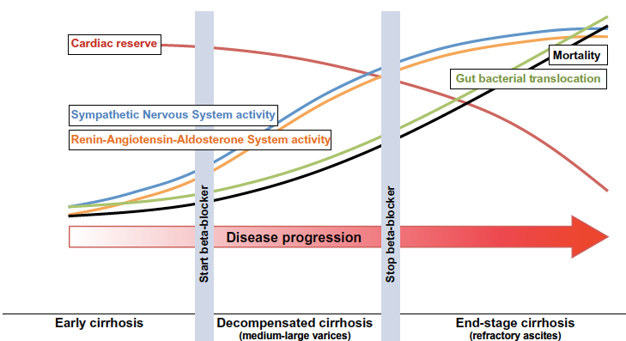
Hitting the Sweet Spot
Ge and Runyon. Journal of Hepatology 2013 vol. 59 j 203–204
Notes:
Type 2 DM –ACE and ARB

Slide 39
Ascites-Housekeeping:
Drugs to avoid -NSAIDs -ARA and ACE inhibitors
Salt History-back to basics
Notes:
Ha ha ha ha

Slide 40
Management of Refractory Ascites
Patient Selection -Excellent heart function no diastolic or systolic dysfunction -No Pulmonary Hypertension -Bili< 5mg/dl -No past significant HE -age< 65
Bureau et al. Gastroenterology 2017

Slide 41
Management of Refractory Ascites
Patient Selection -Excellent heart function no diastolic or systolic dysfunction -No Pulmonary Hypertension -Bili< 5mg/dl -No past significant HE -age< 65
Bureau et al. Gastroenterology 2017

Slide 42
Albumin
Is there a survival benefit with long term administration?

Slide 43
Long -term Albumin administration in patients with ascites, a RCT: the Rationale
Patients with ascites have a effective hypovolemia
Albumin corrects effective hypovolemia
Albumin has been shown additional beneficial effects: –Anti-inflammatory –Corrects immune paralysis etc.
Caraceni et a. EAS L 2017.Late breaking abstract

Slide 44
Long – term Albumin administration in patients with ascites, a RCT
437 Pts with cirrhosis and uncomplicated ascites treated with spironolactone 200mg/d + furosemide 25 mg/d
SOC
SOC + Albumin 40 g biweekly x 2wk followed by 40 g q week
18 months
Caraceni et a. EAS L 2017.Late breaking abstract

Slide 45
Long – term Albumin administration in patients with ascites, a RCT
18 – month survival: SOC 66%, SOC + Alb 78%(p=0.029)
NNT: 8 patients would need to be treated with weekly albumin for 18 months to prevent one death
Decreased risk of all complications except variceal bleeding
Caraceni et a. EAS L 2017.Late breaking abstract

Slide 46
Midodrine and albumin for prevention of complications of cirrhosis in patients waiting list for liver transplantation.
Albumin Infusion in Wait Listed OLT Patients
196 patients with ascites on the waiting list for LT
midodrine tid + alb 40g 15 days
Double blind
12 months
Randomized multi center, double-blind, Placebo-controlled
No difference in cirrhosis complications
Sola et al. EASL 2017

Slide 47
2015 Salt Lake City III (Feb 21-22 2015) Jimmy Buffet Margaretville Consensus Group Risk Stratification and Management of Ownership Issues
1-We don’t know the reason we stayed here all season
2-Some people claim there is a woman to blame but we know… it’s nobodys fault or our own damn fault, or Buddy Sussman’s fault
3- Where is Margaitiville
Notes:
Many will say these updates really began in Italy at the Baveno Beg to differ Group of internationally renowned Hepatologist came together for a special weekend to tackle the heady controversies in Jimmy Buffets Margaretiville_ie we did we stay all season with nothing to show but this tattoo
And whose fault is it
Tackled really heady questions
I thinke we threw down the gauntlet –really raising the bar for Baveno to follow

Slide 48
Take Home Messages:
Portal HTN is a marker of Cirrhosis and correlates with the clinical course and Risk Stratification
Direct and Indirect Measurements of PH
NSBBs should be used with caution in patients with ascites. Dose needs to be monitored. Dose reduction or discontinuation with hypotension. Progressive liver dysfunction increases exposure to propranolol and kidney dysfunction to Nadolol.
Early TIPS should be considered in Childs -Pugh Class C <14 patients with acute variceal bleeding
In most cases, ARB and ACE inhibitor should be discontinued in patients with ascites.
Further studies clarify the role of long-term albumin administration and patients with ascites.

Slide 49
Thank You

