Slide 1
Management of Hepatitis B in Pregnancy
Second Annual
Intermountain West
Hepatology Update
2014
Ray Thomason MD

Slide 2
Disclosures : Research Support
AbbVie
Boehringer Ingelheim
Bristol-Myers Squibb
Idenix Pharmacetuticals
Novartis
Vital Theraputics

Slide 3
Disclosures : Research Support
AbbVie
Boehringer Ingelheim
Bristol-Myers Squibb
Idenix Pharmacetuticals
Novartis
Vital Theraputics

Slide 4
Course Objectives
Review HBV epidemiology and consequences of HBV
Review Immunologic phases of chronic hepatitis B
Review AASLD guidelines based on theses phases
Understand Immune Tolerance and it’s implications for vertical transmission, chronic liver disease and HCC
Review Chronic HBV and pregnancy focusing on
the impact on the mother/new born
the approach to various clinical scenarios

Slide 5
Epidemiology-Hepatitis B
  2 billion people exposed to chronic HBV worldwide
  Chronic HBV infection affects 400 million people worldwide.
  1.25-2 million infected persons in the United States
  25% mortality in perinatally acquired disease
  7% mortality in adult acquired disease
  Up to 2 million die each year from HBV infection, making it the 9th leading cause of death worldwide
Gish RG and AC Gadano. J Vir Hep. 2006.

Slide 6
Hepatitis B Prevalence : Pregnant Women
US (<2%)
Asian women- 6%
African-American women- 1%
Caucasian women - 0.6%
Latina women- 0.14%
China: ~10%
India: 1-9%
Thailand 3-8%
South Africa: 2-5%
Cote D’Ivoire: 8%
Uganda 5%
Sinha Hepatology Res 2010

Slide 7
Transmission
Perinatal
  Primary mode in E. Asia and SE Asia
Horizontal Transmission Infancy/Childhood
  Primary mode in Africa
  Close contact within households, medical procedures
Sexual
  Primary mode of transmission in US
Parenteral
  Second most common mode of transmission in US

Slide 8
HBV Transmission: When Does It Happen?
In utero (<10%)¹
  Associated with
    Acute HBV in third trimester
    Maternal HBeAg and high HBV DNA
    History of threatened preterm labor
    HBV in the placenta
At the time of delivery¹
  HBeAg-positive mothers: 85%
  HBeAg-negative mothers: 31%
After birth
  Breastfeeding not associated with transmission ²
  May be related to scarification, other parenteral exposures
1. Gambarin-Gelwan Clinics Liv Disease 2007 2. Beasley Lancet 1975

Slide 9
Impact of HBV on Pregnancy:
Maternal Liver Disease
Liver disease:
  No worsening of liver disease in majority of women¹
-- Case reports of hepatic exacerbations/fulminant hepatic failures ²⁻⁴
1.
Terrault NA, et al. Semin Liver Dis. 2007;(suppl 1):18-24 2. Mahtab MA, et al. Hepatobiliary Pancreat Dis Int. 2008;7:161-164. 3. Yang YB, et al. World J Gastroenterol. 2004;10:2305-2306 4. Rawal BK, et al. Lancet. 1991;337:364.

Slide 10
Impact of HBV on Pregnancy:
Pregnancy Outcomes
Yes--Association with gestational diabetes and lower Apgar scores^{1,2}
No-- Association with adverse pregnancy outcomes³⁻⁵
  1. Lao J Hepatol 2007 2. Tse J Hepatol 2005 3. Pastorek AJOG 1988
  4. Wong Am J Perinatol 1999 5. To Aust N Z J Obstet Gynaecol 2003

Slide 11
Impact of Pregnancy on HBV
ALT levels
  MEDIAN ALT levels DECREASED during pregnancy
  Increase in ALT (3x lowest ALT) within 6 mos after delivery¹
HBeAg seroconversion
  12.5 % (5/40) eAg seroconversion rates with 1 year follow-up²
1. ter Borg J Viral Hepat 2008 2. Lin J Gastroenterol Hepatol 2006

Slide 12
Impact of Pregnancy on HBV
HBV DNA levels
  Overall increase in median HBV DNA levels during pregnancy (n=55)¹
    4/16 (20%) HBeAg negative women had > 1 log increase in HBV DNA during pregnancy
    With lamivudine therapy
      7.8 log10 copies/mL → 8.2 log10 copies/mL during pregnancy (P = 0.06), despite lamivudine therapy in 13 patients²
Soderstrom SJID 2003
ter Borg JViralHep 2007

Slide 13
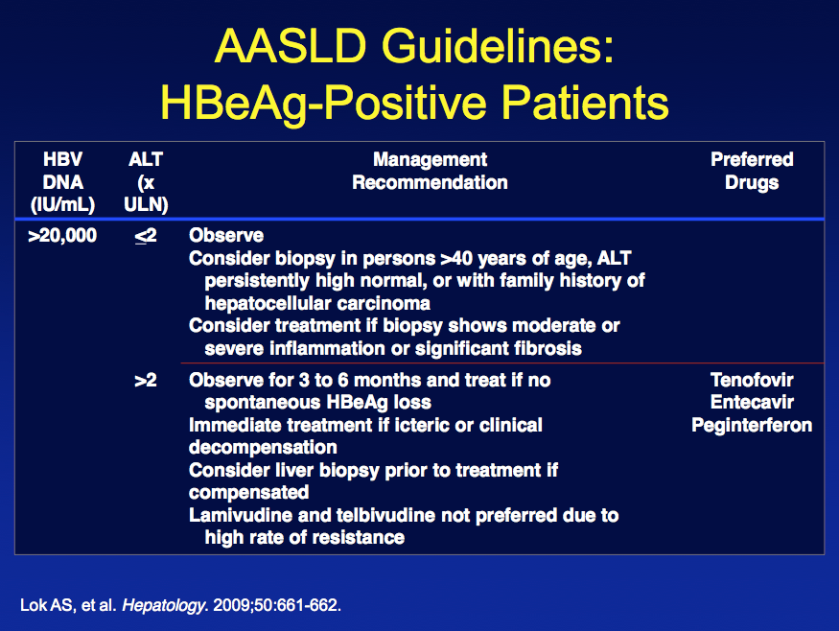

Slide 14
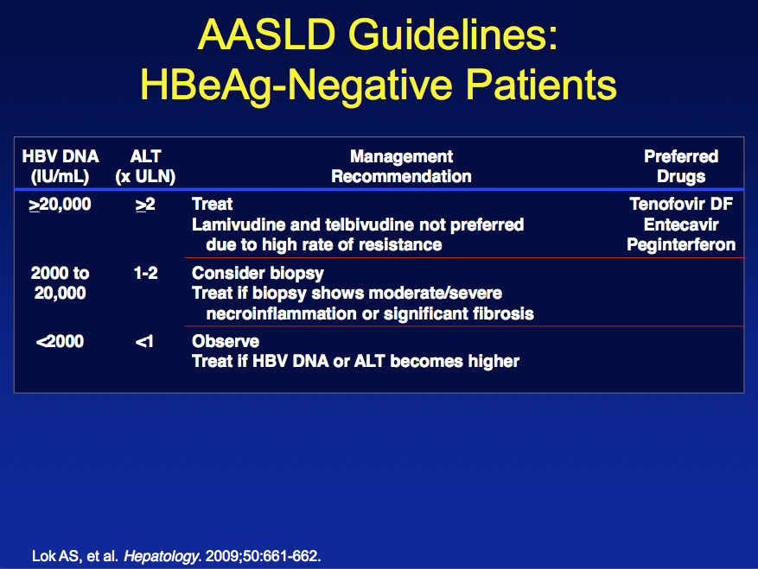

Slide 15
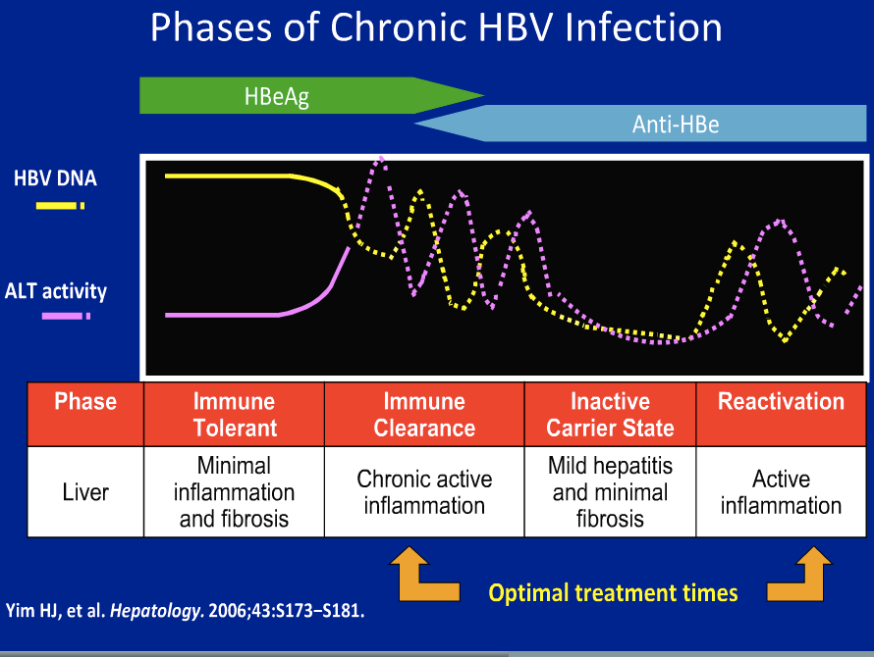

Slide 16
How Do We Develop Immune Tolerance
Maternal HBeAg induces tolerance in neonate immune system to HBcAg and HBEAG
Hepatitis B specific T cells are hyporesponsive
Ineffectice antigen processing
Anergy, deletion, altered maturation of virus specific effector cells and expansion of regulatory T cells
Carey I et al j virol 2011;85:2416

Slide 17
HBV Classification: Importance of HBeAg
Significance of HBeAg
  Marker of active replication and infectivity
  HBeAg loss and conversion to HBeAb is a marker of immune clearance
  In the setting of viremia, absence may represent precore or core promoter mutations

Slide 18
Perinatal HBV Transmission Rates
 | Without immunoprophylaxis | HBIG and HBV vaccine series
HBeAg positive | 70-90% | 5-10%
HBeAg negative | 10-40% | <5%

Slide 19
Preventing Perinatal HBV Transmission:
Why Is It So Important?
Risk of progression to chronic infection is inversely related to age at infection
100
80
60
Progression to
Chronic Infection (%)
40
20
0
Newborns
Infants/Children
Immunocompetent
Adults
11. Lok AS, et al. Hepatology. 2009;50:661-662.

Slide 20
Perinatal HBV Transmission Is Related to Maternal HBV DNA Level
All infants received HBIG + first dose HBV vaccine within 12 hrs of birth and additional doses of HBV vaccine at 2, 4, and 6 mos
P = .039
P = .031
15
Perinatal Transmission*
Rate (%)
10
8.5
6.6
5
n/N =
4/61
0/77
0/73
0/18
4/47
0
HBeAg+
HBeAg-
< 5 log
5-8 log
> 8 log
Maternal HBeAg Status
Maternal HBV DNA (copies/mL
*Perinatal transmission = HBsAg positive at Mo 9.
14. Wiseman E, et al. Med J Aust. 2009;190:489-492.

Slide 21
The Challenges of Pregnancy in
Chronic Hepatitis B
Women who contemplate/anticipate starting a family
Women who become pregnant while receiving antiviral therapy
Women who are pregnant, have high HBV DNA, and not currently on treatment
Women with newly diagnosed HBV infection during pregnancy

Slide 22
Chronic HBV Infection in Women Considering Starting a Family
Should plans to start a family influence management decisions?
  Depends on immediacy of plan to become pregnant
  Uncertainty regarding safety of antiviral medications in pregnancy
  Careful discussion with patient and spouse regarding benefits vs risks

Slide 23
Considering Starting a Family: Which Drug?
FDA classification
Based on in vitro and animal studies
  Class B: telbivudine and tenofovir
  Class C: interferon, adefovir, entecavir, and lamivudine
Based on Human data:
  Antiretroviral pregnancy registry: safety established for lamivudine and tenofovir, including exposure in first trimester^{[1]}
  Clinical studies of antiviral therapy to prevent perinatal transmission: safety established for lamivudine and telbivudine, mainly exposure in third trimester^{[2-5]}
1. Antiretroviral Pregnancy Registry. December 2012. 2. Xu WM, et al. J Viral Hepat. 2009;16:94-103.
3. Shi Z, et al. Obstt Gynecol. 2010;116:147-159. 4. Han GR, et al. J Hepatology. 2011;55:1215-1221.
5. Pan CQ, et al. Clin Gastroenterol Hepatol. 2012;10:520-526.

Slide 24
Incidence of Birth Defects With in Utero Exposure to HBV Nucleos(t)ide Analogues
Regimen Containing | First Trimester |  | Second or Third Trimester
 | Exposed, n | Birth Defects, % (95% CI) | Exposed, n | Birth Defects, % (95% CI)
Lamivudine | 4185 | 3.2 (2.7-3.8) | 6843 | 2.8 (2.4-3.2)
Tenofovir | 1612 | 2.4(1.7-3.3) | 838 | 2.3(1.4-3.5)
6. Antiretrovirals Pregnancy Registry. December 2012. 7. Correa A, et al. Birth Defects Res A Clin Mol Teratol. 2007:79;65-186
Notes:
6. Antiretroviral Pregnancy Registry. December 2012. 7. Correa A, et al. Birth Defects Res A Clin Mol Teratol. 2007;79:65-186.

Slide 25
Limitations of the Antiretroviral Pregnancy Registry
Depends on voluntary reporting
Information is reviewed but not verified
Long-term follow-up is limited
Data available for live births only
No data on miscarriages or subsequent developmental delay
Limited data on antivirals used for HBV monoinfection
  < 100 pregnancies reported for exposure to adefovir, entecavir, or telbivudine
8. Antiretroviral Pregnancy Registry. December 2012.

Slide 26
When Considering Starting a Family
Which nucleos(t)ide analogue?
Safety to fetus, including exposure during first trimester
  Lamivudine, tenofovir, telbivudine
Risk of drug resistance
  Lamivudine > telbivudine > tenofovir
Preferred drug: tenofovir
  Established safety; potent; low risk of drug resistance
Benefit vs risk discussed with patient and spouse
  Inform if become pregnant

Slide 27
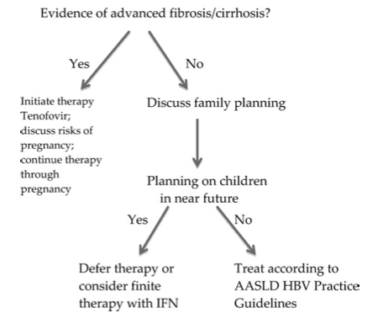
Antiviral Therapy for Chronic HBV Infection in Women Starting a Family in Near Future

Slide 28
Women Who Become Pregnant
While Receiving Antiviral Therapy
Continue, switch, or stop?
Review indications for treatment
  Advanced fibrosis or cirrhosis: continue
  Early/mild disease or uncertain indications: stop?
Assess whether therapeutic endpoint has been reached
  HBeAg seroconversion: stop?
Discuss potential risks/benefits to mother and fetus

Slide 29
Become Pregnant
On Antiviral Therapy
  Tenofovir: continue
  Lamivudine or telbivudine:
  continue if DNA is UNDECT
  switch to tenofovir if DNA detectable
  Adefovir, entecavir, or pegIFN
  stop- switch to TN
If stop or switch- monitor for hepatic Flares
Notes:
HBV, hepatitis B virus; pegIFN, peginterferon.
When a decision is made to continue treatment, the safety of the patient’s current regimen must be considered. If the patient is currently receiving tenofovir, then treatment may be continued. If the patient is receiving lamivudine or telbivudine, then treatment may continue with the same drug if HBV DNA is undetectable. If the virus is not fully suppressed, then switching to tenofovir is recommended to prevent breakthrough during pregnancy. Adefovir, entecavir, and peginterferon are pregnancy class C drugs with limited safety data in vivo, and if the patient is currently receiving one of these drugs, then it is best to switch therapy to tenofovir.
When treatment is altered or stopped, it is important to monitor for hepatitis flares, as this could compromise the health of both the mother and the baby.

Slide 30
Prevention of Perinatal HBV Transmission
Cornerstone: HBIG + HBV vaccine
  HBIG + first dose vaccine within 12 hrs of birth, different sites
Efficacy: ~ 95%
Reasons for failure
  Delay in administration of HBIG and first dose of vaccine
  Failure to complete vaccine series
  Mother HBeAg positive and/or high HBV DNA
12. Lok AS, et al. Hepatology. 2009;50:661-662. 13. Mast EE, et al. MMWR Recomm Rep.
2005;54(RR-16):1-31.

Slide 31
Pregnant Women With High HBV DNA and Not Currently on Antiviral Therapy
Should antiviral therapy be recommended to reduce risk of perinatal transmission?
What should be the cutoff maternal HBV DNA level for initiation of antiviral therapy?
When to start?
Which antiviral drug?
When to stop?
What is the risk of post-treatment flares?

Slide 32
Lamivudine in Late Pregnancy May Reduce HBV Transmission in High Viremic Mothers
Randomized, double-blind, placebo-controlled trial
  All mothers HBV DNA > 10⁹ copies/mL prior to starting lamivudine at Wk 32 of pregnancy
  All infants received HBIG + HBV vaccine
100
Lamivudine (n = 56)
Placebo (n = 59)
80
60
P = .014
7 infants in lamivudine group and 18 in placebo group did not return for HBsAg test at 1 yr
Infants HBsAg Positive at 1 Yr (%)
40
39
P = .15
20
18
18
7
0
15. Xu WM, et al. J Viral Hepat. 2009;16:94-103.

Slide 33
Meta-analysis of Lamivudine to Interrupt Perinatal Transmission of HBV
Infant HBsAg Seropositive | Lamivudine, Events/N | Control , Events/N | Risk Ratio (95% CI)*
Han 2005 | 0/43 | 5/35 | 0.07 (0.00-1.30)
Li 2006 | 1/36 | 7/44 | 0.17 (0.02-1.35)
Feng 2007 | 7/48 | 16/42 | 0.38 (0.17-0.84)
Guo 2008 | 4/70 | 12/40 | 0.19 (0.07-0.55)
Xu 2009 | 10/56 | 23/59 | 0.46 (0.24-0.87)
Zhang 2010 | 1/50 | 8/50 | 0.13 (0.02-0.96)
Total | 23/303 | 71/270 | 0.33 (0.21-0.50)
Risk Ratio (95% CI)*
0.01
0.1
1
10
100
Favors Lamivudine
Favors Control
Infant HBV DNA Seropositive | Lamivudine, Events/N | Control , Events/N | Risk Ratio (95% CI)*
Feng 2007 | 7/48 | 16/42 | 0.38 (0.17-0.84)
Guo 2008 | 6/70 | 18/40 | 0.19 (0.08-0.44)
Xu 2009 | 11/56 | 27/59 | 0.43 (0.24-0.78)
Zhang 2010 | 1/50 | 8/50 | 0.13 (0.02-0.96)
Total | 25/224 | 69/191 | 0.32 (0.20-0.50)
Risk Ratio (95% CI)*
*Risk ratio calculated using the Mantel-Haenszel random-effects model.
0.01
0.1
1
10
100
17. Han L, et al. World J Gastroenterol. 2011;17:4321-4333.

Slide 34
Antiviral Treatment During Pregnancy:
TBV Starting Wk 20-32
HBeAg-positive Chinese mothers with HBV DNA > 10⁷ copies/mL received TBV 600 mg/day beginning in Wk 20-32 of gestation or served as untreated controls
  Not randomized; controls chose not to receive treatment
TBV (n = 135)
100
TBV + HBIG + Vac (n = 132)
92
80
Control (n = 94)
80
HBIG + Vac
(n = 88)
60
60
P = .001
Proportion of Patients, %
40
33
40
P = .001
20
20
8
0
0
0
0
Maternal HBV DNA
< 500 c/mL at Delivery
HBsAg+
at 7 Mos
Anti-HBs Detectable
at Wk 28
16. Han GR, et al. J Hepatol. 2011;55:1215-1221.

Slide 35
Pregnant Women With High HBV DNA and Not Currently on Antiviral Therapy
Should antiviral be recommended to reduce risk of perinatal transmission?
  Yes; although quality of evidence is low, all studies showed benefit and no harm
What should be the cutoff maternal HBV DNA level for initiation of antiviral therapy?
  > 8 log₁₀ IU/mL: Yes
  6-8 log₁₀ IU/mL: Maybe
  < 6 log₁₀ IU/mL: No

Slide 36
Pregnant Women With High HBV DNA and Not Currently on Antiviral Therapy
When to start antiviral?
  Late second/early third trimester
  Allow at least 4-6 wks for an effect
Which antiviral drug?
  Lamivudine, telbivudine, or tenofovir
  Tenofovir preferred: low risk of drug resistance, baseline HBV DNA high, and some mothers may need treatment for their liver disease in the future

Slide 37
Pregnant Women With High HBV DNA and Not Initially on Antiviral Therapy
When to stop antiviral after delivery?
  To prevent perinatal transmission: immediately, especially if mother plans to breast-feed, or up to 3 mos postdelivery
  To treat liver disease: continue until therapeutic endpoint
19. Ter Borg MJ, et al. J Viral Hepat. 2008;15:37-41.

Slide 38
Pregnant Women With High HBV DNA and Not Initially on Antiviral Therapy
What is the risk of posttreatment flare?
  Seemingly rare, but mild ALT elevation common; also seen in postpartum period for women not receiving antiviral
  Decompensation not reported in clinical trials; likelihood low because most pregnant women have early-stage liver disease
  Important to closely monitor ALT after antiviral therapy is discontinued (eg, 1, 3, and 6 mos posttreatment)
19. Ter Borg MJ, et al. J Viral Hepat. 2008;15:37-41.

Slide 39
BIG FINISH

Slide 40
All Women With Newly Diagnosed HBV Infection During Pregnancy
Refer for further evaluation
Assess HBV replication and liver disease
  HBeAg/anti-HBe, HBV DNA
  Blood counts, liver panel ± ultrasound
Evaluate need for antiviral therapy
  For control of liver disease in mother
  For prevention of transmission to baby
Emphasize importance of long-term follow-up

Slide 41
All Women With Newly Diagnosed HBV Infection During Pregnancy
Register HBV status in OB record
  HBIG + first dose of vaccine to baby within 12 hrs of birth
  Complete full course of vaccine
  Check baby for HBsAg and anti-HBs at 9-15 mos
Counseling on precautions to prevent HBV transmission
Screening and vaccination of family members
18. Lok AS, et al. Hepatology. 2009;50:661-662.

Slide 42
Chronic HBV Infection in Women Considering Starting a Family
Indications for treatment
  Start now: advanced fibrosis/cirrhosis, severe flares/persistently high ALT
  Defer: no/mild fibrosis, normal/minimally elevated ALT

Slide 43
Algorithm for HBV Management in
Women During Pregnancy
1st trimester: assess HBV replication and liver disease
Active disease/suspected cirrhosis: consider initiating treatment with tenofovir
End of 2nd trimester: quantitative HBV DNA and ALT levels
HBV DNA < 10⁶ IU/mL*
HBV DNA > 10⁶ IU/mL*
Consider initiating treatment with tenofovir, lamivudine, or telbivudine at 28-32 wks†
Monitor;
infant receives HBIG + vaccine at birth
Infant receives HBIG + vaccine at birth
†Tenofovir is preferred if treatment is expected to be > 12 weeks or if treatment is expected to continue while breastfeeding.
Notes:
*The cut-off level of maternal HBV DNA level for initiation of therapy is unclear, and HBV DNA from 6-8 log₁₀ IU/mL can be considered for therapy based on physician and patient preference.
†Tenofovir is preferred if treatment is expected to be > 12 weeks or if treatment is expected to continue while breastfeeding.

Slide 44
Algorithm for Management of HBV Infection
During Pregnancy
Pregnant woman
First trimester:
Check HBsAg, anti-HBc, anti-HBs
HBsAg (-)
Anti-HBc (-)
Anti-HBs (-)
HBsAg (+)
Confirm HBsAg (+)
Check baseline quantitative HBV DNA
Check quantitative HBV DNA at 28 weeks
Initiate maternal HBV
vaccination series
No
Previous child HBV (+)
Yes
Infant receives
vaccine at birth
HBV DNA
< 10⁶ copies/mL
HBV DNA
>10⁷-10⁸ copies/mL
HBV DNA
>10⁶ copies/mL
HBV DNA
<10⁶ copies/mL
Monitor
Consider treatment with lamivudine,
tenofovir, or telbivudine at 32 weeks
Infant received HBlg + vaccine at birth

Slide 45
Women Receiving Antiviral Therapy Who Desire to Breast-feed
Breast-feeding generally not recommended while receiving antivirals
  Nucleos(t)ide analogues present in breast milk
Tenofovir: a prodrug with low oral bioavailability
  Nursing rhesus macaques administered tenofovir (n = 2): peak concentration in breast milk 2% to 4% of that in serum; AUC_{milk} is
  ~ 20% AUC_{serum}^{[9]}
  HIV-infected women (n = 5): median concentration of tenofovir in breast milk 0.03% of proposed oral infant doses^{[10]}
Existing data suggest tenofovir is safe
9. Van Rompay K, et al. Antimicrob Agents Chemother. 2005;49:2093. 10. Benaboud S, et al. Antimicrob Agents Chemother. 2011;55:1315.

Slide 46
Acknowledgements
Anna Lok, M.D.
Paul Pockros, M.D.
Tram Tran, M.D.

Slide 47


