Slide 1
The Curious Case of a Jaundiced Professor
Ray Thomason, M.D.

Slide 2
A Case Presentation:
59 yr old male U of U Professor
JAUNDICE x10 days : Tbili-12.3
AST/ALT : 1244/1797
F-actin : 84
Ca 19-9 : 343
Referred from primary care to assess for
CCA and PSC

Slide 3
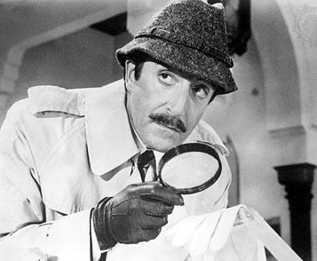
I Suspect Everyone
I Suspect No one
Chief Liver Inspector
Jacques Clouseau

Slide 4
Curious?
Questions from the Attendee’s ?
Faculty : DDX
Acute Liver failure
Viral Hepatitis
Mechanical Biliary Obstruction-Benign/Malignant
Cholestatic Process
DILI
Autoimmune:PSC with Overlap/PBC/AIP-SC
Cholangiocarcinoma

Slide 5
History: Constitutional
12 mo prior pruritic rash
6 mo prior dark urine
1 mo prior low grade fever-afternoon nausea fatigue
10 days prior jaundice
1 week prior pale stool non-productive cough

Slide 6
History
PMH/PSH : 2013 Sinus Myctoma ( Fungus Ball )
Medication: No Hepatotoxins
Family History: No liver disease No Autoimmune Diseases

Slide 7
High Risk Exposure
Travel : 2 months prior Cabo Mexico
Infectious Disease: Research Lab Assist-Active tbc Vaccinations: current-HAV/HBV
Hepatotoxins : none
Blood Transfusion : none

Slide 8
Physical
BMI - 25 in NAD
Jaundice with Scleral Icterus
No Palmar Erythema , No Spider Telangectesia, No Abdominal Wall Veins
No Rashes
No Ascites
No Peripheral Edema
No Encephalopathy

Slide 9
LABS ?

Slide 10
Data: Labs 8/15/14
CBC Wbc 4.7 Hct 49 Plts 144
INR 1.5
CMP TBili 12.3 23.4 AP 157 AST/ALT 1244/1797 Lipase 54
Autoimmune ANA/AMA not detected F-Actin 84 IgG 1760 IgG4 76
Ca 19-9 343
Viral Markers Hep A/B Immune Hep C/E NR

Slide 11
Why the Ca 19-9 Drives Us Crazy
Dr. Norman Sussman An Editorial Comment

Slide 12
Ca 19-9 : Dif Dx
MALIGNANT
BENIGN
Acute Cholangitis
Cirrhosis and other Cholestatic Diseases (gallbladder dz)
Pancreatic Cancer (exocrine and neuroendocrine)
Biliary Cancer(GB, CCA,and Ampullary Cancer)
Hepatocellular
Gastric, Ovarian, Colorectal
Lung, Breast, Ovarian

Slide 13
Ca19-9: recent updates on Genotypes
Fut2 and Fut3 : Ca 19-9 cut-off values for detecting CCA in patients with PSC Wannhoff A et al. Journal of Hep 2013 vol.59:1278-84
Fut2 genotype-Risk for Dominant stricture candidal infections in PSC C.Rupp et al.Aliment Pharacol Ther 2014;39:873-882

Slide 14
Cholangiocarcinoma : Suspicion
AASLD PG 2010

Slide 15
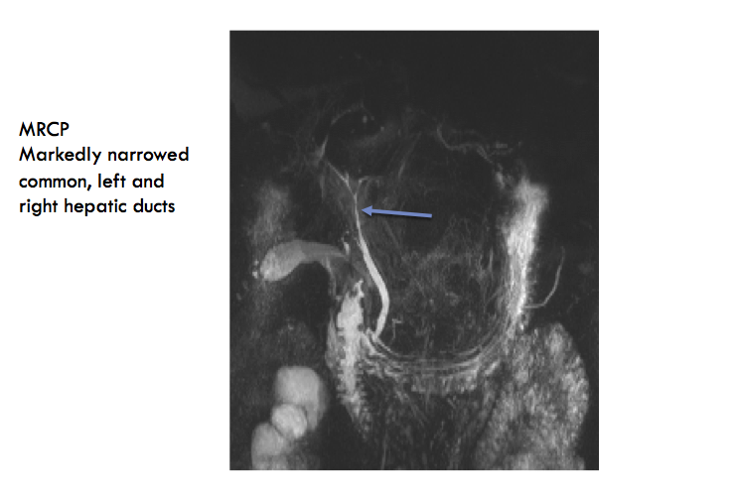
Imaging
Courtesy of Dr. Akram Shaaban

Slide 16
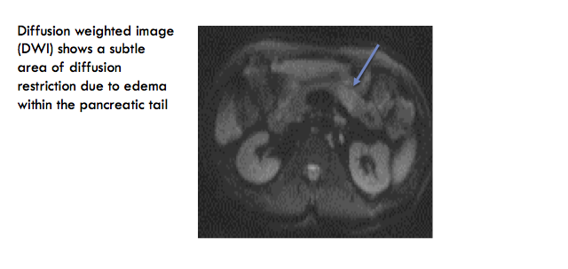
Imaging
Courtesy of Dr. Akram Shaaban

Slide 17
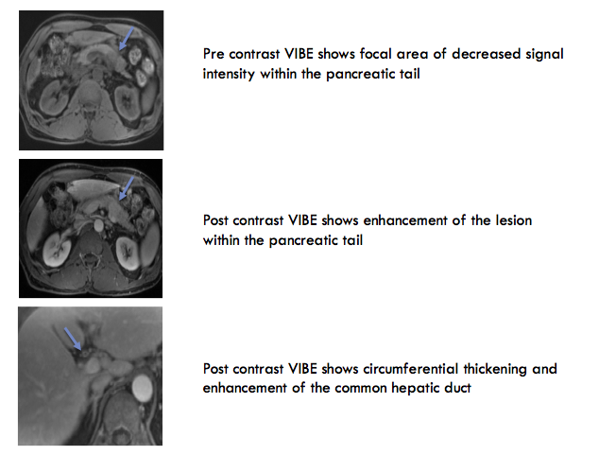
Imaging
Courtesy of Dr. Akram Shaaban

Slide 18
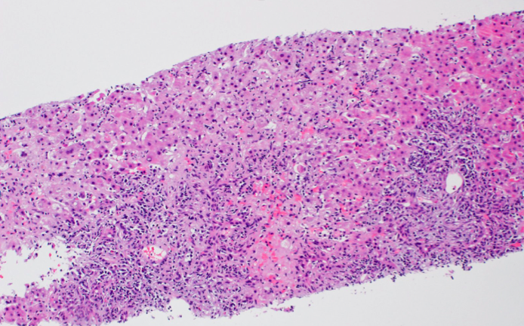
Liver Biopsy: two portal tracts
Marked inflammatory infiltrates with extension past the limiting plate(Interface hepatitis)
Surrounding lobular hepatocytes with marked inflammation

Slide 19
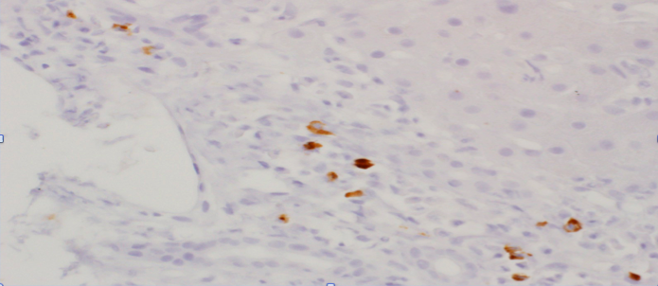
Liver Biopsy-IgG4 Stain

Slide 20
Dr. Vierling’s Thoughts
IgG subclass 4
Presence/Absence Autoantibodies in PSC
Dif Dx

Slide 21
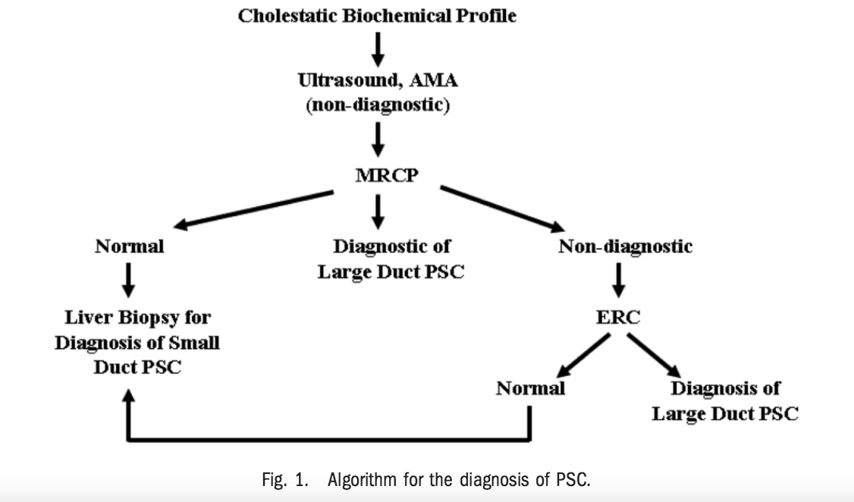
AASLD : PSC - How to Diagnose

Slide 22
AASLD –PG : PSC
Cholestatic profile: Imaging to make Diagnosis Indirect(MRC) or Direct Cholangiography(ERCP) (1A)
Liver biopsy ? NO-Imaging Abnormal-typical : PSC 1(B)
YES-Imaging Normal : Dx Small Duct Disease1(B) YES-AST/ALT Elevated : Dx Overlap Syndrome1(B)
All Patients with PSC : Measure Serum IgG 4 to Dx or exclude -IgG-SC. (2C)

Slide 23
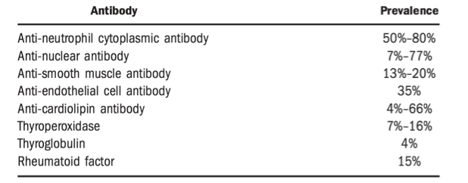
Serum Antibodies in PSC

Slide 24
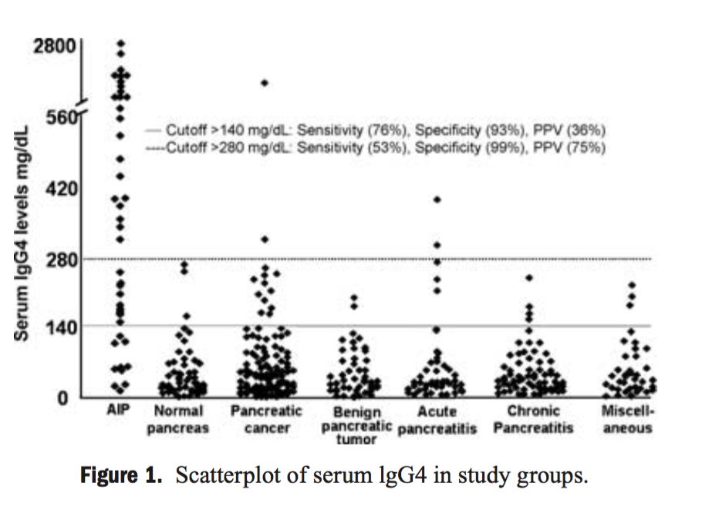
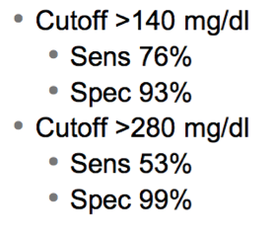
IgG4-in AIP/SC

Slide 25
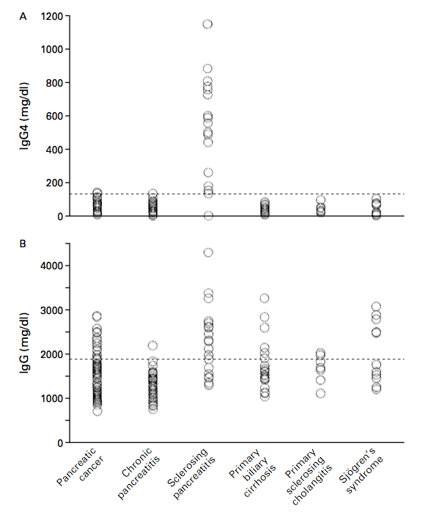
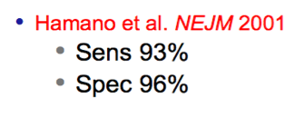
IgG4

Slide 26
NOW WE HAVE ALL THIS DATA
WHAT IS
THE DIAGNOSIS ?

Slide 27
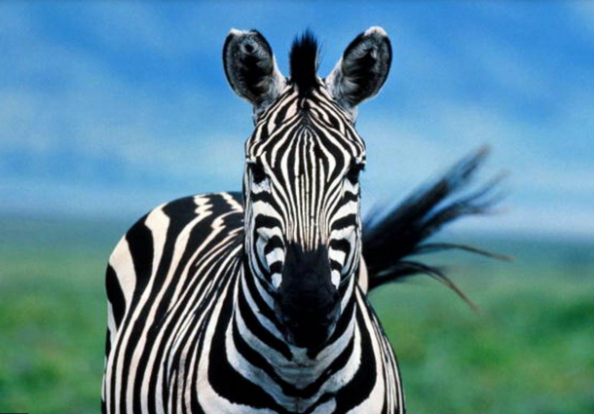

Slide 28
What you need to know: AIP-SC
Systemic Disease with manifestations in the Pancreas, Bile Duct, Salivary Gland, Retroperitoneum and the Lymph Nodes
Histology : Lymphoplasmacytic infiltration with abundant IgG4 + positive cells
Inflammatory process response to steroid therapy

Slide 29
Prevalence of AIP/ AIC
Rare form of chronic pancreatitis
2% of new cases of chronic pancreatitis per year
Prevalence across the world 4% Italy at 11% USA
Felt to make up 10% of the cases of PSC

Slide 30
Prevalence of AIC
Courtesy: DR. John Vierling

Slide 31
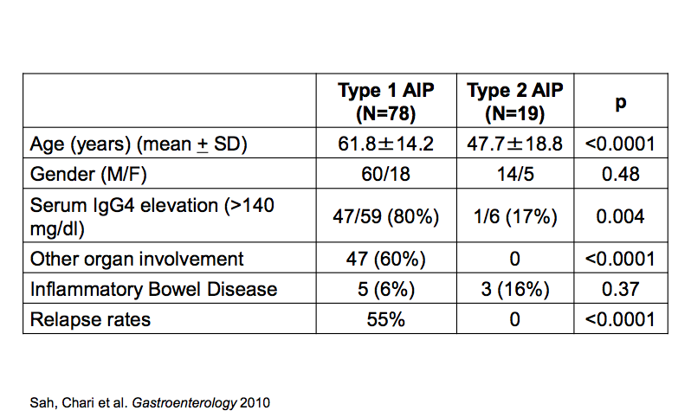
Two Clinical Types based on : Age and Autoimmune Antibodies

Slide 32
CT/MRI findings
Pancreas enlargement
Pancreas stranding without vascular encasement
Calcification or Peri-Pancreatic fluid
Narrow pancreatic duct
Rim like enhancement of the pancreas
Mass

Slide 33
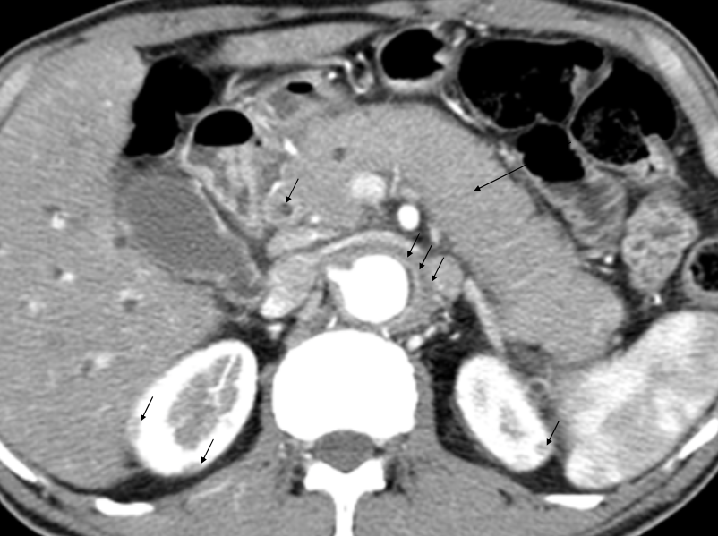

Slide 34
ERCP findings
Segmental or diffuse PD narrowing
Strictures
No upstream dilatation
Narrowing of the intra-pancreatic portion of the common bile duct
Irregular narrowing of the extra-hepatic bile ducts
Gastrointest Endosc Apr2002;55(4):494-9

Slide 35
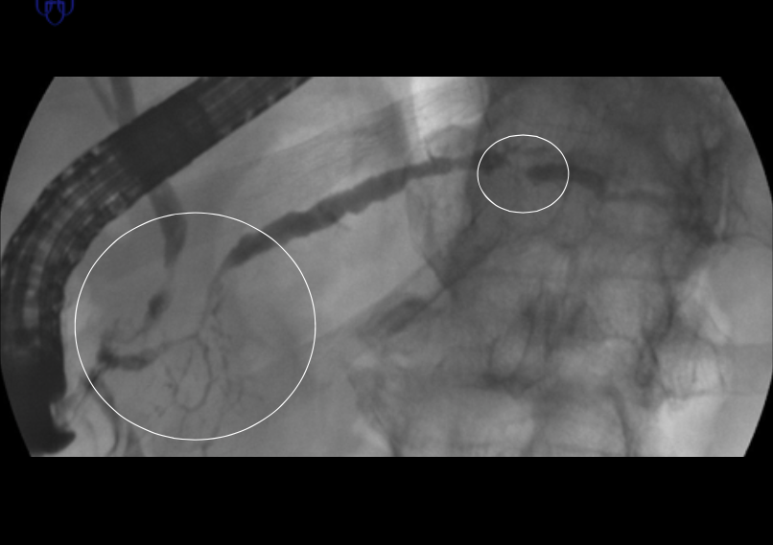
ERCP findings

Slide 36
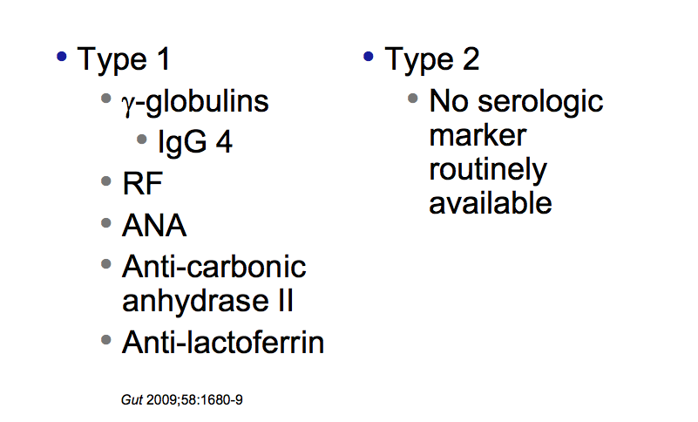
Serology: 2 Types

Slide 37
Histology: 2 types

Slide 38
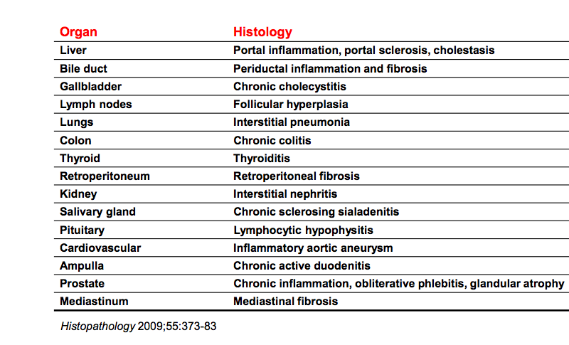
Histologic Features of IgG4 AIP/SC

Slide 39
Therapy
Prednisone 40 mg/day for 4-6 wks followed by a taper of 5 mg/week
Relapses : managed repeat course or maintenance therapy(typically 10 mg/day)
Incomplete response or relapses often associated with biliary strictures

Slide 40
When To Treat
ACUTE : Symptomatic/ jaundiced/mass/stricture LATE : Persistent pancreatic mass/BD stricture
Diagnostic Value: Response Reassuring Rapid improvement in masses/strictures
Prevent organ damage ?? AIP: not sure if preserves gland fx Fibrosis may leave a scarred atrophic gland AIC : ? Prevent ESLD

Slide 41
Difficult to Treat: Refractory AIP or IgG4 cholangiopathy
Azathioprine
Methotrexate
Mycophenolate Mofetil
Rituximab( anti-CD20)
Internal medicine 2009;48:1995-6
Clinic Gastro Hepat 2008;6(3)364

Slide 42
Therapy
Immunosuppressive therapy is effective
Because of side effects it is limited to refractory steroids
Studies are necessary to establish second line drug therapy

Slide 43
Treatment outcomes
Exocrine and Endocrine insufficiency
Relapses in the pancreas in other organs
Pancreatic cancer
ESLD-?

Slide 44
Pitfalls : Why we miss this diagnosis
Biopsies are read as reactive
IgG4 stain not done
IgG4 serum not ordered
Doctors don’t know about it
Steroids cover it up

Slide 45
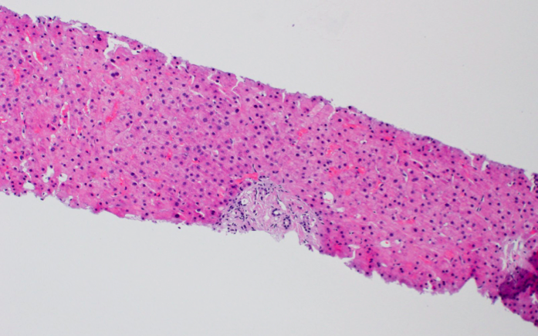
Liver Biopsy-One year post treatment
Pristine portal tract….No inflammation in the portal tract or lobule

Slide 46
Take Home Points
Don’t forget Zebras : the Spice of Life
AASLD PG w/u PSC
Ca 19-9
IgG4
AIC : Systemic Disease Suspicion H and P IgG4-serum and bx stain W/U chest-abdomen-pelvis Treatable Steroids-immunosuppression

Slide 47
When You Hear Hoof-beats

Slide 48
Acknowledgments
Dr. Norman Sussman
Dr. John Verling
Dr. Massimo Raimondo
Dr. Akram Shabaan
Dr. Erin Kelly-Downs

