Slide 1
Hepatology Updates
March 23 2019
My Painful Journey through the “Waste”
of Industrialized Medicine
to find “Value”
How A Cow Saved the life of a struggling Hepatologist
I have no financial closures for this presentation
I.Ray Thomason, MD
Notes:
good afternoon im RT
excited topic although not classic
it has enhanced my ability to care for my hepatology PTs and brought enormous value to my personal and profess
hope you too will find it to be of value your practice of medicine
SLIDE READ Topic SLIDE
SLIDE

Slide 2
Goals:
Burnout- Definition, Causes, Impact
Review 2019 Annual Physician Risk Assessment Report
Introduce Skills for Survival
- The Meaning of Frustration
- Mindset
- Workflow Process
Review a Case Study of Wasteful Behavior that became a Value Project and the lessons learned
Notes:
I want to share with you my journey and perspective over past 8 year and To Try to Convince you that We Providers Are on a Slippery Slope
one of privileges of being old You can then
speak about PERSPECTIVE
READ Goal then SLIDE

Slide 3
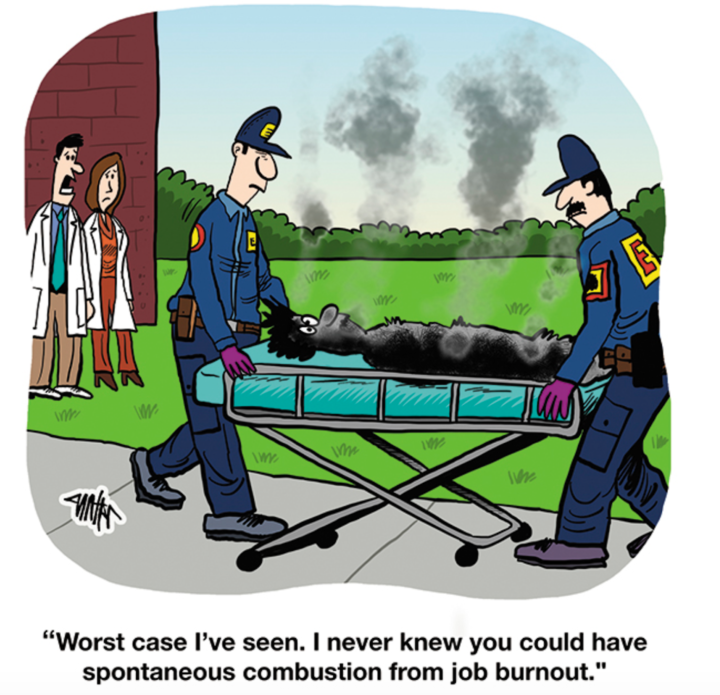
Notes:
BUT Being OLD I’m afraid
I was like coach Tom Hanks in a League
When to a weeping team who was on his team professional baseball he screamed there’s
no cryng in baseball
I would have screamed there’s NO BO in medicine
But Im sorry to report I was wrong -I want to share with you ---START DEFINITION SLIDE

Slide 4
Burnout: Formal Definition
A psychological syndrome emerging as a prolonged response
to chronic interpersonal stressors on the job.
Three key dimensions of this response:
1-overwhelming exhaustion,
2-feeling of cyanismn and detachment from the job
3-a sense of ineffectiveness and lack of accomplishment
Merriam-Webster: Exhaustion of physical and emotional strength or motivation, usually as a result of prolonged stress and frustration
Notes:
Here are 2 Formal Definitions
Slide

Slide 5
My Definition of Burnout
Burnout is a response
to chronic excessive wasteful work,
that creates no value for you or your patient
This response robs you of the joy of medicine
and creates a sense of hopelessness
Notes:
share a more palpable granular definition

Slide 6

Notes:
survey
>15ooo
29 subsp
SLIDE

Slide 7
Survey Statistics:
Over 15,000 physicians-29 subspecialties
Despite interventions rise burnout and depression
44% /28% of U.S. physicians reported feeling burned out
Suicide rate for physicians
Notes:
Despite efforts by many .... Growing Incidence
Data I was shocked about
48/ 28 report feeling BO

Slide 8
Medscape Survey-cont:
>50 hours Worked
57% BO
<40 hours Worked
33% BO
Highest vs lowest rates BO: Urologist vs Public Health
Main Causes:
60% demands of EHR
34% long hours
Notes:
Urologists 54%, Neurologist 53%,

Slide 9
Survey – cont:
Depression Rate
Physicians
12% in males
18% in females
Medical Residents
15% to 30%
In Medical Economics Jan 2016:
25% of Medical Residents
NOT repeat decision to attend medical school

Slide 10
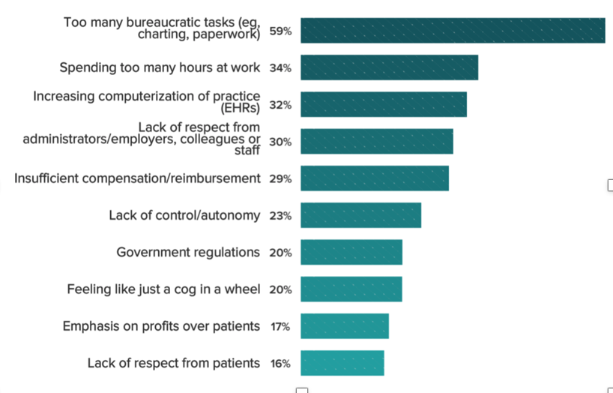
What contributes most to your Burnout

Slide 11
My Drivers of Burnout
Work overload: 2-6x as long as paper charts
Lack of control: no control of your template
Bonds with patients are difficult to establish
Breakdown of community
Absence of Fairness
Mismatch of Values
Notes:
We’ve all seen the studies that show that for every hour we spend with a patient, we spend two hours on administrative work, and we take hours of work home with us each night. But as we’ll see, it’s not all just about the additional work that the EHR brings. Burnout is more than being exhausted due to overwork.
We’ll start by reviewing the six drivers of burnout:
Work overload. Too much to do to do your work well and maintain work-life balance.
Lack of control. Lack of say over placing limits on your work or over how you do the work.
Insufficient reward. Not just money, but professional recognition and the satisfaction of connecting with patients.
Breakdown of community. The relationships among co-workers and colleagues that provide support in tough times.
Absence of fairness. The sense that expectations and support are different for you than others, worse if decisions are made without communication.
Mismatch of values. A disconnection in priorities between you and your organization.

Slide 12
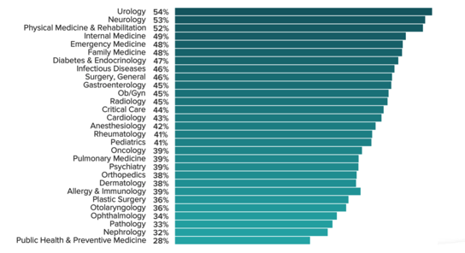
Which Physicians are most likely to burnout

Slide 13
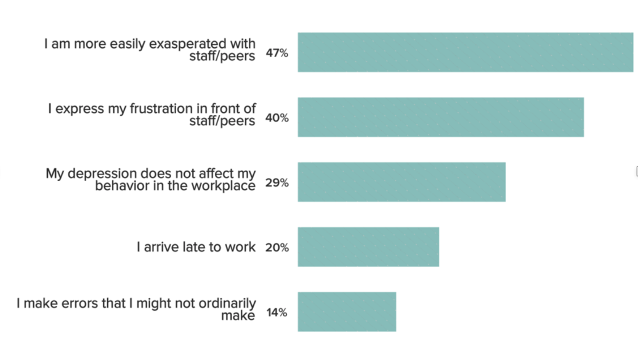
Consequences of Depression and Frustration
Notes:
50% responded exasperated with
40% expressed frustration in front
SEXTON –Duke University importance of + vs - Environment
15% might make errors otherwise not

Slide 14

We are facing a Tsunami of New Clinical Data, Emails and Artificial Intelligence:
Wave of Information:
Library of Congress –Doubling
46 RCT’s daily
160,000 new studies in Pubmed/yr
Emails: Refreshing Inbox –”Addictive”
Watson vs……….
Jeopardy
NCU Tumor Board
Notes:
Doubling
46 RCT studies published DAILY
Search PUBMED 160,000 NEW Studies
EMAIL -How many refresh email
ucla done studies PET /MRI
texting opening email -give response similiar to euphoria
WATSON

Slide 15
We have lost our way
Internal Medicine Residents John Hopkins- 900 hours time analysis
8 minutes per patient
12 % of their work time at bedside

Slide 16
Final Thoughts BO
AMA Website BO 56% BO Calculator
Biggest piece missing from all surveys/commentaries
LIFE
Medicine Does Not Get Easier –when times are tough
Notes:
Survey/commentaries like we live in a bubble
That is just not true
Life is sticky and not easy

Slide 17
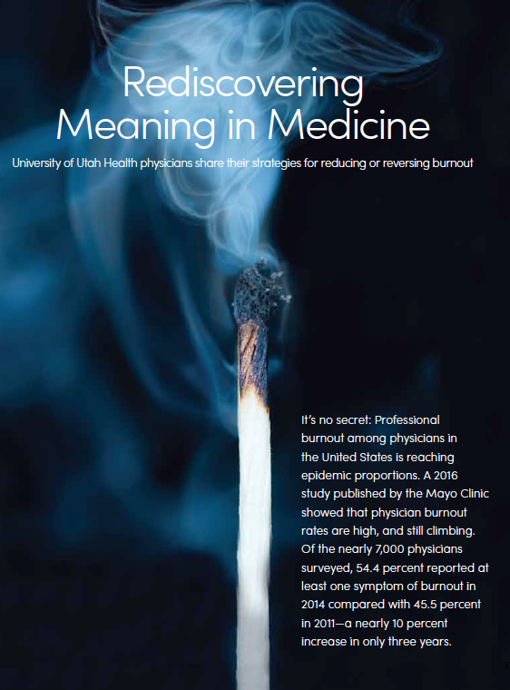
Illumination –Magazine for the School of Medicine Alumni Board
Speaking to Mindfulness:
Dale Sandweiss, MD
Speaking to Efficient Workflow:
I.Ray Thomason, MD
Notes:
Recently opportunity co aurthor article on BO and rediscovering medicine
Dr sandweiss spoke to his avoidance of BO
using mindfulness and
I described my avoidance BO using workflow
So as Ive deeply studied BO Ive developed a different model with skill sets from 2 categories
SLIDE

Slide 18
Two Basic Categories in Defending Against Burnout:
Mindset:
ATTITUDE-Ownership
Vicktor Frankl: WWII Sturdy Survivors
Mindfulness-Stress Reduction
”To late when House is already on fire”
Value Engineering:
Improving the Process of Workflow Efficiency
Notes:
Survivors Not give up their Freedom to choose attitude or meaning of life especially their spiritual life Quote my Mentor –
When your house is on fire
you don’t need mindfulness
Need a real solution

Slide 19
2nd Categories: Workflow Efficiency Process
Value/Lean/Six Sigma:
Toyota’s Model - Gemba Kaizen
Essentialism: Greg McKeown
Only Value-added choices in your personal life
Approach to Deep Work: Cal Newport
Focused Attention

Slide 20
In Process Flow the First Skill To Learn
Awareness of Your Frustration
First warning sign of Bad Process
There aren’t bad people there are bad processes

Slide 21
I Learned Process Flow by Becoming a Value Project
My Timeline from Waste to Value:
2012 signed contract UU-Such Lofty Expectations: research, education,
First Call Week-End Call with Fellow Matt Steenblik, MD. I’m exposed
Next 2 years: Epic til 2 AM
A deteriorating relationship wife children and dog
Learn the Propped Eyelid maneuver
Developed up-down diplopia, profound Ptosis-60% obstructed of my pupil
W/U Myasthenia and finally corrective surgery
Son’s disappointing words
Marilyn Paine
Enrolled in Value Engineering Course taught by –
Steve Johnson, PhD and Robert Pendleton, MD
Mentor-Frank Thomas, MD assigns value project
Notes:
2012 signed contract UU
First Week-End Call - Fellow Matt Steenblick
True confessions my skills-8 words a minute, dictate my notes or write them in paper charts, didn’t use email, IT skills
Home at night spend an hour with my wife and then next 4-5 hours trying to write my notes on Epic and powerchart-developed saggy lids covered 80% of my pupil and up down diplopia-w/u myasthenia and eventually had a restorative surgery at the Moran-prior to the surgery
18 months -Relationship with my wife children and dog
Birthday-Marilyn Paine
Value Engineering-Steve Johnson, Robert Pendleton,
Assigned Mentor-Frank Thomas
Project: How not to take work Home at Night Improve the quality of my outpatient

Slide 22
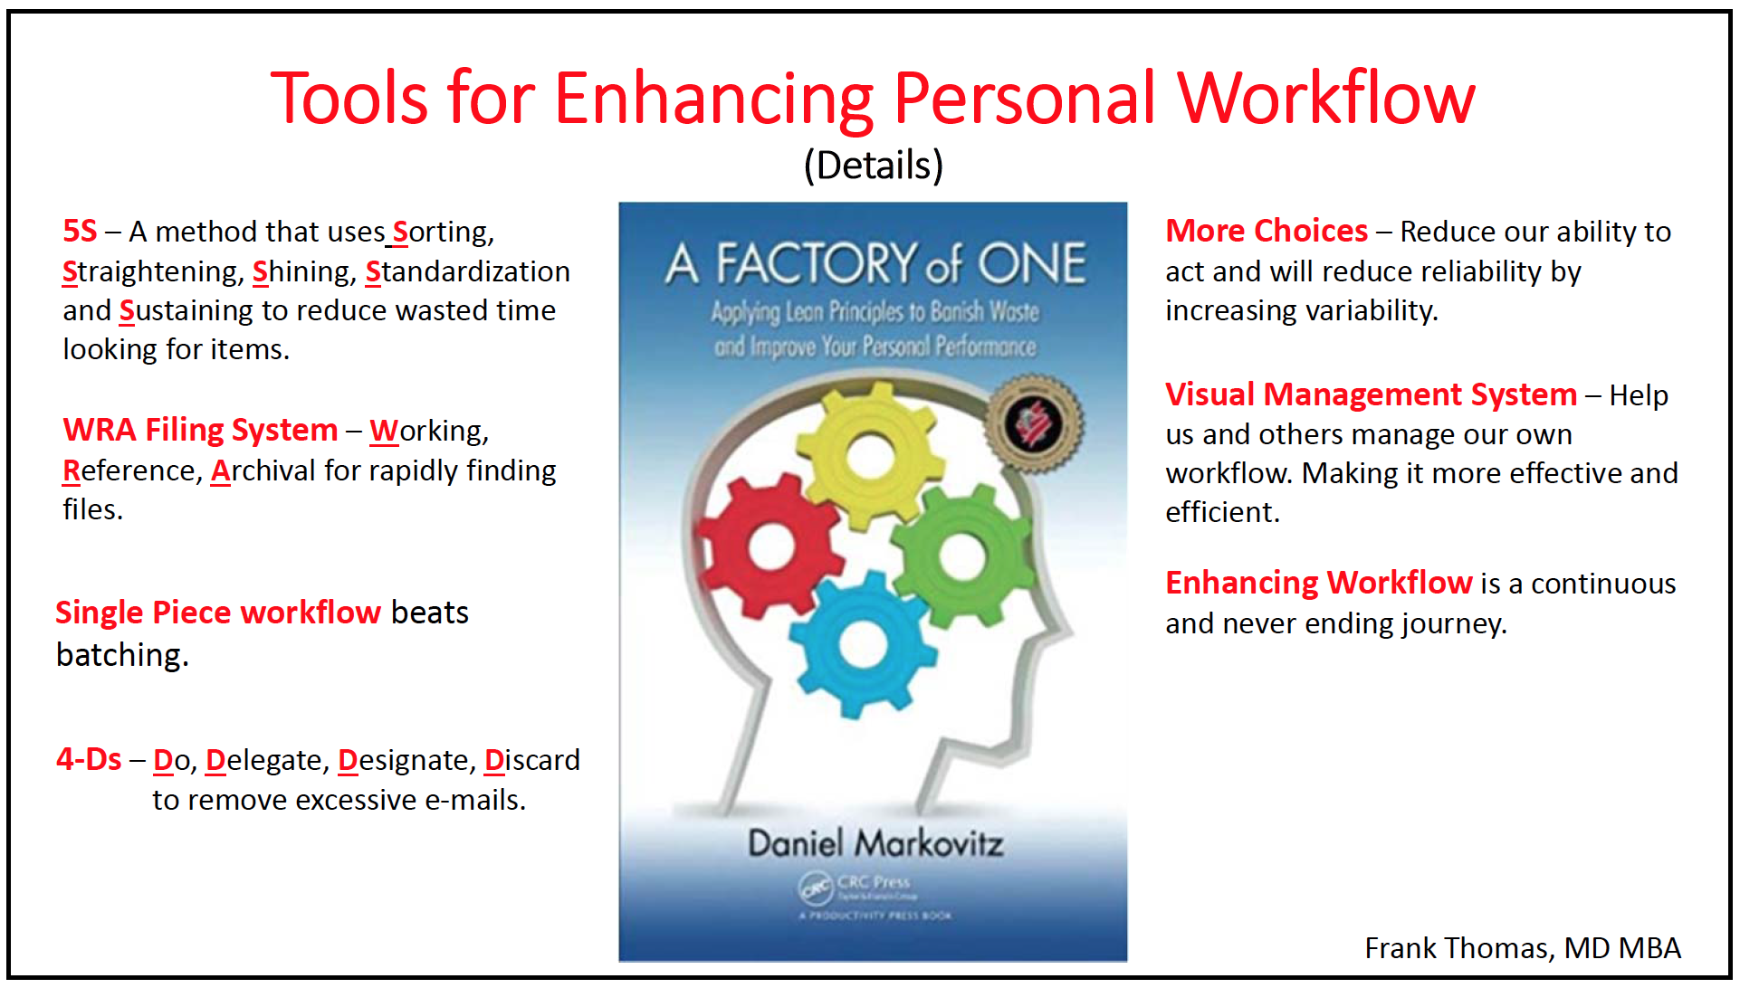
Factory of One-Concepts of Individual Process
Notes:
8
Into Weekend5%

Slide 23
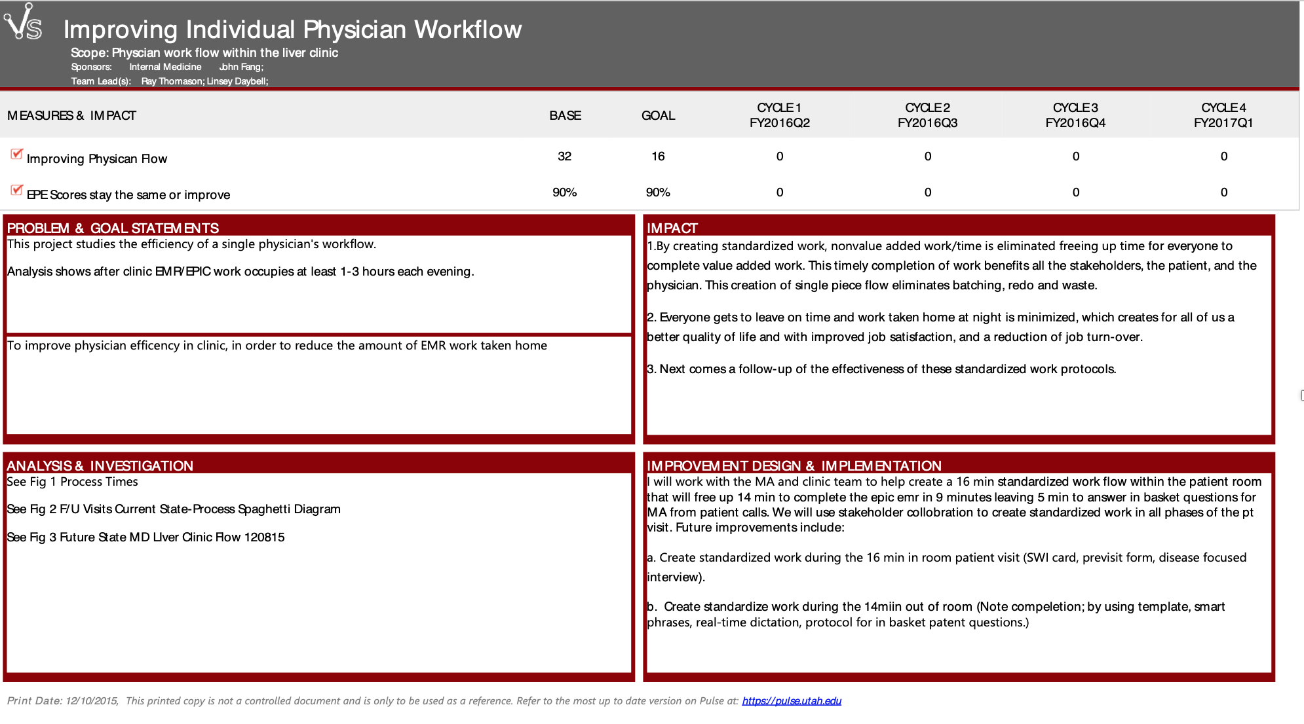

Slide 24
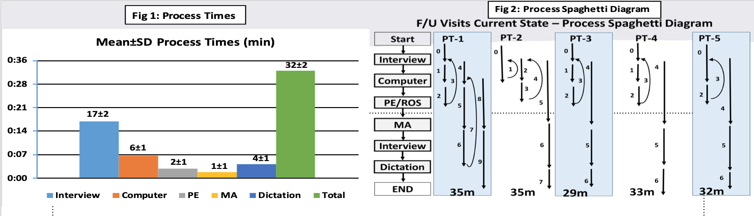
Process Time in the examine room
Bar Graph vs Spaghetti Diagram
My Mentor: 85% WASTE
“My use of the computer during a visit reminded him of a Treasure Hunt from his childhood”
Notes:
not use computer
no sense of time

Slide 25
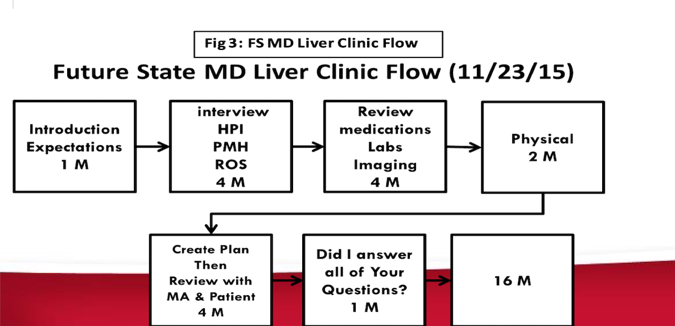

Slide 26
Value: Toyota’s Gemba Kaizen- Improve Productivity Elimination of Waste or “Muda”
Inefficient or Excessive Movement
Excessive Walking
Duplication
Interjecting attempt at note creation on computer
Unorganized
Overproduction Adding Data
not necessary for the specialty
Batching

Slide 27
5 S’s: Back Bone of the Work Place(Gemba) organization
Sort out all unnecessary items from the Gemba.
Leader walks thru –Red Tape
Straighten things out-orderly placement of items. Organized
Shine-sweep the floor keep everything neat
Standardize - systematizing the first 3 steps. Standardized work
Sustain- maintaining what the created. Need to constantly reassess

Slide 28
Survival Skills I Learned in Value
If you have frustration, you have an undesirable outcome.
So take ownership and fix it.
To change the outcome, must change the process.
Share the problem-solving fellow employees
1st remove process waste to improve efficiency.
2nd change process to optimize effectiveness
3rd Create standardized protocols to reduce process variability which
improves outcome reliability
Most problems are process, not people problems

Slide 29
Survival Skills I Learned in Value:
Realization I used Batching to approach work which
resulted in taking incomplete work home
Single Process Flow is the most effective and efficient method for approaching clinic flow
Notes:
END How I applied

Slide 30
Resources:
Wealth of available information
Online courses to a variety of books
Accelerate.com –Online Value courses
Request Value Mentor through our
Value Engineering Department
Notes:
END with another applied process waste elimination
Received a call from DrSussman who was threatening

Slide 31
So…….How did a Cow save Dr. Sussman from a possibly career ending catastrophe ?
I received a very disturbing about Muda
Frustration
-Time walking to and from the patient’s examine room to his computer
-Logging on booting up through multiple fire walls
Logging off
Log-on …..2 minutes
log-off …..1 minute
14/day
14 x 3=42 minutes/day-?Waste?
Not including walking time nor the damage caused by Residual Focus and Distraction

Slide 32
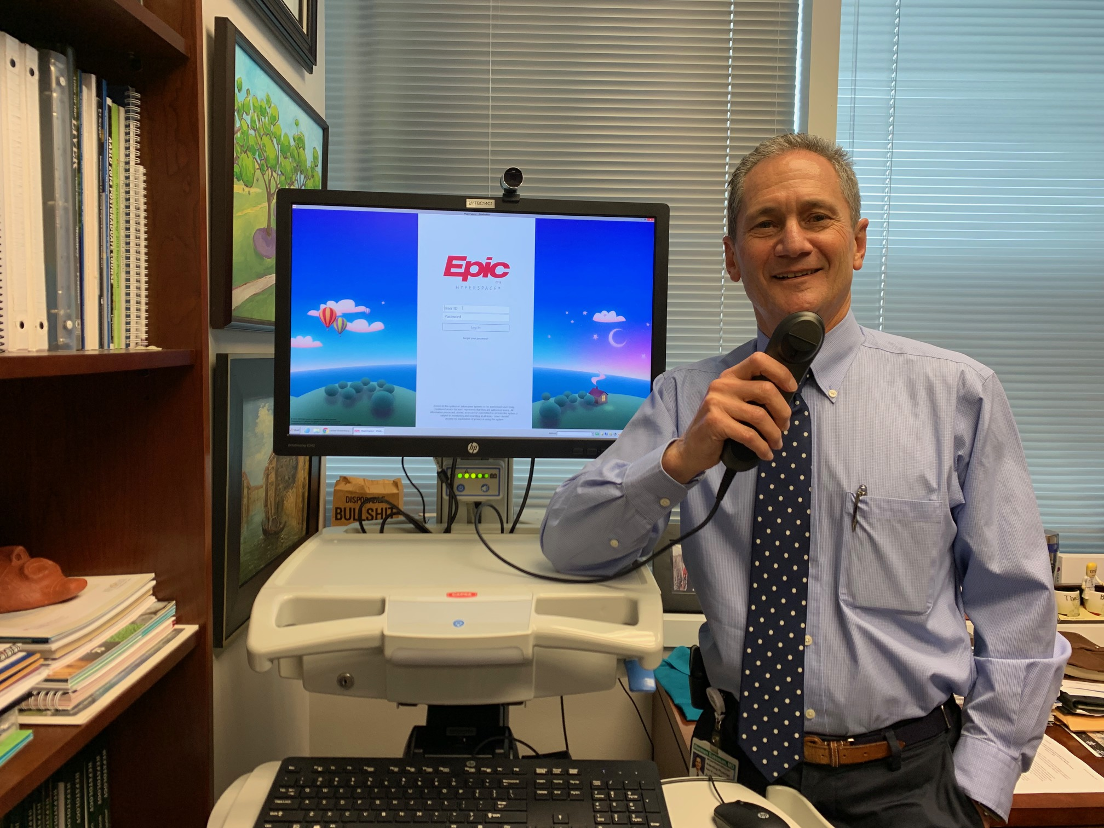
Buddy’s COW
Computer
On
Wheels

Slide 33
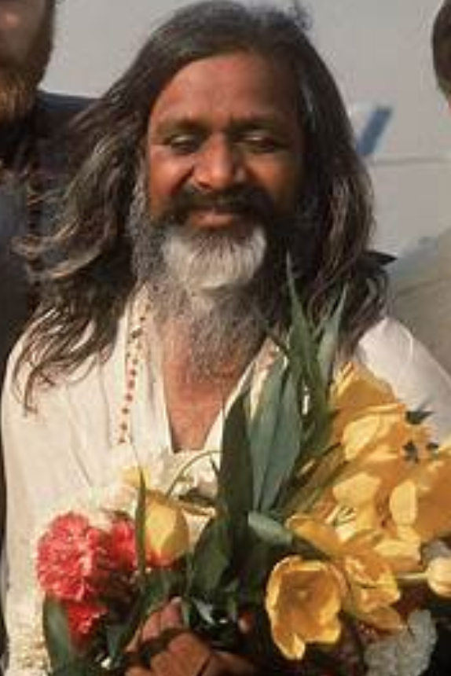
Mindfulness: TM-Transendental Meditation
SMU 1969-I attended the first TM course
taught on campus by
the Marharishi
my personal Mantra

