Slide 1
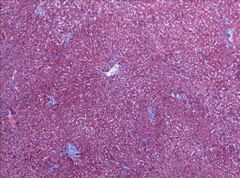
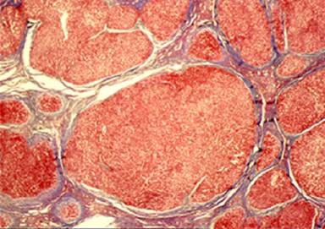
Management of Cirrhosis
AN UPDATE
Normal Liver
Cirrhosis
RAY THOMASON MD
Notes:
I would like to thank the codirectors of this years course Drs Gallegos n Sussman who have graciously asked me to speak along side this very esteemed faculty on the updates of managing cirrhosis
In addition I want to take this time to acknowledge and thank Colleen Sorensen my dear friend and our behind the scene den mother who has really made this all possible -
I realize that we all have our favorite disease states
Dr Vierling and autoimmune
Dr pockros and viral hepatidides
Dr box n Sussman and their infatuation with evils of wheat and corn syrup
But I would say to you we've not been able to eradicate these diseases and at the end of the day we all have to face our failures and stare the enemy in the face -cirrhosis

Slide 2
Learning Objectives
Review the prognosis of decompensation
Review approach to managing cirrhosis
Strategies to prevent decompensation
Review new therapies and diagnostic modalities
Understand the effect of Sarcopenia on decompensation

Slide 3
Natural History – Chronic Liver Disease
Chronic liver
disease
Compensated
cirrhosis
Decompensated
cirrhosis
Death
Development of complications:
Variceal hemorrhage
Ascites
Encephalopathy
Jaundice
Cirrhosis is classified into two main prognostic stages based on clinical complications
Notes:
Involves around two stages of clinical complicationsOneWithoutClinical complications and one withEach of whichHasIts own unique prognosis

Slide 4
Survival: Compensation vs Decompensation
1987 vs. 2006 – are we getting better?
Ginés P, et al. Hepatology 1987; 7:122-8
D’Amico et al. J Hep-2006
Notes:
startedo in preparingI noticedMy slide prognosis was dated 1987So I looked for a more currentUpdateAnd found thatWith D’AmicoIn 2006
But Sbut you can’t doing updateUnless you know From whence you startedwhereYou

Slide 5
Approach to Managing Cirrhosis
Treat the underlying disease- strive for good liver hygiene
Prevent progression to decompensation
Manage complications of decompensation

Slide 6
Treat the Underlying Disease
Increasing liver
fibrosis
Chronic liver
disease
Compensated
cirrhosis
Decompensated
cirrhosis
Death
Alcohol
Hepatits C/B
NASH
Cholestatic
Autoimmune
Treating etiology
Notes:
On the online websiteThe bullet pointsAre reviewed in detailWith referee journals

Slide 7
In HCV cirrhosis-viral clearance leads to less decompensation, transplantation or death

Slide 8
In Hep B cirrhosis antiviral therapy decreases disease progression and development of HCC

Slide 9
Complete Alcohol Cessation Aggressively treat autoimmune hepatitis

Slide 10
Goal-Prevent Progression
Compensated
cirrhosis
Decompensated
cirrhosis
Further
decompensation
Death
Avoid superimposed liver injury
No alcohol
Cautious use of drugs
Be aware of hepatitis B reactivation
Avoid unnecessary surgeries
Aggressive early treatment of infections

Slide 11
Goal–Prevent Progression
Chronic liver
disease
Compensated
cirrhosis
Decompensated
cirrhosis
Death
Alcohol
Hepatits C/B
NASH
Cholestatic
Autoimmune
Screen for varices
Aim for normal weight
A/B vaccination
Treat etiology
Notes:
So after we have treated the underlying diseases Then we certainly need to prevent further injury

Slide 12
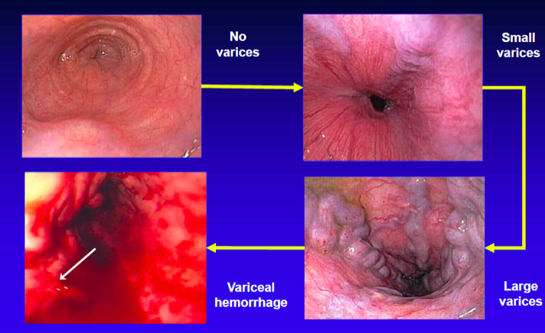
Variceal Size-the main predictor of Bleeding

Slide 13
Two treatments reduce risk of first Variceal bleed in Medium/Large Varices

Slide 14
Large Varices without bleeding-impact of decrease in HVPG on Survival

Slide 15
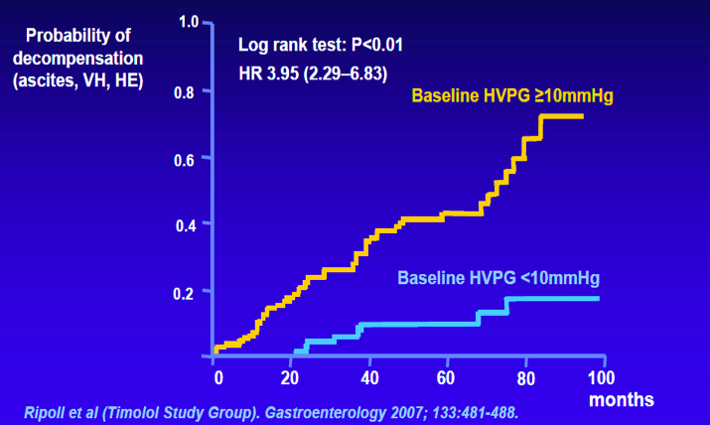
Probability of Decompensation using a benchmark of HVPG of 10mmHg

Slide 16
Large Varices without bleeding-impact of decrease in HVPG on Ascites Formation

Slide 17
Goal–Prevent Decompensation
Increasing liver
fibrosis
Chronic liver
disease
Compensated
cirrhosis
Decompensated
cirrhosis
Death
Alcohol
Hepatits C/B
NASH
Cholestatic
Autoimmune
Preventing first variceal bleed
Variceal hemorrhage
Ascites
Encephalopathy

Slide 18
What’s New in Slowing Disease Progression
Treatment of Obesity-Weight Loss
Daily Coffee

Slide 19
Obesity Independent Predictor of Decompensation
Berzigotti, Garcia-Tsao (Timolol Study Group). Hepatology 2011;54:555-61
Notes:
We will Review the impact of coffee later and talk
Burgers coffee And Garcia soAnd the Tamil walls studyShowedThat OBCWas an independent predictor of decompensation
Conversely weight lossReduces the probability of decompensation

Slide 20
Coffee In Liver Disease
Daily caffeine intake above two cups of coffee was associated with lower rate of hepatic fibrosis.
Modi AA, Feld JJ, Park Y, et al.
Increased caffeine consumption is associated with reduced fibrosis.
J Hepatol 2010;51:201-9.
Molloy’s cross-sectional study demonstrated an inverse relationship between coffee consumption and hepatic fibrosis
Molloy JW, Calcagno CJ, Williams CD, Jones FJ, Torres DM, Harrison SA. Association of coffee and caffeine consumption with fatty liver disease, nonalcoholic steatohepatitis, and degree of hepatic fibrosis. Hepatology. 2012;55(2):429-36. doi:10.1002/hep.24731.

Slide 21
Coffee In Liver Disease
Saab’s recent review : clear benefit of coffee consumption with a variety of liver chemistries, histology diseases, and HCC Saab S, Mallam D, Cox GA, 2nd, Tong MJ. Impact of coffee on liver diseases: a systematic review. Liver international : 2014;34(4):495-504
Not only has coffee been associated with a decrease in a number of liver diseases, but its consumption may also decrease mortality
Freedman ND, , et al. Association of coffee drinking with total and cause-specific mortality. N Engl J Med 2012; 366: 1891-904
Notes:
Coffee consumption is global and is one of the most popular consumed beverages
Higdon JV, Frei B. Coffee and health: a review of recent human research.
CRIT Rev Food Sci Nutr 2006: 46: 101-23.
Over 50% of Americans consume coffee daily
National Coffee Association USA. http://www.ncausa.org. Accessed Feb 2, 2013

Slide 22
Coffee In Liver Disease
Consumption of a dark roast coffee decreases the level of spontaneous DNA strand breaks:
A randomized controlled trial.
Conclusion: Regular coffee consumption contributes to DNA integrity
Bakuradze T¹, Lang R, Hofmann T, Eisenbrand G, Schipp D, Galan J, Richling E. Eur J Nutr. 2015 Feb;54(1):149-56
Notes:
Coffee consumption has been reported to decrease oxidative damage in peripheral white blood cells (WBC). However, effects on the level of spontaneous DNA strand breaks, a well established marker of health risk, have not been specifically reported yet. We analyzed the impact of consuming a dark roast coffee blend on the level of spontaneous DNA strand breaks.

Slide 24
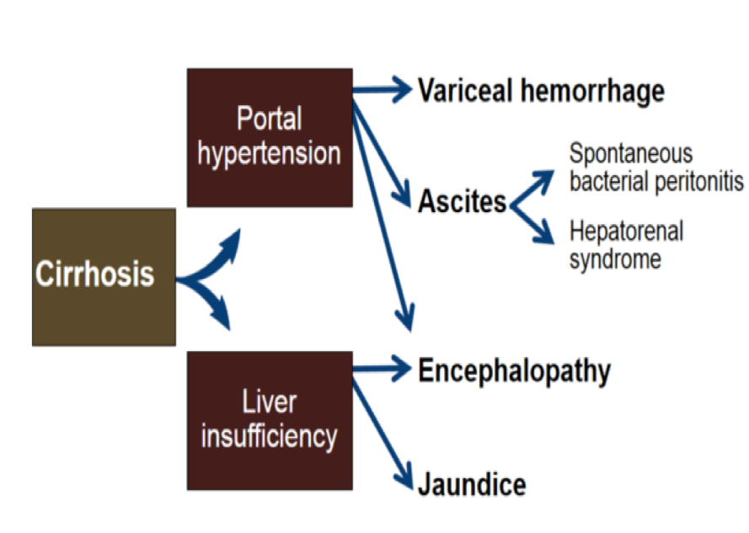
The Complications of Cirrhosis Hepatic Insufficiency or Portal Hypertension
Notes:
So let this go backTo OslerAnd listen to his definitionOf the complications of cirrhosis
So let’s nowReviewWhat is new and the futureIn the state of clinical compensation

Slide 25
What’s New in Portal Hypertension
Vascular Tone
Statins

Slide 26
Statins – a Mechanism
Pleiotrophic action
on endothelial cell function - improved portal vascular tone
Ramirez, Gonzalo et al. Current Vascular Pharmacology.2012 10:767-772
Notes:
Read
And with that comes several good EFax

Slide 27
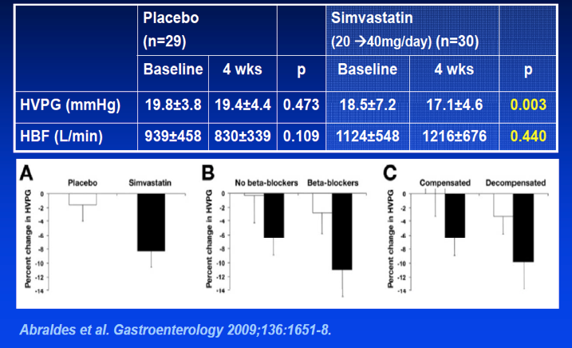
Simvastin-HVPG and Blood Flow
Notes:
With statins there is a decreased portable pressure.The drop is similar to the useOfBeta blockers.There is no reduction in hepatic blood flowAs shown by the brother dallies 2009 and 2013

Slide 28
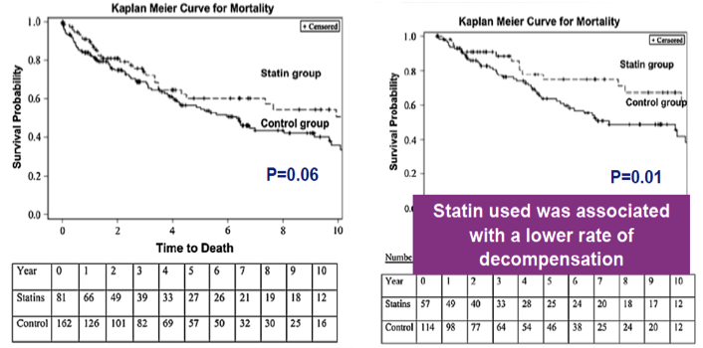
Statins-Lower Rate of Decompensation
All patients with cirrhosis
Patients with Child A cirrhosis
Kumar et al. Dig Dis Sci 2014;59:1958-65
Notes:
Statins even though a lower rate of decompensation

Slide 29
Simvistatin-added to standard therapy following Variceal Bleed-Reduction in all cause mortality
Abraldes et al. EASL 2013
Notes:
The study from 2013ShowedOr said differently basically a decrease and all cause mortality

Slide 30
What’s New with Ascites
B-type Natriuretic Peptide Use in New Onset Ascites
Beta Blockers

Slide 31
To Understand Ascites- What Should You First Understand?
1. Paul Simon’s lyric:
“Why am I so soft in the middle when the rest of my life is so hard? ”
You Can Call Me AL- Graceland Aug1986 OR
2. Portal Hypertension

Slide 32
Courtesy of Guadalupe Garcia-Tsao

Slide 33
SAAG–Total Protein Table
 | SAAG >1.1 | SAAG <1.1
Total Protein <2.5 | Cirrhosis Acute Liver Failure | Nephrotic Syndrome Myxedema
Total Protein >2.5 | CHF Constrictive Pericarditis Budd-Chiari Syndrome Venocclusive Disease | Peritoneal Carcinomatosis Tuberculosis peritonitis Pancreatic Ascites Chylous Ascites

Slide 34
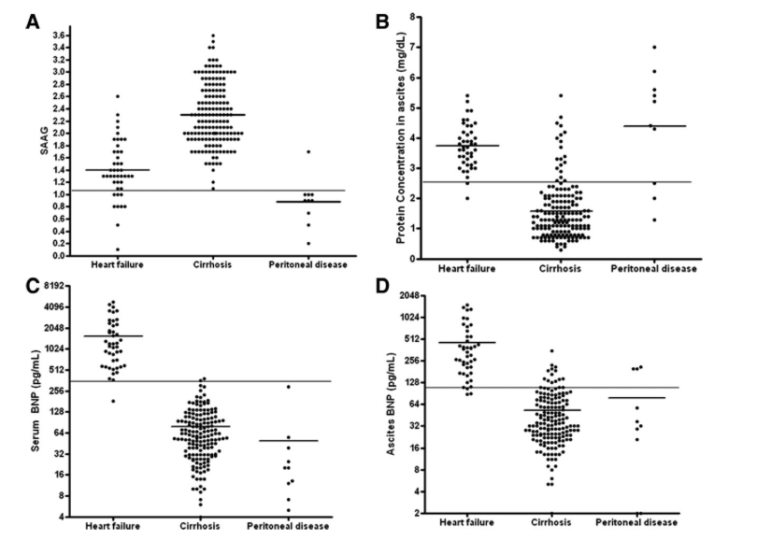
Ferrari and Garcia-Tsao.Hep:Mar 2014

Slide 35
BNP-Superior to SAAG/Total Protein
Plasma BNP-SUPERIOR in discriminating
ascites due to heart failure vs cirrhosis
Plasma BNP > 364 pg/ml 98% sensitivity, 99% specificity, 99% diagnostic accuracy predicting ascites due to heart failure
Plasma BNP < 182 pg/ml negative likehood of ascites caused by CHF
Ferrari and Garcia-Tsao.Hep:mar 2014

Slide 36
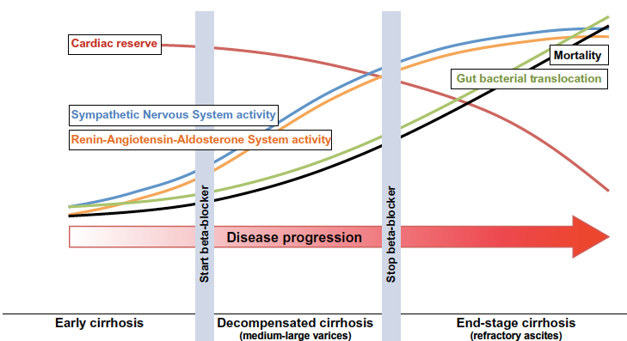
Appropriate Use of Beta Blockers
Ge and Runyon. Journal of Hepatology 2013 vol. 59 j 203–204

Slide 37
What’s new in Encephalopathy
Glycerol Phenylbutyrate (GPB)
Zinc
Probiotics
Treatment of Sarcopenia

Slide 38
Medical Therapy for Overt Hepatic Encephalopathy
Current medical therapies are thought to work by reducing blood ammonia.
Current drugs approved for managing HE are
non-absorbable disaccharides and
non-absorbable antibiotics.
Investigational agents -either
increase flux through the urea cycle or
increase urinary excretion of other ammonia-containing compounds.

Slide 39
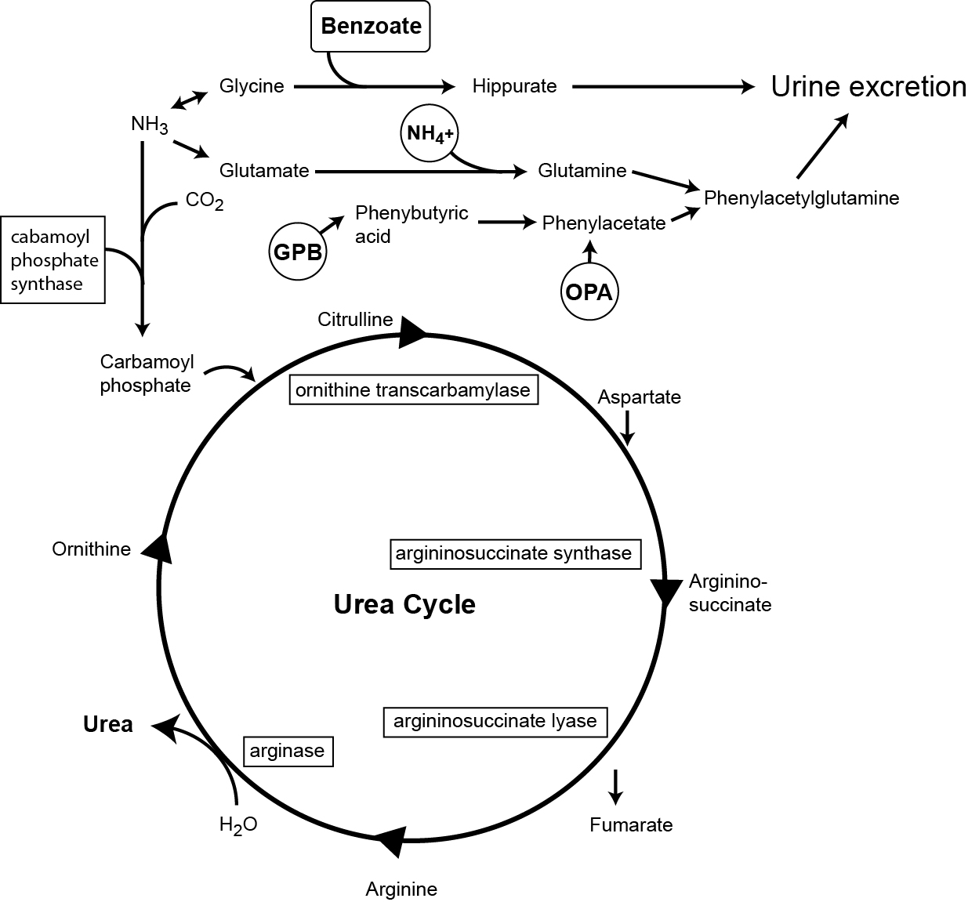
Three Elimination Pathways of Ammonia
Sussman, Norman. Clinics in Liver Disease:pending publication
Notes:
Figure 2: Elimination of ammonia; three potential elimination pathways.
Ammonia is normally eliminated as urea via the urea cycle – L-ornithine L-aspartate (LOLA) increases activity of the urea cycle.
Patients who lack one of the enzymes of the urea cycle accumulate ammonia. These patients are treated with ammonia scavengers that increase ammonia excretion in the urine.
Benzoate promotes ammonia excretion as hippurate (one NH₄⁺ per molecule).
Phenyacetate (given as ornithine phenylacetate - OPA) or its precursors, sodium phenylbutyrate (SPB) or glycerol phenybutyreate (GPB) promote ammonia excretion as phenylacetylglutamine (two NH₄⁺ per molecule).

Slide 40
Hepatic Encephalopathy–a combination of liver failure and portosystemic shunting.
HE is associated with elevated blood ammonia concentration.
Factors other than ammonia may contribute to HE, but remain to be defined. HE is frequently ascribed to excess activity of gabaergic (inhibitory) neurons in the brain in response to nitrogenous overload.

Slide 41
Medical Therapy for Overt Hepatic Encephalopathy
Lactulose and rifaximin. Two drugs are FDA approved in the USA
Zinc-Low zinc reported in cases of HE, leading to the theory zinc supplementation might prove therapeutic.
A meta-analysis of four trials found
improvement in the number connection test in three trials,
but episodes of HE were not reduced in two trial.
Zinc replacement is not harmful, but it does
not appear to have a place in the management of HE.

Slide 42
Medical Therapy for Overt Hepatic Encephalopathy
Glycerol Phenylbutyrate (GPB):
Liquid triglyceride precursor of PBA
combines with glutamine to form
phenylacetylglutamine (PAGN), excreted in the urine.
A phase 2 clinical trial showed
GBP– lowered serum ammonia and
reduced first event and total HE events.
GPB is available as Ravicti® (Hyperion Therapeutics Inc.).
It is approved for restricted use in hyperammonemia
phase 3 testing is pending for HE.

Slide 43
Probiotics-Lack of consistency in probiotic used
Primary prophylaxis study showed that overt encephalopathy occurred in more controls than treated patients (P < .05; hazard ratio for controls vs probiotic group, 2.1; 95% confidence interval, 1.31-6.53).
130 patients following an episode of HE were randomized to receive
either VSL#3 (CD Pharma India) or placebo.
The probiotic group had a lower incidence of breakthrough HE
although this did not reach statistical significance (34.8% in the probiotic group vs 51.6% in the placebo group; hazard ratio HR 0.65; 95% confidence interval 0.38-1.11; P = .12)³⁹.
Notes:
The effectiveness of lactulose and rifaximin suggest that altering gut flora to a non-urease producing population may be effective in managing HE. Probiotics are not an accepted therapy for HE, but a
As in previous studies from this group, abnormal psychometric testing correlated with the development of HE³⁸.

Slide 45
What’s New in Sarcopenia
Definitions
Survival
Myostatin/Ammonia Connection
Timing of treatment

Slide 46
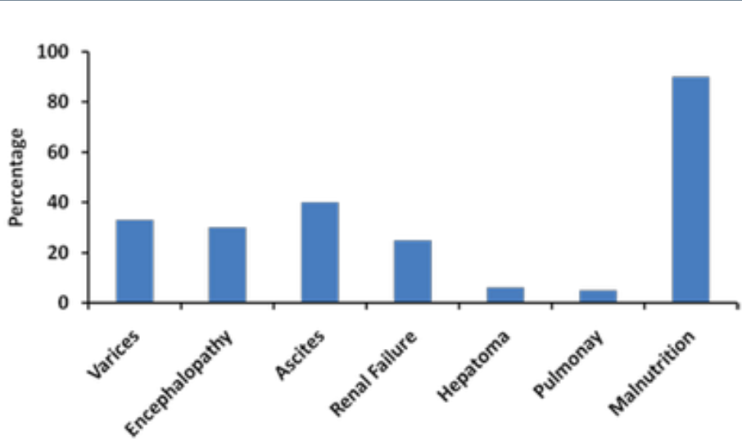
Complications of Cirrhosis

Slide 47
Malnutrition-a New Definition
Sarcopenia or Loss of Skeletal Muscle – decrease in fiber diameter – decrease in number of muscle fibers – decrease in number of nuclei
Altered Energy Metabolism

Slide 48
Survival in Sarcopenia

Slide 49
Decrease Function Predicts Survival

Slide 50
Cirrhosis with Sarcopenia a State of Accelerated Starvation
Notes:
Cirrhosis causes low RQ+increase fat metabolismafter overnight fast
Increase use of leucine for energy metabolism-Potential treatment
Increase gluconeogenesis-use of protein for energy
NET EFFECT-decrease protein mass

Slide 51
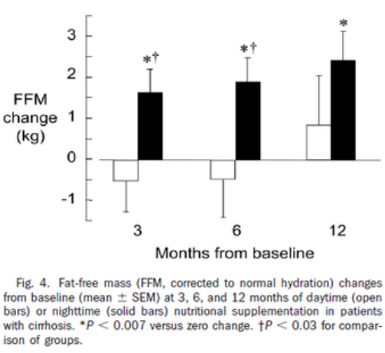
Timing of Protein Supplement Effect

Slide 52
Malnutrition in Cirrhosis
Gluconegenesis is Defective in Cirrhosis
Energy is Removed from Muscles at Night
Muscles Disappear as Ascites Develops
Two cans of Ensure plus between 9 PM and 7 AM Increased Muscle Mass in an RCT

Slide 53
Cirrhosis a Disease of Accelerated Starvation
Fat and protein are used preferentially
Gluconeogenesis is defective in cirrhosis
Leucine provides 7% of energy ( 3% normally)
Energy is Removed from Muscles at Night
Muscles Disappear as Ascites Develop
Infection adds stress on top of starvation

Slide 54
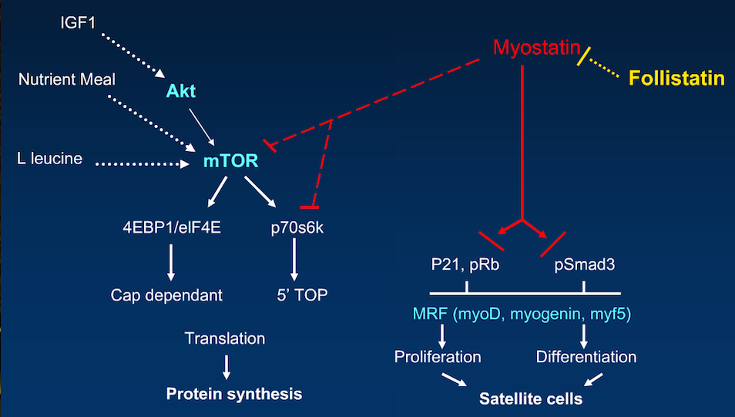
Steps to Produce Muscle Mass
Ammonia

Slide 55
Mechanisms of Sarcopenia
Decresed Synthesis –Anabolic Resistance –Increased Myostatin-Driven by Ammonia Inhibits growth-differentiation in Skeletal muscles
Increase Breakdown –Altered metabolism of cirrhosis

Slide 56
Use of mTOR in Transplantation

Slide 57
Therapy based on Mechanisms of Sarcopenia

Slide 58
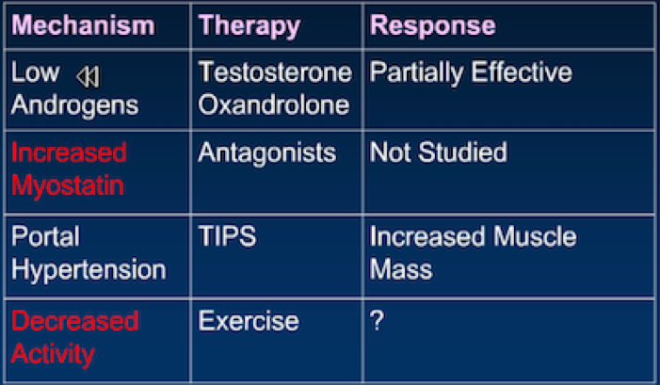
Therapy based on Mechanisms of Sarcopenia

Slide 59
Big Finish

Slide 60
What Can We Do
Understand Decompensation and it’s implications
Manage Cirrhosis
Follow the guidelines

Slide 61
What can we do
Ascites -check BNP -Avoid Bblockers when hypotensive
Portal Hypertension-statins
Encephalopathy -treat sarcopenia -Glycerol phenylbutyrate -probiotics
Sarcopenia -assess function -bedtime snack -treat ammonia

Slide 63
Acknowledgement
Guadalupe Garcia-Tsao MD
Arthur McCullogh
Bruce Runyon MD
Norman Sussman

