Slide 1
Cholestasis
Hepatology Update
Ray Thomason, M.D.
February 23 2013

Slide 2
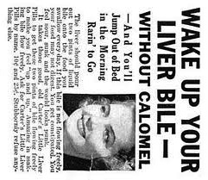
YES
BILE IS SO MUCH MORE
THAN YOUR ORDINARY
DETERGENT

Slide 3
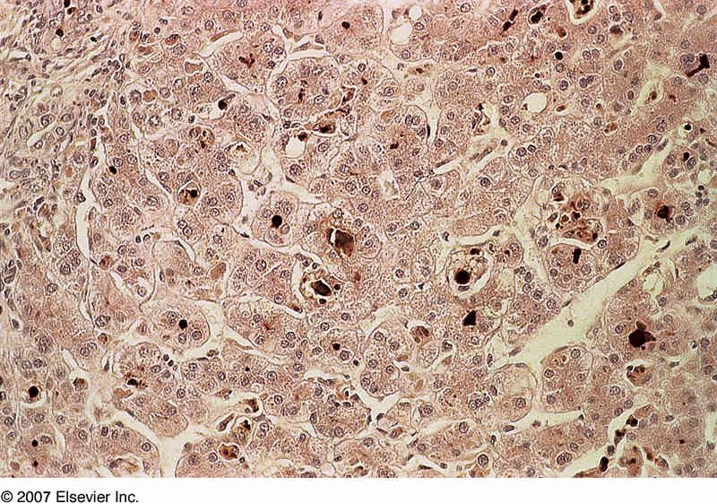
CHOLESTASIS
Failure To Deliver Bile
Or Abnormal Accumulation of
Bile Acids

Slide 4
LEARNING OBJECTIVES
1 ) The definition of Cholestasis and understand the causes
The anatomy of the Enterohepatic Circulation with
related bile flow and composition
3) The transport system for Bile Acids , Bilirubin, and Organic Anions
4) Effects of Bile Acids
5) The consequences of Bile Acid Excess
6) How to manage cholestatic liver disease based on the targeting the
transporters
7) Future adverse effects with new DAA

Slide 5
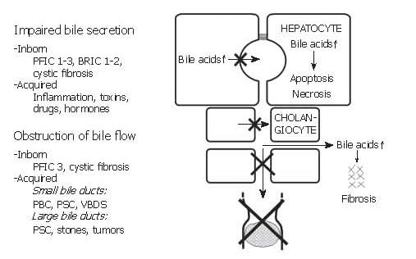
Causes of Cholestasis- failed delivery of bile to duodenum
  BRIC: benign recurrent intrahepatic cholestasis
  PFIC: progressive familial intrahepatic cholestasis
  PBC: primary biliary cirrhosis
  PSC: primary sclerosing cholangitis
  VBDS: vanishing bile duct syndrome
  Cystic fibrosis

Slide 6
The enterohepatic circulation of bile acids
Cholesterol →→→
8-10x
qd
Small bowel

Slide 7
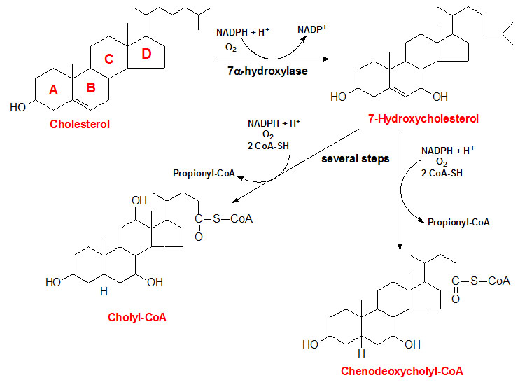
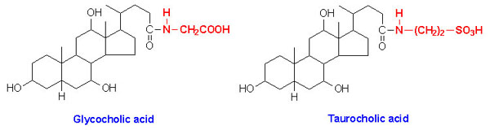
Bile Acid Synthesis
Bile Acids (BA’s) are made in the liver from the cytochrome P450 oxidation of cholesterol
BA’s emulsify dietary fats, eliminate cholesterol, osmotically drive flow of bile to eliminate catabolites from liver, aid in reduction of intestinal and biliary bacteria
Bile acid refers to protonated (-COOH) form and bile salt to the ionized (-COO) form
Major BA’s are cholic acid and chenodeoxycholic acid
BA’s conjugated w/ glycine or taurine, or w/ sulfate or glucuronide and stored in gallbladder
Taurocholic acid and glycholic acid represent ~ 80% of all bile salts
Conjugation increases water solubility, preventing passive reabsorbption in the intestine
~90% excreted BA’s reabsorbed in ileum and recycled via active enterohepatic circulation

Slide 8
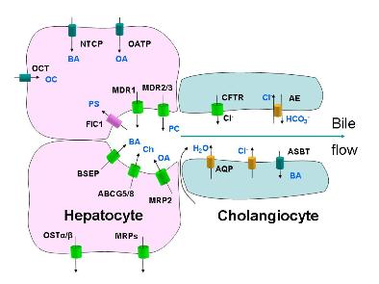
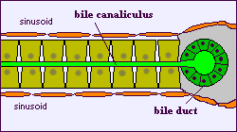
Terminal Branch of the Biliary Tree

Slide 9
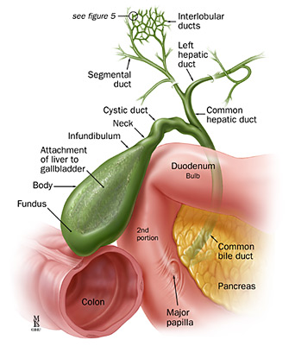
Extrahepatic Biliary Tree

Slide 10
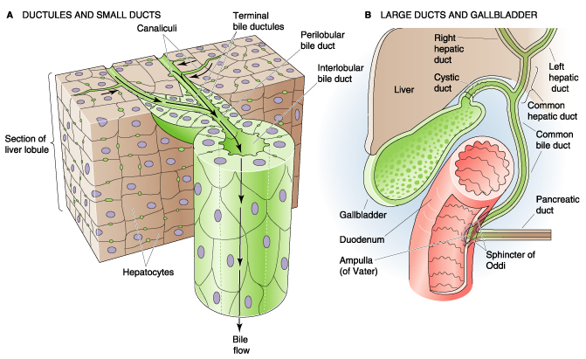
Biliary Drainage
Fig 45-4

Slide 11
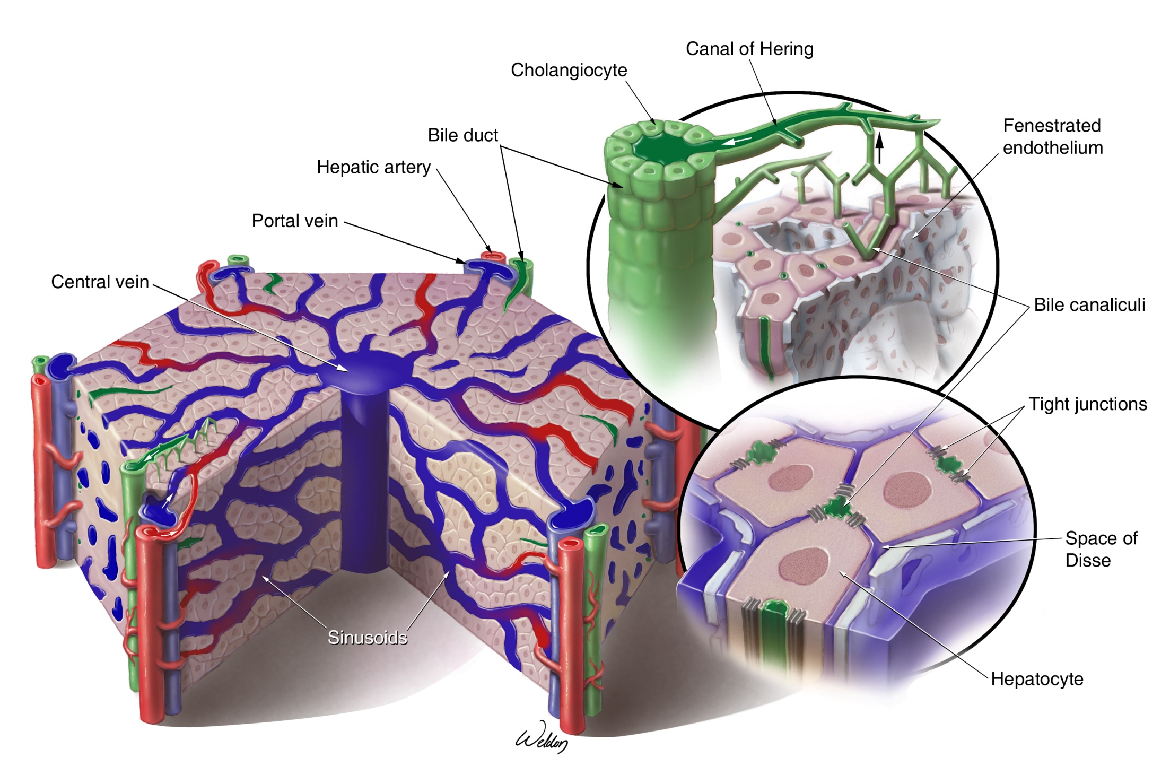

Slide 12
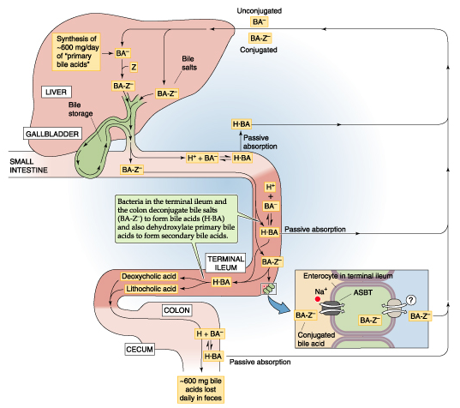
Fig 45-13

Slide 13
Summary of Liver Anatomy
Hepatocytes are secretory epithelial cells
Hepatocytes separate the blood space (sinusoids) from the bile space (canaliculi)
Liver contains hepatocytes, Kupffer, stellate cells
Liver has a dual blood supply, but a single venous drainage system
Arrangement of hepatocytes can be considered as classic lobule, portal lobule, or acinar unit
Bile drains from canaliculi to larger bile ducts
Gallbladder stores bile for controlled release

Slide 14
Bile Composition Varies
Along the Biliary Tree
CANALICULAR
Liver
HEPATIC
Canalicular Bile plus
Ductular Modification
GALLBLADDER
Concentrated and
Acidified Hepatic Bile
DUODENAL
Gallbladder Bile plus
Gastric, Pancreatic, and
Intestinal Juices

Slide 15
Bile Flow
The choleretic activity varies from 8 to 30 µL bile flow per µmole of bile acid secreted
In humans most canalicular bile flow is generated by bile acid secretion
Newly secreted hepatic canalicular bile is modified during its transit in the biliary tree – ductular epithelial cells (cholangiocytes) may add up to 40% volume of bile.
Ductular modifications to hepatic bile
  Absorption of solutes (glucose, amino acids, bile acids)
  Secretion of solutes (bicarbonate, chloride)
  Addition of water paracellularly and through channels (aquaporins)

Slide 16
Bile Formation
Osmotically active inorganic and organic solutes are secreted into the canalicular lumen – water follows passively
Flow is described as bile acid dependent (organic ions) and bile acid independent (inorganic ions)
ATP-dependent carriers actively secrete bile acids
Water, plasma electrolytes, calcium, glucose, amino acids, bicarbonate, etc. flow into the canaliculus in response to the osmotic gradient

Slide 17
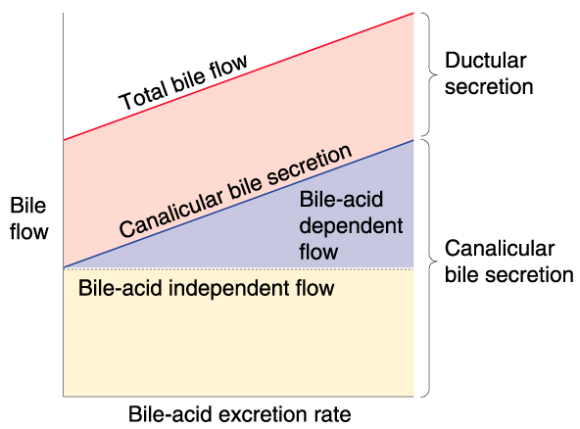

Slide 18
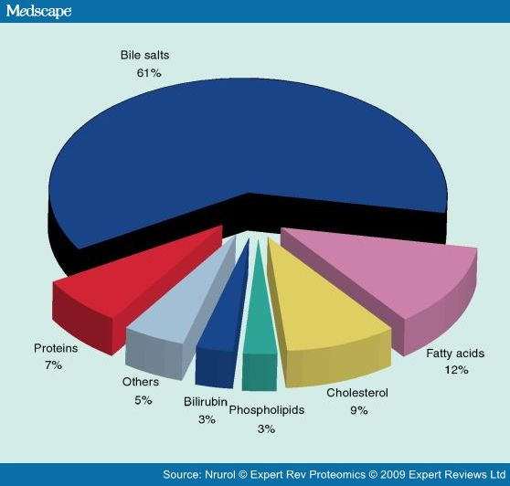
Solute composition of human bile

Slide 19
Canalicular Transporters Determine Biliary Components
?
ATP
Solute composition of human bile
FIC1
BA⁻
ATP
PFIC1
7 mM
Phospholipids
17%
3 mM
Cholesterol
3%
BSEP
PFIC2
Proteins
7%
Bilirubin
1%
ATP
XOL
Sitosterolemia
Electrolytes
31%
ABCG5 G8
ATP
PFIC3
Bile acids
41%
30 mM
MDR3
PL
Dubin-Johnson
MRP2
ATP
Conj. Bilirubin

Slide 20
Hepatic Bile Acid Transport
95% of the bile acids secreted into bile are derived from the recirculating pool – highly efficient transport is needed
Liver parenchymal cells must transport bile acids efficiently from the portal blood into bile
Trans-hepatocellular movement of BA is driven by primary (ATP-dependent), secondary (Na⁺ gradient dependent), and tertiary (OH⁻- or HCO₃⁻-dependent anion exchange) transport systems at the sinusoidal and canalicular plasma membranes
Bile acid synthesis is zonal
  Periportal hepatocytes absorb and excrete BAs
  Pericentral hepatocytes synthesize BAs

Slide 21
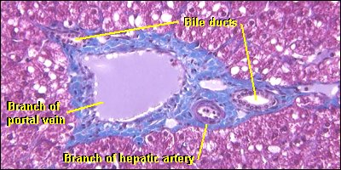
Hepatic Zonal Architecture (Microanatomy)
Central Vein (THV)
Portal Tract (Triad)
Bile ducts
Branch of
Portal Vein
Branch of Hepatic Artery

Slide 22
Hepatic zonal architecture
Central Vein
Zone 1
Fatty acid β Oxidation
Cholesterol Synthesis
Gluconeogenesis
Zone 3
Drug Metabolism
Ketogenesis
Bile acid Synthesis
Glycolysis
Portal Vein
Hepatic Artery
Bile Duct

Slide 23
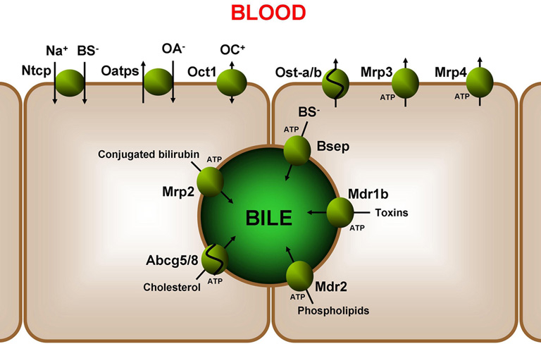
Molecular Pathways of Bile Synthesis
Composition of bile
Hepatocellular bile formed by active transport of solutes into biliary canaliculi
  Bile Salts
  Conjugated bilirubin
  Cholesterol
  Phospholipids
  Xenobiotics(drugs/toxins)
Creating osmotic gradient between canalicular bile and sinusoidal plasma
Causing flow of water/electrolytes into canaliculi through hepatocellular “tight junctions”

Slide 24
Bile Salts - BSEP
ATP-dependent bile salt export pump (BSEP)
Member of ATP-binding cassette family: ABCB11
BSEP has high affinity for bile salts – charged
Transport against a significant gradient
Mutation in BSEP can produce a form of progressive intrahepatic cholestasis
  PFIC2
  High GGT type

Slide 25
Non-Bile Acid Organic Anions
Multidrug resistance-associated protein 2 (MRP2)
  Member of ATP-binding cassette: ABCC2
  Broad substrate specificity: divalent, amphipathic phase II products (GSH, glucuronide, sulfate)
  Bilirubin diglucuronide, sulfated bile acid, glucuronidated bile acids, several xenobiotics
  Absence causes conjugated hyperbilirubinemia (Dubin-Johnson syndrome)
ABCG2
  Estrone-3-sulfate, diehydroepiandrosterone sulfate
Inorganic anions are excreted by anion exchangers

Slide 26
Organic Cations
Transport is poorly understood
Confusing nomenclature
MDR1 (ABCB1) on the canalicular membrane
  Secretes bulky organic cations including xenobiotics, cytotoxins, anticancer drugs (e.g. colchicine, quinidine, verapamil, cyclosporine)
Electroneutral H-organic cation exchanger – uncertain role
Passive movement of cations

Slide 27
Biliary Lipids
Phopholipids and Cholesterol
MRD3 (ABCB4) – “flippase”
  Promotes the active translocation of phophatitylcholine (PC) from the inner to the outer leaflet of the canalicular membrane – PC absorbed into bile → micelles
  Absence causes progressive liver disease (PFIC3)
ABCG5 & ABCG8 (heterodimer)
  Cholesterol transport – mechanism uncertain
  Absence causes sitosterolemia:
    Defective secretion of dietary sterols
    Increased absorption of plant and dietary plant sterols
    Hypercholesterolemia
    Early atherosclerosis

Slide 28
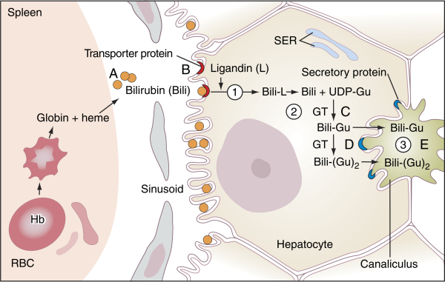
Bilirubin Transport

Slide 29
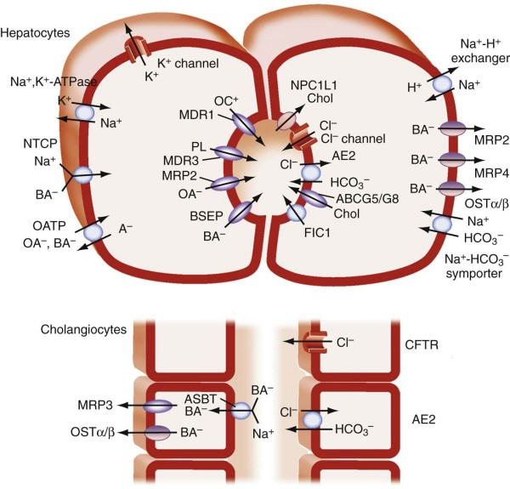
Na+-taurocholate
cotransporting polypeptide

Slide 31
Molecular Pathways of Bile Synthesis
Final bile composition depends on transporters in cholangiocyte membrane
  Chloride-bicarbonate anion exchanger 2 (AE2)>>Cl-/HCOO-
  Cystic fibrosis transmembrane conductance regulator, a chloride channel (CFTR)>>Cl-

Slide 32
Molecular Pathways of Bile Synthesis
Bile formation dependent on coordinated functions of hepatobiliary transport systems
!Secretion of BA’s from sinusoid into bile
Sodium-Taurocholate Cotransporter Protein (NTCP)>>cBA’s w/ Na+
Organic Anion-Transporting Polypeptide 2 (OATP2)>>uBA’s/Bili/other OA’s
Rate limiting active transport across canalicular membrane
via ATP-Binding-Cassette Transport Proteins (ABC-transporters)
Bile Salt Export Pump (BSEP)>>cBA’s
Multidrug Resistance Associated Protein 2 (MRP2)>>cBili/glutathione/OA’s
Multidrug Resistance P-glycoprotein 2/3(MDR2/3)>>flips Phospholipids to inner canalicular membrane

Slide 33
Molecular Pathways of Bile Synthesis
Hepatocellular Bile
Sodium-Taurocholate Cotransporter Protein (NTCP)
Organic Anion-Transporting Polypeptide 2 (OATP2)
ATP-Binding-Cassette Transport Proteins (ABC-transporters)
Bile Salt Export Pump (BSEP)
Muitidrug Resistance Associated Protein 2 (MRP2)
Multidrug Resistance P-glycoprotein 3 (MDR3)

Slide 34
Molecular Pathways of Bile Synthesis
Final bile composition depends on transporters in cholangiocyte membrane
  Chloride-bicarbonate anion exchanger 2 (AE2)>>Cl-/HCOO-
  Cystic fibrosis transmembrane conductance regulator, a chloride channel (CFTR)>>Cl-

Slide 35
Molecular Pathways of Bile Synthesis
Cholangiocellular bile
  Chloride-bicarbonate anion exchanger 2 (AE2)
  Cystic fibrosis transmembrane conductance regulator (CFTR)

Slide 36
EFFECTS OF BILE ACIDS
Digestion of Fats
Toxic to hepatocytes and cholangiocytes
Critical in Cellular Homeostasis

Slide 37
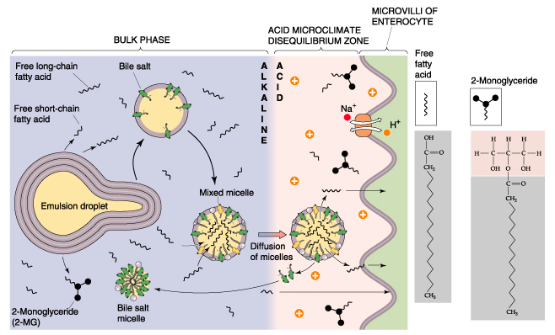
Bile salts aid intestinal fat digestion
Fig 44-13

Slide 38
Bile acid accumulation→hepatocyte damage
↑ apoptosis
Δ membrane fluidity
Δ cell signaling
    Fas, PKC, Ca²⁺, …
? role in hepatocyte transformation
↑ pro-inflammatory cytokine expression
The hepatocyte must maintain safe intracellular BA levels
Guicciardi & Gores, Dig Liver Dis 2002
Paumgartner & Beuers, Hepatology 2002

Slide 39
Adaptation to bile acid retention
↓ BA import
NTCP
ntcp
bsep
RXR
RAR
RXR
FXR
BSEP
BA sinusoidal
export
shp
BA canalicular
export
RXR
FXR
SHP
SHP
SHP
OST α/β
ost α & β
RXR
FXR
↓ BA synthesis
MRP3
cyp7a
LRH-1
RXR
LXR
cyp3a
Sult2a1
MRP4
RXR
PXR
RXR
CAR
BA metabolism
( hydroxylation & conjugation)

Slide 40
Multiple molecular roles of bile acids
LXR
PXR
FXR
Nuclear
Receptors
Cell
Signaling
VDR
MAPK
CAR
PI3K
PGC1α
PKC
TRAIL
TGR5
FAS
AP1
Apoptosis

Slide 41
Bile Acid Homeostasis:
Functional integration of transporters & enzymes
Import
(Phase 0)
BSEP
NTCP
Phase I
Phase II
Biliary
Export
(Phase III)
Ost α/β
Hydroxylation
Cytochrome P₄₅₀’s
SER
Conjugation
Sulfation
Glucuronidation
Amidation
SER or Cytosol
MRP3
MRP4
Sinusoidal
Export
(Phase III)
CYP7A1
CYP3A4
Sulfotransferases
Portal blood

Slide 42
Bile Acid Homeostasis:
Functional integration of transporters & enzymes
Import
(Phase 0)
BSEP
NTCP
Phase I
Phase II
Biliary
Export
(Phase III)
Ost α/β
Hydroxylation
Cytochrome P₄₅₀’s
SER
Conjugation
Sulfation
Glucuronidation
Amidation
SER or Cytosol
MRP3
MRP4
Sinusoidal
Export
(Phase III)
CYP7A1
CYP3A4
Sulfotransferases
Portal blood

Slide 43
Nuclear Receptors – SXR and CAR
Steroid and Xenobiotic Receptor (SXR)
  Promiscuous transcription factor → multiple genes including Cyp 3A4, GST, MDR1
Constitutive Androstane Receptor (CAR)
  Regulates all components of bilirubin metabolism
    Uptake: OATP
    Conjugation: UGT1A1
    Excretion: MRP2

Slide 44
Adaptation to bile acid retention
↓ BA import
NTCP
ntcp
bsep
RXR
RAR
RXR
FXR
BSEP
BA sinusoidal
export
shp
BA canalicular
export
RXR
FXR
SHP
SHP
SHP
OST α/β
ost α & β
RXR
FXR
↓ BA synthesis
MRP3
cyp7a
LRH-1
RXR
LXR
cyp3a
Sult2a1
MRP4
RXR
PXR
RXR
CAR
BA metabolism
( hydroxylation & conjugation)

Slide 45
Cholestasis
Extrahepatic vs. intrahepatic
  Bile contents in the circulation
    Bilirubin → jaundice
    Bile salts → pruritus
  Hepatocyte effects
    Obstruction → alkaline phosphatase
    Damage → ALT and AST
  Malabsorption of fats and FS vitamins
  Absence of stercobilin in stool (clay-colored) and urobilin in urine – urine colored by bilirubin

Slide 46
Causes of Cholestasis- failed delivery of bile to duodenum
  BRIC: benign recurrent intrahepatic cholestasis
  PFIC: progressive familial intrahepatic cholestasis
  PBC: primary biliary cirrhosis
  PSC: primary sclerosing cholangitis
  VBDS: vanishing bile duct syndrome
  Cystic fibrosis

Slide 47
Molecular Mechanisms of Cholestasis
Inborn impairment of bile secretion
  Mutation of BSEP
    PFIC2 or BRIC2
  Mutation of MRP2
    Dubin-Johnson Syndrome (selective defect of bili-glucuronide secretion)
  Mutation of MDR3
    PFIC3
  Mutation of CFTR
    Cystic Fibrosis

Slide 48
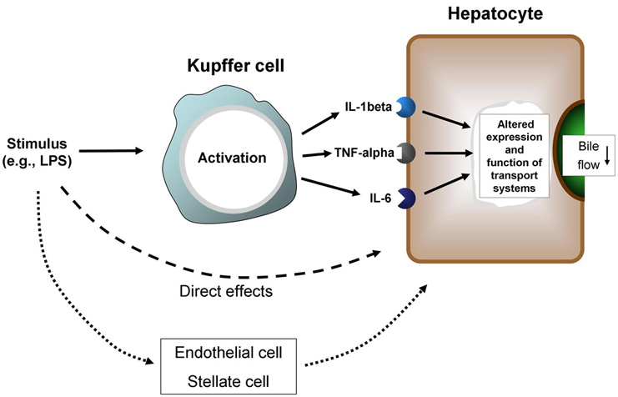
Molecular Mechanisms of Cholestasis
Acquired impairment of bile secretion
  Inflammatory cytokines
    assoc. w/sepsis
    bacterial infection
    viral hepatitis
    toxin/drug-induced hepatitis

Slide 49
Hepatobiliary Effects of Inflammatory Cytokines
Figure 3. Inflammatory stimuli can interfere with normal hepatocellular function via activation of Kupffer cells and subsequent release of pro-inflammatory mediators through direct effects on hepatocytes.
Figure 3. Linking inflammatory signals to hepatocellular effects. Inflammatory stimuli can interfere with normal hepatocellular function either via activation of Kupffer cells and subsequent release of pro-inflammatory mediators (top), through direct effects on hepatocytes (middle) or through effects on hepatocytes.

Slide 50
Molecular Mechanisms of Cholestasis
Acquired impairment of bile secretion
  Inflammatory cytokines
    assoc. w/ sepsis
    bacterial infection
    viral hepatitis
    toxin/drug-induced hepatitis
  TNFa, IL1b, IL6 down regulate
    NTCP & BSEP (BA transport)
    OATP2 & MRP2 (bili and OA transport)

Slide 51
Molecular Mechanisms of Cholestasis
Drugs inhibit function of transport proteins
  cis-inhibition of BSEP (inside hepatocyte)
    cyclosporine A
    glyburide
    troglitazone
    bosentan
  trans-inhibition of BSEP (inside canalicular lumen)
    estradiol 17b-D-glucuronide

Slide 52
Molecular Mechanisms of Cholestasis
Obstruction of bile flow
  Inborn disorders
    PFIC3, Cystic fibrosis
  Acquired
    PBC, PSC, VBDS
    Stone(s), tumor

Slide 53
Molecular Mechanisms of Cholestasis
Acquired obstruction
Extracellular hydrophobic BA’s >> destruction and progressive loss of bile ducts
  Initial immune injury to bile duct with extracellular spillage of bile (e.g.PBC)
  Inspissated bile (cystic fibrosis)
  Toxicity to normal ducts when phospholipids in bile are low
    PFIC3
    BA/phospholipid imbalance after OLTx
Intracellular BA toxicity due to increased bile acid concentration
  Multiple causes of chronic cholestasis

Slide 54
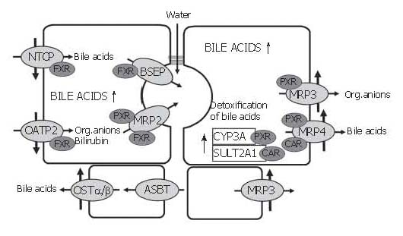
Adaptive Responses to Cholestasis
Compensation for loss of biliary excretory function
BSEP:bile salt export pump
CAR:constitutive androstane nuclear receptor
CYP3A:cytochrome P450 enzyme 3A
FXR:farnesoid X nuclear receptor (BA sensor)
OATP:organic acid transporting polypeptide
OST:organic solute transporter
MRP:multidrug resistance associated protein
NTCP:sodium taurocholate co-transporting polypeptide
PXR:pregnane X nuclear receptor (binds xenobiotics)
SULT2A1:sulfotransferase 2A1

Slide 55
Adaptive Responses to Cholestasis
Limit hepatocellular accumulation of toxic biliary constituents
  Down regulation of NTCP and OATP2 via FXR reduces uptake of BA’s, Bilirubin and other OA’s
  Up regulation of MPR3 and MPR4 via PXR pumps BA’s and OA’s out of hepatocytes
  Prior to extrusion from hepatocytes, up regulation of SULT2A1 and CYP3A via CAR modifies toxicity of hydrophobic BA’s and xenobiotics
  Ligands for the nuclear receptors
    BA’s and derivatives
    Bilirubin
    Drugs
      Rifampicin, Phenobarbital, Fibrates, Statins

Slide 56
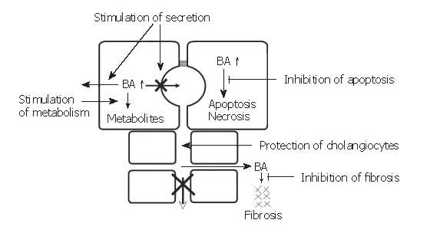
Targets for Pharmacologic Therapy
Objectives of targeted
therapy
Stimulation of ortho- and retrograde secretion of BA’s
Stimulation of metabolism of hydrophobic BA’s
Protection of injured cholangiocytes
Inhibition of apoptosis
Inhibition of fibrosis

Slide 57
Targets for Pharmacologic Therapy
Stimulation of secretion of BA’s and other toxins
  Upregulated BSEP and MPR2 expression and targeting to canalicular membrane stimulated by cholic acid and UDCA binding to nuclear receptors
  Expression of MPR2 increased by Rifampicin receptor binding
  Enhanced activation of cholangiocyte phosphorylation by UDCA receptor binding

Slide 58
Targets for Pharmacologic Therapy
Stimulation of metabolism of hydrophobic BA’s to less toxic compounds
  Rifampicin stimulates expression of CYP3A4
  UDCA has no such effect

Slide 59
Targets for Pharmacologic Therapy
Stimulation of metabolism of hydrophobic BA’s to less toxic compounds
  Rifampicin stimulates expression of CYP3A4
Inhibition of apoptosis due to elevated hydrophobic BA’s
  UDCA stabilizes mitochondrial membrane and inhibits capsase 8 and apoptosis

Slide 60
Targets for Pharmacologic Therapy
Protection of injured cholangiocytes by making bile more hydrophilic
  UDCA renders BA composition more hydrophilic and increases phospholipid secretion
Inhibition of fibrosis
  Nothing yet identified

Slide 61
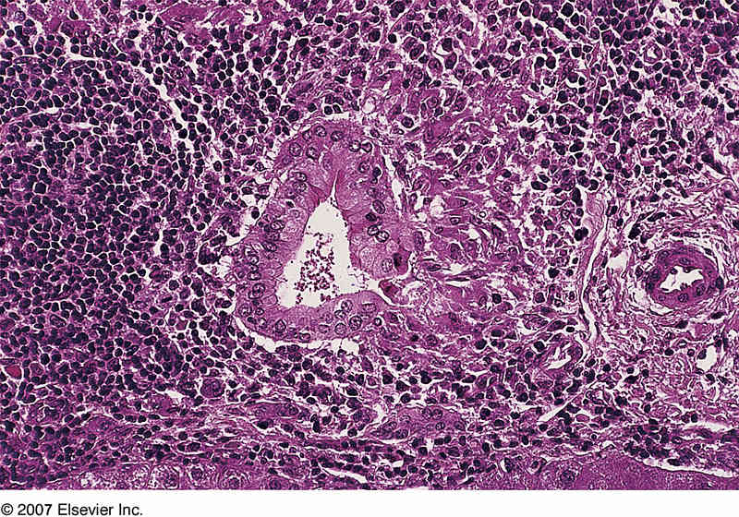
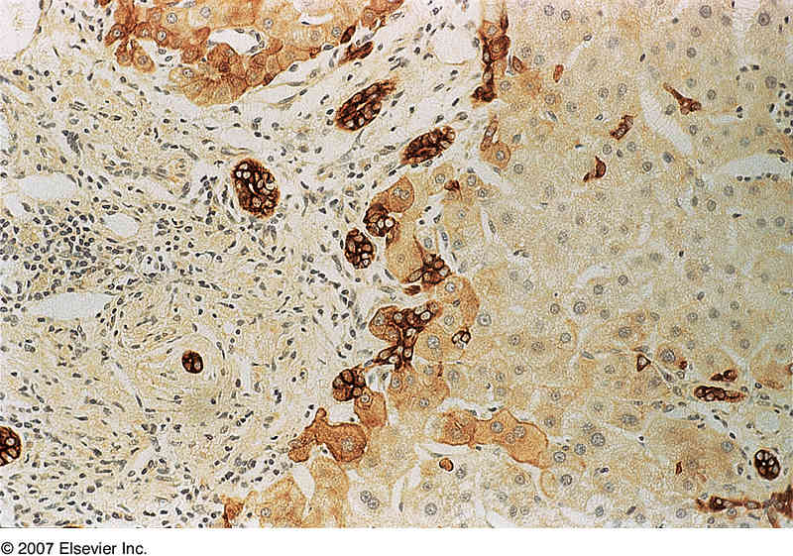
Pharmacological Treatment of Chronic Cholestatic Liver Disease
Primary Biliary Cirrhosis as model
  Pathogenesis
    Chronic non-suppurative destructive cholangitis
    Primary immunologic injury of interlobular bile ducts
    Aggravation of bile duct lesion by cytotoxic bile acids
    Obstruction and loss of small bile ducts followed by
      Cholestasis and retention of bile acids
      Hepatocyte injury
      Apoptosis and necrosis
      Fibrosis>> cirrhosis>> liver failure

Slide 62
Pharmacological Treatment of Chronic Cholestatic Liver Disease
UDCA only FDA approved drug for PBC
  Renders bile less toxic for the injured biliary epithelium
  Reduces retention of BA’s in hepatocytes
  Inhibits apoptosis
  Immunosuppressives
  limited utility in combination
  with UDCA
UDCA @ 13-15 mg/Kg body weight/day for PBC Rx
  Improves bilirubin and other markers of cholestasis
  Inhibits histological progression in early stage PBC
  Delays onset of esophageal varices
  Can delay time to liver transplant/death
    Survival benefit not seen in first 2 years of treatment
    Doses lower than 10 mg/Kg/day of no benefit

